Slide 1
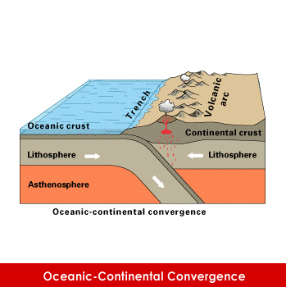
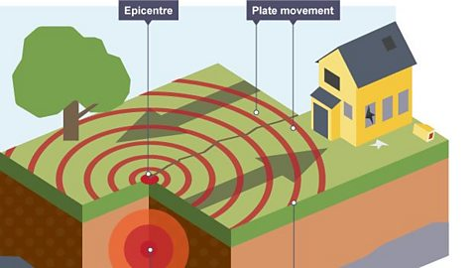
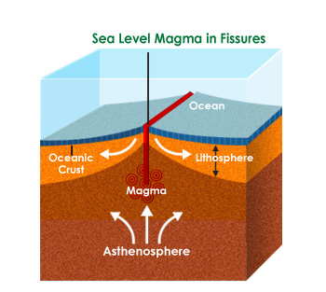
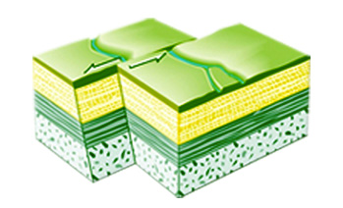
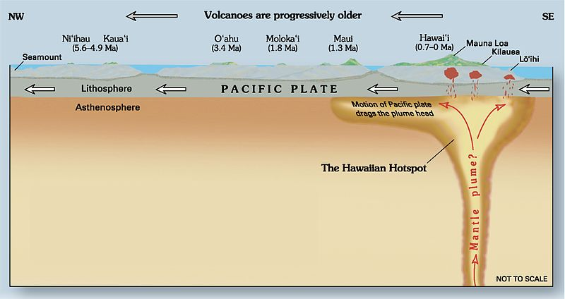
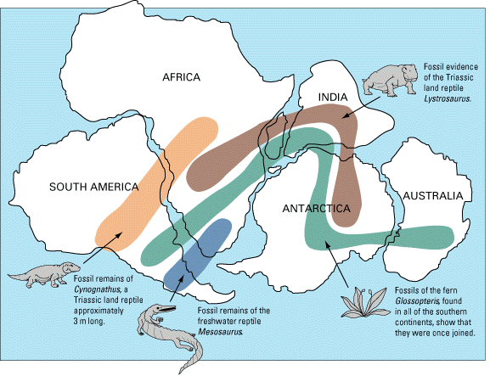
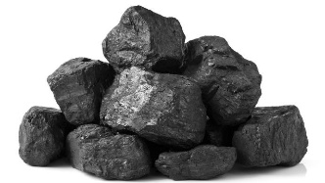
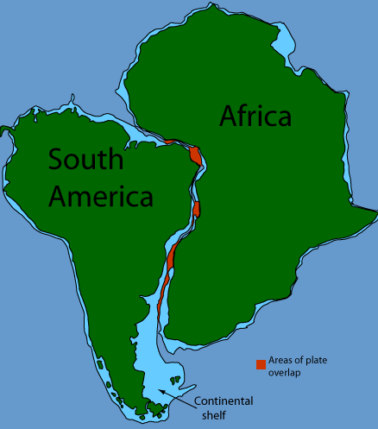
Tectonics A3 Knowledge Organiser Big Q: How do tectonic plates move and what impacts do they have?
Box 3: Explain what the epicentre and focus of an earthquake are in words and/ or a diagram.
Box 1: Explain 2+ points about the formation of 3 different plate boundaries.
Convergent plate boundaries
Convergent margins (often referred to as destructive plate margins) occur when
Continental crust and Oceanic crust converge (meet), Oceanic crust sinks below
Continental crusts because it is more dense (think – Oceans weigh a lot!).
Divergent plate boundaries
Divergent plate margins (sometimes called constructive plate margins) are where there are two plates moving away from each other causing new oceanic crust to be formed.
Conservative (transform) plate boundaries
A conservative plate boundary (sometimes called a transform fault boundary) is where two plates grind past each other without the production or destruction of lithosphere.
Extension: Explain 2+ points about the formation of hotspots
Some times volcanoes can occur over hot spots away from plate boundaries, forming volcanic islands such as the Hawaiian Islands. Hot spots are caused by an area of hotter magma near to the earth’s surface, once again the less dense magma rises upwards to form a volcano.
The hot spot remains stationary but the plate moves over the hot spot and a chain of islands is created, in the direction of the plate movement.
The point inside the crust where the pressure is released is called the focus. The point on the Earth's surface above the focus is called the epicentre.
Earthquake energy is released in seismic waves. These waves spread out from the focus.
The waves are felt most strongly at the epicentre, becoming less strong as they travel further away.
The most severe damage caused by an earthquake will happen close to the epicentre.
Box 4: Explain the impacts of an earthquake or tsunami, example: _____________, LIC/MIC/HIC…
Social & Economic impacts Environmental impacts
Overall, what were the greatest/ most severe (worse) impacts and why?
Example judgement: Overall, this shows some of the potential impacts from the tsunami were huge to the large number of people living near to the coast from the tsunami and further south in Tokyo from the potential nuclear meltdown.
Socio-economic | Environmental
Social 1. Japan was largely prepared for the earthquake and many buildings remained standing afterwards – saved lives. 2. The tsunami warning issued 3 minutes after the earthquake – saved lives. 8. Immediate power outages in Tokyo and eight other prefectures reportedly affected some 4 million homes – people left without power in the Winter. Economic 1. Japan was largely prepared for the earthquake and many buildings remained standing afterwards – meaning Japan could recover quicker | 17. Radiation leaks caused large evacuations – meaning radioactive material with widespread health and environmental effects – meaning parts of Japan were left contaminated.
Box 2: Explain 2+ pieces of evidence for Plate Tectonics theory.
There is lots of evidence to suggest the plates are moving, for example fossils of land dinosaurs like Cynognathus have only been found in the south of South America and south of Africa (1) showing the two must have been joined for it to travel/migrate(1).
South America and Africa appear to ‘fit’ together (1) proved by matching of very similar rock shapes in key locations where these continents would have joined (1).
Other reasons – similar rock types, coal found in Antarctica (only forms in tropical regions), other reptiles/ animals credited.
Tectonics Key terms: What words or terms are important?
Magnitude - The strength of an earthquake, measured on the Richter Scale
Hawaii - An island formed by a hot spot
Convergent - When 2 plates move together
Divergent - When 2 plates pull apart
Conservative - When 2 plates move past each other
Focus - The point where seismic waves are released under the Earth’s surface
Epicentre - The centre of an earthquake, on the Earth’s surface
Liquefaction - When the ground shakes and water rises through rock to make ground act like a liquid
Debris - Material left from a collapsed or damaged building that could be a hazard, such as blocking a road for emergency vehicle
Tsunami - A huge wave caused by the uplifting of a tectonic plate
STAR: Research answers for 2 of your own simple or complex enquiry questions and record on the back of sheet.

