Slide 1
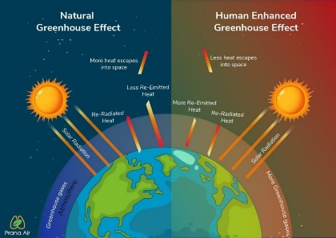
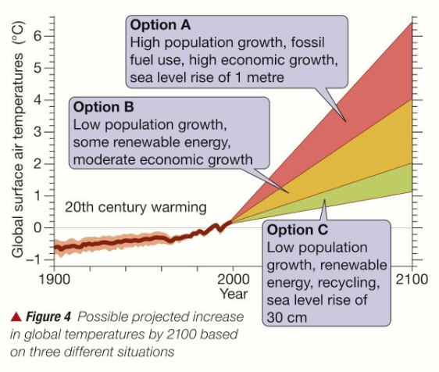
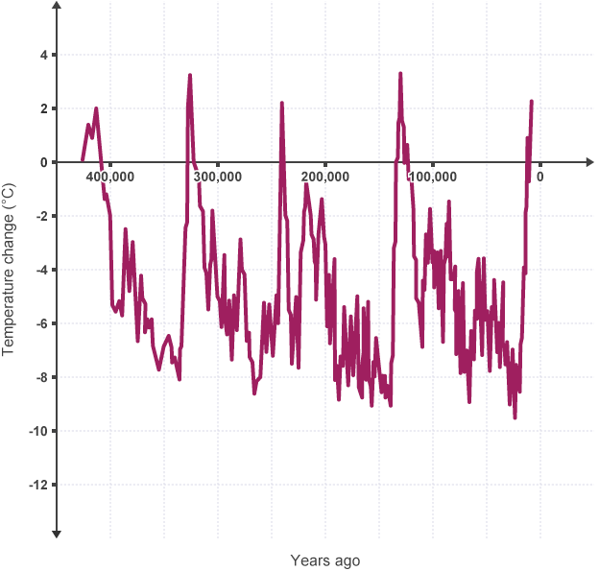
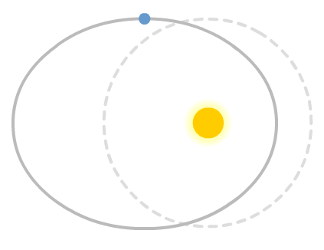
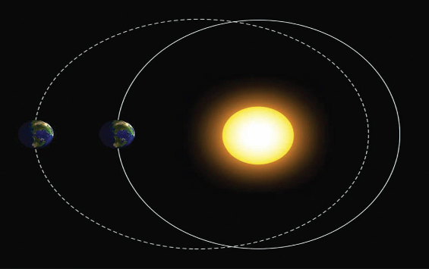
Climate Chaos KO Big Q: How will our climate change in the future?
Box 3: Explain 2+ ways how the Earth’s climate may change in the future.
Box 1: Why is the Earth’s climate in chaos?
Explain 2+ reasons why the Earth’s climate is in chaos or challenging for people in different parts of the world, such as High-Income Countries (HICs) to Low-Income Countries (LICs).
Impacts of climate change in the UK
sea levels could rise, covering low lying areas, in particular east England
droughts and floods become more likely as extreme weather increases
increased demand for water in hotter summers puts pressure on water supplies
impact on some industries, eg Scottish ski resorts may have to close due to lack of snow
Impacts of climate change around the world
sea level rise will affect 80 million people
tropical storms will increase in magnitude (strength)
species in affected areas (eg Arctic) may become extinct
diseases such as malaria increase, an additional 280 million people may be affected
Greenhouse gases (GHGs) | % of GHGs produced | Sources | Warming power compared to CO2 | % increase since 1850
Carbon dioxide CO2 Makes-up only 0.04% of the Earth’s atmosphere 20% will last for 800 years | 89% | Burning fossil fuels, deforestation | 1 | +30%
Methane CH4 | 7% | Gas pipeline leaks, rice production, farming, cattle farming | 21 times more powerful | +250%
Nitrous Oxide N2O Stays in atmosphere for 100yrs. Traps infrared radiation changing to nitric oxide | 3% | Jet aircraft enginges, cars and lories, fertilisers, sewage farms, production of synthetic chemicals | 250 times more powerful | +16%
Halocarbons | 1% | Used in industry, solvents and cooling equipment | 3000 times more powerful | Not natural
Box 4: Explain 3+ ways to collect climate data
Factor | Equipment | Units
Wind speed To know where the wind is strongest | Anemometer for wind speed (km/hr) | (km/hr)
Wind direction To know where the wind is coming from | Weather vane (N,S,E,W) | (N,S,E,W)
Temperature To know where is the sun is strongest | Thermometer (ºC) | (ºC)
Precipitation (rain, snow etc) To know where is the wettest | Rain gauge (mm water fallen) | (mm)
Evaporation To know where evaporation rates are higher | Containers to mark on the starting point of water (mm water evaporated) | (mm)
Soil infiltration rates To know where the soil can absorb the most water | Plastic tube or clean tin can with ends removed (mm/minute) – | (mm/ minute)
Air pressure To know how air pressure changes | A barometer (mb) | (mb)
Box 2: How has the Earth’s climate changed in the past?
Caused by: orbital change, its tilt and wobble, volcanic eruptions, solar output.
About 50,000 years ago
Today and about 100,000 years ago
About 150,000 years ago
Climate Chaos Key terms:
Greenhouse gases (GHGs)are gases in the earth's atmosphere that trap heat.
Greenhouse effect is the process when GHGs in atmosphere trap the Sun's heat.
Human enhanced greenhouse effect changing composition of the atmosphere
Global warming is the long-term heating of Earth's surface
Halocarbons the most potent GHG
Ice age a long period of reduction in the Earth's surface and atmospheric temperature, Inter-glacial period geological era of warmer global temperature in-between ice ages..
Milankovitch cycles are changes in Earth's movements over thousands of years
Sunspots are spots on the surface of the sun where the magnetic field becomes stronger. Albedo effect is the ability of a surface to reflect sunlight.
STAR: Research answers for 2 of your own simple or complex enquiry questions and record on the back of sheet.

