Slide 1
AQA AS ECONOMICS

Slide 2
Contents
4.1.1-8 Microeconomics
4.2.1-6 Microeconomics
Unit | Page
3.1.1 Economic methodology & the economic problem | 4-5
3.1.2 Price determination in a competitive market | 6-10
3.1.3 Production, costs and revenue | 11-12
3.1.4 Objectives of the firm | 13-16
3.1.5 The market mechanism, market failure & government intervention | 17-21
Unit | Page
3.2.1 The national economy in a global context | 23 -24
3.2.2 Determinants of Aggregate Demand and Supply | 25 – 29
3.2.3 Economic performance | 30-40
3.2.4 Economic Policy | 41-44

Slide 3
AS Micro Economics

Slide 4
3.1.1. ECONOMIC METHODOLOGY & THE ECONOMIC PROBLEM
3.1.1. ECONOMIC METHODOLOGY & THE ECONOMIC PROBLEM
3.1.1.1 ECONOMIC METHODOLOGY
WHY IS ECONOMICS A SOCIAL SCIENCE? | It uses scientific methods to build theories that can help explain the behaviour of individuals, groups and organisations. Economics attempts to explain economic behaviour, which arises when scarce resources are exchanged.
WHAT ABOUT EMPIRICAL EVIDENCE? | Economic theory is to be judged by its predictive power supported by empirical regularity. Only factual or empirical evidence can make a theory go from a “meaningless” hypotheses to part of man's accumulated knowledge.
SIMILARITIES TO NATURAL SCIENCES | Economics shares the combination of qualitative and quantitative elements common to all social sciences.
DIFFERENCES TO NATURAL SCIENCES | Some critics of the field argue that economics falls short of the definition of a science for a number of reasons, including a lack of testable hypotheses, lack of consensus, and inherent political overtones. Despite these arguments,
POSITIVE ECONOMIC STATEMENTS | Objective and fact-based where the statements are precise, descriptive, and clearly measurable. E.g. GDP rose by 2.5% in 2021.
NORMATIVE ECONOMIC STATEMENTS | These are opinions or value judgements which are not based on real economic data.
USE OF VALUE JUDGEMENTS IN ECONOMICS | Economists often demonstrate a lack of consensus and inherent political overtones.
THE INFLUENCE ON PEOPLE’S MORAL & POLITICAL JUDGEMENTS | The first rule of economics is scarcity. The first rule of politics is to ignore the first rule of economics. As such politics has a profound impact upon economic policy.
3.1.1.3. ECONOMIC RESOURCES
FACTORS OF PRODUCTION | These are the key economic resources of Land, labour, capital, enterprise.
LAND | Land includes all natural physical resources. Some nations are richly endowed with natural resources and then specialise in the their extraction and production. Other countries such as Japan are heavily reliant on importing these resources.
LABOUR | Labour is the human input into production e.g. the supply of workers available and their productivity. An increase in the size and the quality of the labour force is vital if a country wants to achieve growth. In recent years the issue of the migration of labour has become important. Can migrant workers help to solve labour shortages? What are the long-term effects on the countries who suffer a drain or loss of workers through migration?
CAPITAL | CAPITAL GOODS are used to produce other consumer goods and services in the future Fixed capital includes machinery, equipment, new technology, factories and other buildings New items of capital machinery or technology are used to boost the productivity of labour.
ENTERPRISE | Regarded by some as a specialised form of labour input An entrepreneur is an individual who supplies products to a market to make a profit Entrepreneurs will usually invest their own financial capital in a business and take on the risks. Their main reward is the profit made from running the business.
3.1.1.4 SCARCITY, CHOICE & THE ALLOCATION OF RESOURCES
FUNDAMENTAL ECONOMIC PROBLEM | Limited resources and unlimited wants.
SCARCITY & CHOICE | Choices must be made about how scarce resources are allocated between different uses.
CHOICES & OPPORTUNITY COST | Choices have an opportunity cost.
OPPORTUNITY COST | The next best alternative foregone.
3.1.1.2 THE NATURE & PURPOSE OF ECONOMIC ACTIVITY
THE CENTRAL PURPOSE | The production of goods & services to satisfy needs and wants
KEY ECONOMIC DECISIONS | What to produce? How to produce? Who is to benefit?

Slide 5
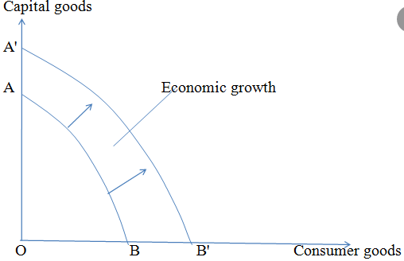
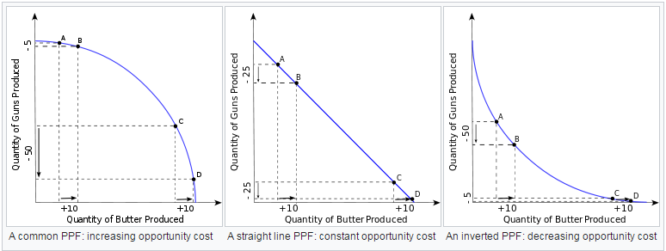
3.1.1.5. PRODUCTION POSSIBILITY DIAGRAMS
PRODUCTION POSSIBILITY DIAGRAMS | Illustrates the possible combinations of two goods that can be produced with existing resources, such that more of one good could be produced only by diverting resources from the other good, resulting in less production of it.
Why does it slope downwards? | Because resources are LIMITED.
Why does it bow outwards? | This is due to the fact that some resources will be better suited to the production of good X & some good Y. eg. Guns & butter. DECREASING RETURNS TO SCALE.
Why is it a straight line? | Because resources are equally well-suited to the production of both goods X & Y. CONSTANT RETURNS TO SCALE
Why does it bow inwards? | Because resources are focused upon SPECIALISATION which generates ECONOMIES OF SCALE. Or INCREASING RETURNS TO SCALE.
How does it illustrate efficiency? | Any point achieved on the PPC is PRODUCTIVELY EFFICIENT. Yet not all points are allocatively efficient as this is determined by supply & demand.
SPECIALISATION & DIVISION OF LABOUR
ADVANTAGES | Will lead to an increase in labour productivity and firms will be able to benefit from ECONOMIES OF SCALE (lower average costs with increased output) and increased efficiency.
DISADVANTAGE | However, workers do specific tasks which may become boring and their productivity may fall as a result. High levels of specialisation could lead to possible DISCECONOMIES OF SCALE.

Slide 6
3.1.2. PRICE DETERMINATION IN A COMPETITIVE MARKET
3.1.2.1. THE DETERMINANTS OF THE DEMAND FOR GOODS & SERVICES
EFFECTIVE DEMAND | The level of demand that represents a real intention to purchase by people with the means to pay.
JOINT DEMAND | When the demand for one product is directly and positively related to market demand for a related good or service. e.g. with 2 complements.
COMPOSITE DEMAND | When goods or services have more than one use so that an increase in the demand for one product leads to a fall in supply of the other.
FACTORS DERTERMINING DEMAND | Price Income Tastes & Trends Expectations Complementary goods
THE DEMAND CURVE | a graphical representation of the relationship between the price of a good or service and the quantity demanded for a given period of time.
FACTORS THAT CAN SHIFT DEMAND | W - Weather I – Income & Interest rates F - Fashion C – Complementary goods & Credit A – Advertising (Promotion) PS – Price of Substitutes
3.1.1.3. ECONOMIC RESOURCES
FACTORS OF PRODUCTION | These are the key economic resources of Land, labour, capital, enterprise.
LAND | Land includes all natural physical resources. Some nations are richly endowed with natural resources and then specialise in the their extraction and production. Other countries such as Japan are heavily reliant on importing these resources.
LABOUR | Labour is the human input into production e.g. the supply of workers available and their productivity. An increase in the size and the quality of the labour force is vital if a country wants to achieve growth. In recent years the issue of the migration of labour has become important. Can migrant workers help to solve labour shortages? What are the long-term effects on the countries who suffer a drain or loss of workers through migration?
CAPITAL | CAPITAL GOODS are used to produce other consumer goods and services in the future Fixed capital includes machinery, equipment, new technology, factories and other buildings New items of capital machinery or technology are used to boost the productivity of labour.
ENTERPRISE | Regarded by some as a specialised form of labour input An entrepreneur is an individual who supplies products to a market to make a profit Entrepreneurs will usually invest their own financial capital in a business and take on the risks. Their main reward is the profit made from running the business.
3.1.1.4 SCARCITY, CHOICE & THE ALLOCATION OF RESOURCES
FUNDAMENTAL ECONOMIC PROBLEM | Limited resources and unlimited wants.
SCARCITY & CHOICE | Choices must be made about how scarce resources are allocated between different uses.
CHOICES & OPPORTUNITY COST | Choices have an opportunity cost.
OPPORTUNITY COST | The next best alternative foregone.
3.1.1.2 THE NATURE & PURPOSE OF ECONOMIC ACTIVITY
THE CENTRAL PURPOSE | The production of goods & services to satisfy needs and wants
KEY ECONOMIC DECISIONS | What to produce? How to produce? Who is to benefit?
Stretch and Challenge Activities
Additional Reading
Extension Activities

Slide 7
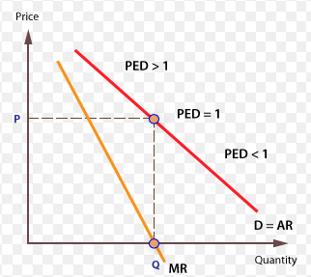
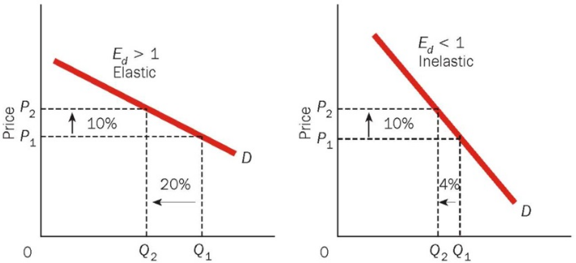
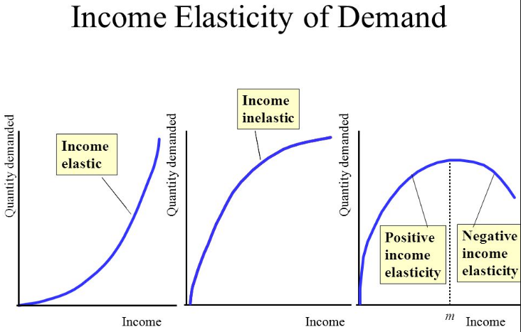
3.1.2.2. PRICE ELASTICITY OF DEMAND (PED)
Measures the responsiveness of demand following a change in price. INVERSE relationship means NEGATIVE PED. Measured by the % change in QD / % change in price.
CO EFFICIENT VALUES | > -1 means price elastic (sensitive). A small change in price causes a large change in QD. 0 to -1 means price inelastic (insensitive). A change in prices causes a smaller impact on QD.
IMPACT ON DEMAND | PRICE CHANGES CAUSE A MOVEMENT ALONG THE DEMAND CURVE
DETERMINANTS OF PED - SPLAT | The number of close substitutes for a good The % of a consumer's income allocated to spending on the good The degree of necessity or whether the good is a luxury Whether the good is addictive The time period allowed following a price change Peak and off-peak demand The cost of switching between products.
BUSINESS USE OF PED | The effect of a change in price on the total revenue & expenditure on a product The effect of a change in an indirect tax (e.g VAT, fuel or other duties) on price and quantity demanded and also whether the business is able to pass on some or all of the tax onto the consumer. Information on the PED can be used by a business as part of a policy of price discrimination. This is where a business decides to charge different prices for the same product to different segments of the market e.g. peak and off peak rail travel. To estimate the impact of price discounts on given products
3.1.2.2. INCOME ELASTICITY OF DEMAND (YED)
Measures the responsiveness of demand following a change in income. Measured by the % change in QD / % change in income.
CO EFFICIENT VALUES | POSITIVE YED represents NORMAL GOODS. E.g. Branded consumer goods. So as consumers' income rises more is demanded at each price i.e. there is an outward shift of the demand curve NEGATIVE YED represents INFERIOR GOODS. Here, demand falls as income rises. E.g. Value brand products. A YED value between 0 & +1 is likely to mean necessity products e.g. fuel.
IMPACT ON DEMAND | An increase or decrease in income will lead to A SHIFT IN DEMAND
LUXURY GOODS & YED | The income elasticity of demand is usually strongly positive for luxury goods such as Fine wines and spirits, high quality chocolates and luxury holidays overseas. Sports cars, Consumer durables - audio visual equipment, smart-phones Sports and leisure facilities (including gym membership and exclusive sports clubs).
NESCESSITY GOODS & YED | In contrast, income elasticity of demand is lower for Staple food products such as bread, vegetables and frozen foods, Mass transport (bus and rail), Beer and takeaway pizza!
INFERIOR GOODS | Income elasticity of demand is negative (inferior) for cigarettes and urban bus services.
BUSINESS USE OF YED | Helps firms predict the effect of an economic cycle on sales. Luxury products with high income elasticity see greater sales volatility over the business cycle than necessities where demand from consumers is less sensitive to changes in the cycle. They could also choose to locate in areas of high or low incomes depending upon whether they sell LUXURY or INFERIOR GOODS or expand their product range to cater for a different consumer group e.g. Lidl Deluxe.

Slide 8
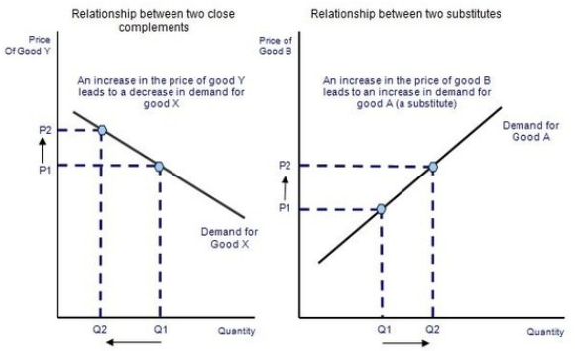
3.1.2.2. CROSS PRICE ELASTICITY OF DEMAND (XED)
Measures the responsiveness of demand for good A following a change in price of good B. Measured by the % change in QD A / % change in price B.
SUBSTITUTES & XED | POSITIVE VALUE means the products are SUBSTITUTES. If the price of one product goes up the QD of another will fall e.g. Beef & lamb. >1 means close substitutes, <1 weak substitutes.
COMPLEMENTS & XED | NEGATIVE VALUE means the products are COMPLEMENTS. If the price of one product goes up the demand for the other falls e.g. Tennis racquets & tennis balls.
IMPACT ON DEMAND | A price change of a substitute or complement will lead to a SHIFT IN DEMAND.
BUSINESS USE OF XED | When setting prices firms will have to look at what alternatives the consumer has, if there are no close substitutes they will be able to increase the price. Therefore, firms spend a lot of money on advertising to differentiate their products and reduce XED. A firm may offer a loss leader to attract complementary sales. E.g, a firm may offer a printer, at a low price, because it knows this will lead to increased sales for the highly profitable ink cartridges.
EVALUATION OF COMMERCIAL APPLICATION OF ELASTICITIES
Do firms really know their Elasticities? Who uses them effectively? Different Elasticities are of use for different firm related decisions. Elasticities vary dramatically across consumer groups/ regions/ even time of day etc. Difficult to calculate! Elasticities & rational behaviour. Irrational consumption may mean more inelastic demand.

Slide 9
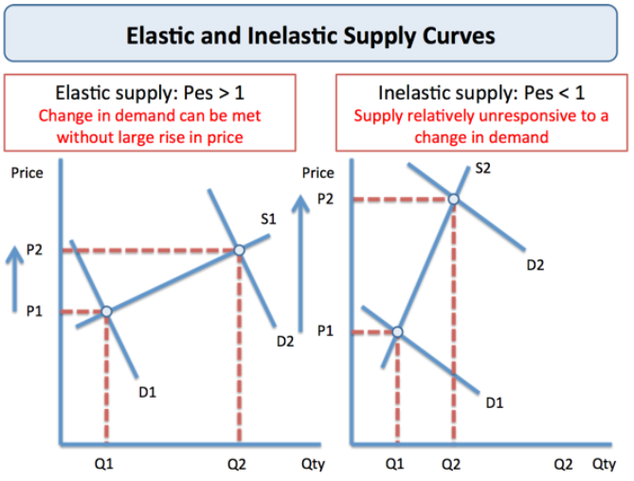
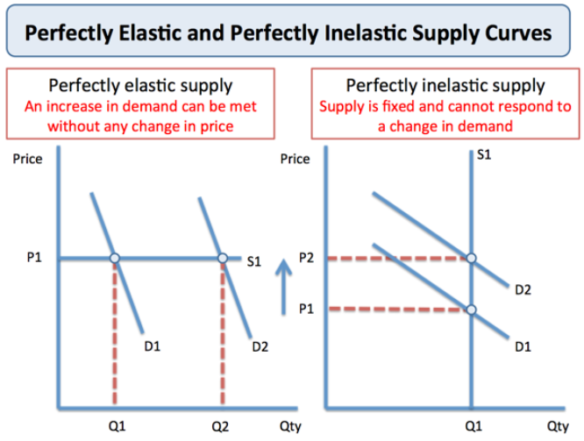
3.1.2.3. SUPPLY
SUPPLY | Output is provided by businesses in the pursuit of profits. Higher profits mean greater incentives to increase supply.
SUPPLY CURVE | A graphic representation of the correlation between the cost of a good or service and the quantity supplied for a given period.
FACTORS CAUSING A SHIFT IN SUPPLY | S - Subsidies P - Productivity Gains E - Efficiency N - Number of firms T - Technology
3.1.2.4. PRICE ELASTICITY OF SUPPLY (PES)
Measures the responsiveness of supply to a change in price. POSITIVE RELATIONSHIP = POSITIVE PES Measured by the % change in QS / % change in Price.
CO EFFICIENT VALUES | >1 Price elastic (sensitive). A small change in price causes a large change in QS. <1 means Price inelastic (insensitive). A change in prices causes a smaller impact on QS.
IMPACT ON SUPPLY CURVE | Price changes cause A MOVEMENT ALONG A SUPPLY CURVE.
DETERMINANTS OF PES | Production lag: Supply is more price elastic the longer the time period that a firm is allowed to adjust its production levels. Stocks of finished products and components: If stocks of raw materials and finished products are at a high level then a firm is able to respond to a change in demand - supply will be elastic. Conversely when stocks are low, dwindling supplies force prices higher. Spare production capacity: If there is plenty of spare capacity then a business can increase output without a rise in costs and supply will be elastic in response to a change in demand. Therefore, supply of goods and services is most elastic during a recession. The ease and cost of factor substitution/mobility: If both capital & labour are occupationally mobile then the elasticity of supply for a product is higher than if capital and labour cannot easily be switched. E.g. a printing press which can switch easily between printing magazines and greetings cards. Time lag- In some agricultural markets the momentary supply is fixed and is determined mainly by planting decisions made months before, and also climatic conditions, which affect the production yield. In contrast the supply of milk is price elastic because of a short time span from cows producing milk and products reaching the market place.

Slide 10
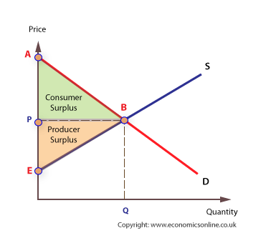
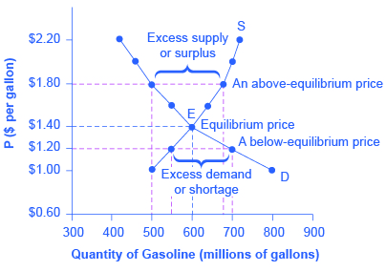
3.1.2.5 & 6 PRICE DETERMINATION & THE INTERRELATIONSHIP OF MARKETS
3.1.2.1. THE DETERMINATION OF EQUILIBIRUM MARKET PRICES
THE PRICE MECHANISM | The manner in which the prices of goods affect the demand & supply of goods & services. There are four functions: 1. Allocating. 2. Rationing. 3. Signalling. 4. Incentivising.
CONSUMER SURPLUS | is an economic measurement of consumer benefits. A consumer surplus happens when the price that consumers pay for a product or service is less than the price they're willing to pay.
PRODUCER SURPLUS | is the total amount that a producer benefits from producing and selling a quantity of a good at the market price. The total revenue that a producer receives from selling their goods minus the total cost of production equals the producer surplus.
MARKET EQUILIBIRUM | Economic equilibrium is a situation in which economic forces such as supply and demand are balanced and in the absence of external influences the values of economic variables will not change.
MARKET DISEQUILIBRIUM | Disequilibrium is a situation where internal and/or external forces prevent market equilibrium from being reached or cause the market to fall out of balance. This can be a short-term byproduct of a change in variable factors or a result of long-term structural imbalances.
EXCESS DEMAND | occurs when the Price of a good is lower than the Equilibrium Price, meaning more consumers will want to buy the good than suppliers are willing to sell. The difference between the Quantity Demanded (QD) and the Quantity Supplied (QS) is the Excess Demand.
EXCESS SUPPLY | an excess supply, economic surplus market surplus or briefly surply is a situation in which the quantity of a good or service supplied is more than the quantity demanded, and the price is above the equilibrium level determined by supply and demand
3.1.2.6. THE INTERRELATIONSHIP BETWEEN MARKETS
INTERDEPENDENCE | The dependence of two or more people or things on each other.
MARKETS ARE OFTEN INTERDEPENDENT | For example, the availability of timber from the lumber industry will affect the housing market.
FIRMS ARE OFTEN INTERDEPENDENT | For example, the decisions of airbus will have a direct impact upon the results of Boeing.
JOINT DEMAND | When the demand for one product is directly and positively related to market demand for a related good or service. e.g. with 2 complements.
DEMAND FOR SUBSTITUTES | Substitutes are goods where you can consume one in place of the other. The prices of complementary or substitute goods also shift the demand curve. ... When the price of a substitute good decreases, the quantity demanded for that good increases, but the demand for the good that it is being substituted for decreases.
COMPOSITE DEMAND | When goods or services have more than one use so that an increase in the demand for one product leads to a fall in supply of the other.
DERIVED DEMAND | Refers to the demand for any goods or services, which is derived from any related goods, services, or intermediate goods or services. In the case of derived demand, a market can exist for both intermediate and related goods or services.
EFFECTIVE DEMAND | The level of demand that represents a real intention to purchase by people with the means to pay.
JOINT SUPPLY | Is an economic term referring to a product or process that can yield two or more outputs. Common examples occur within the livestock industry: cows can be utilized for milk, beef, and hide.

Slide 11
3.1.3. PRODUCTION, COSTS AND REVENUE
3.1.3.1. PRODUCTION & PRODUCTIVITY
PRODUCTION | Converting inputs, or the services of factors of production such as capital and labour into final output.
LABOUR PRODUCTIVITY | Labour productivity is concerned with the amount (volume) of output that is obtained from each employee.
3.1.3.4. ECONOMIES OF SCALE
Advantages that arise for a firm because of its larger size, or scale of operation. This translates into lower unit costs & increased productive efficiency.
RISK BEARING | A larger firm can be safer from the risk of failure if it has a more diversified product range. A larger firm may have greater resilience in the case of a downturn in its market because of larger reserves.
FINANCIAL | There is a wider range of finance options available to larger firms, such as the stock market, bonds and other kinds of bank lending.
MARKETING | More options are available for larger firms, such as television and other national media, which would not be cost-effective for smaller producers.
TECHNICAL | More cost-effective to invest in advanced production machinery, IT & software when operating on a larger scale.
MANAGERIAL | Larger firms can afford to have specialist managers for different functions within a business.
PURCHASING | Firms producing on a larger scale should be able to bulk buy raw materials or products for resale in larger quantities.
3.1.3.2. SPECIALISATION, DIVISION OF LABOUR & EXCHANGE
SPECIALISATION | The process of concentrating on and becoming expert in a particular subject or skill.
DIVISION OF LABOUR | The separation of tasks in any economic system or organisation so that participants may specialise
SPECIALISATION & TRADE | Specialisation requires trade. Specialisation and trade mean that countries that produce no oil can consume oil products and countries with large reserves of raw materials can export them in exchange for other goods that they need.
SPECIALISATION & DIVISION OF LABOUR
ADVANTAGES | Will lead to an increase in labour productivity and firms will be able to benefit from ECONOMIES OF SCALE (lower average costs with increased output) and increased efficiency.
DISADVANTAGE | However, workers do specific tasks which may become boring and their productivity may fall as a result. High levels of specialisation could lead to possible DISCECONOMIES OF SCALE.
EXTERNAL ECONOMIES OF SCALE
External economies of scale arise from firms in related industries operating in a concentrated geographical area; suppliers of services and raw materials to all these firms can do so more efficiently. Infrastructure such as roads and sophisticated telecommunications are easier to justify. There is also likely to be a growing local pool of skilled labour as other local firms in the industry also train workers. This gives a larger and more flexible labour market in the area.
3.1.3.3. COSTS OF PRODUCTION
FIXED COSTS | Costs that remain constant at any level of output e.g. rent, insurance.
VARIABLE COSTS | Costs that rise with output. Directly involved in the production of a good or service. e.g. stock.
TOTAL COSTS | Sum total of Fixed + Variable costs.
AVERAGE TOTAL COSTS | Average unit costs calculated by: Total costs/ quantity produced
MARGINAL COSTS | Represent the change in total costs from the next unit produced. Change in TC / change in Total Output
SHORT RUN | At least one factor of production is fixed
LONG RUN | All factors of production are variable
DISECONOMIES OF SCALE
LACK OF MOTIVATION | In larger firms, workers can feel that they are not appreciated or valued as individuals.
POOR COMMUNICATION | It can be easier for smaller firms to communicate with all staff in a personal way. In larger firms, there is likely to be greater use written notes rather than by explaining personally.
CO-ORDINATION | A very large business takes a lot of organising, leading to an increase in meetings and planning to ensure that all staff know what they are supposed to be doing. New layers of management may be required.

Slide 12
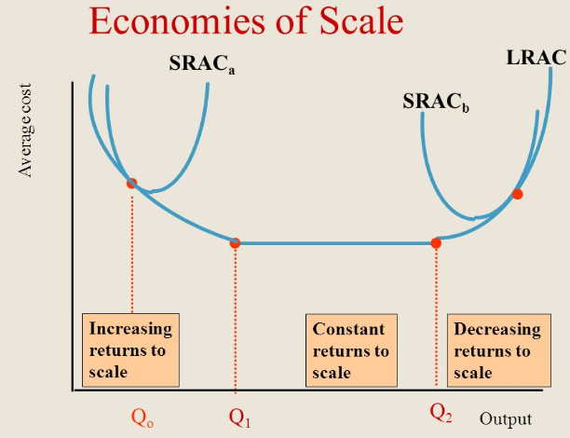
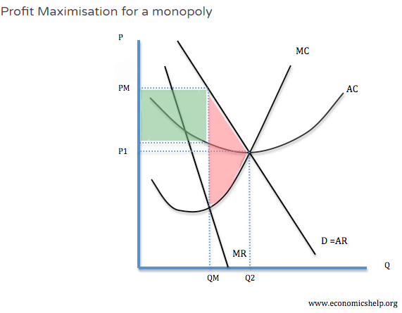
3.1.3.5 AVERAGE REVENUE, TOTAL REVENUE & PROFIT
REVENUE | Represents money earnt through sales of goods or services.
TOTAL REVENUE | Calculated by PRICE X QUANTITY
AVERAGE REVENUE | Calculated by TOTAL REVENUE/ QUANTITY. AR=PRICE=DEMAND
MARGINAL REVENUE | Revenue earnt from the last unit sold. Calculated by CHANGE IN TR / CHANGE IN Q
WHY D=AR | AR is average revenue, and the calculation for average revenue is Total Revenue / Quantity. Total Revenue = Price X Quantity Therefore AR = Price X Quantity / Quantity => Price (as the Quantity is cancelled out) Hence AR = P, and D = P so we can say that D = AR.
PROFIT | Where TR > TC
3.1.4.2 OBJECTIVES OF THE FIRM
OBJECTIVES OF FIRMS | CONDITION NEEDED | EXPLANATION
PROFIT MAXIMISATION | Produce where MC=MR | As long as MR> MC, total profits will be increasing. Maximising total profit. However, it is difficult to know your marginal revenue and marginal cost of last goods sold. E.g. Difficult for firms to know PED for their good – which determines the MR. This may enable dynamic efficiency to be achieved which is in the long run interests of all. Yet economies of scale are not fully realised. However, some consumers will not be able to make purchases & DWL exists. Firms may also have other objectives and considerations. For example, increasing price to maximise profits in the short run could encourage more firms to enter the market; therefore firms may decide to make less than maximum profits and pursue a higher market share e.g. Amazon.
REVENUE MAXIMISATION | Produce where MR=0 | Revenue maximisation is a theoretical objective of a firm which attempt to sell at a price which achieves the greatest sales revenue. Enables greater exploitation of economies of scale. May be more appropriate for recessionary periods. May help to establish market presence and later dominance to enable the firm to pursue long run profit maximisation. E.g. Amazon, Netflix.
SALES MAXIMISATION | Produce where AC=AR | Firms often seek to increase their market share – even if it means less profit. This could occur for various reasons: Increased market share increases monopoly power and may enable the firm to put up prices and make more profit in the long run. Managers prefer to work for bigger companies as it leads to greater prestige and higher salaries. Increasing market share may force rivals out of business. E.g. the growth of supermarkets have lead to the demise of many local shops. Some firms may actually engage in predatory pricing which involves making a loss to force a rival out of business.
PROFIT SATISFICING | Produce BETWEEN MC=MR & AC=AR AR>AC | In many firms, there is a separation of ownership and control. Those who own the company (shareholders) often do not get involved in the day to day running of the company. This is a problem because although the owners may want to maximise profits, the managers have much less incentive to maximise profits because they do not get the same rewards, (share dividends). Therefore managers may create a minimum level of profit to keep the shareholders happy, but then maximise other objectives, such as enjoying work, getting on with other workers. (e.g. not sacking them) This is the problem of separation between owners and managers. This is known as the Principal-agent problem.
3.1.4. COMPETITIVE & CONCENTRATED MARKETS
MARKET STRUCTURES | Refers to how different industries are classified and differentiated based on their degree and nature of competition for services and goods.
DETERMINANTS OF MARKET STRUCTURES | Number of firms Degree of product differentiation Ease of entry and exit Degree of information assymmetry

Slide 13
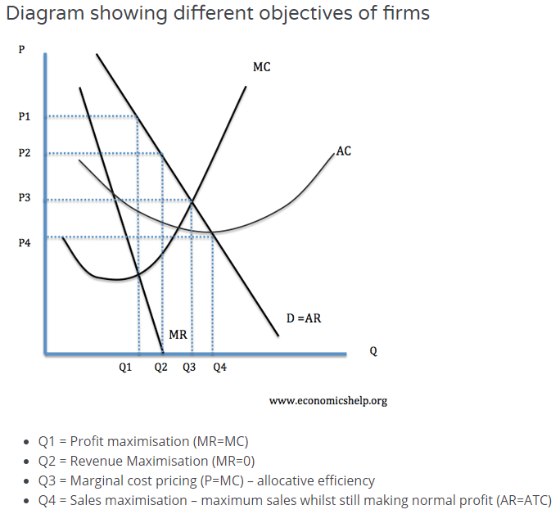
3.1.4.2 OBJECTIVES OF THE FIRM
OTHER OBJECTIVES & CONSIDERATIONS
GROWTH MAXIMISATION | This is similar to sales maximisation and may involve mergers and takeovers. With this objective, the firm may be willing to make lower levels of profit in order to increase in size and gain more market share.
LONG RUN PROFIT MAX | In some cases, firms may sacrifice profits in the short term to increase profits in the long run. For example, by investing heavily in new capacity, firms may make a loss in the short run but enable higher profits in the future. E.g. Amazon network effects.
BHEAVIOURAL THEORIES | This principle argues that many different stakeholders influence business decision making.
MANAGERIAL THEORIES | Shareholders and managers can be completely different people and as such they have different objectives from the firm. They are interested in their own gains.
EVALUATION OF OBJECTIVES OF THE FIRM
Who truly controls the firm & therefore determines the objectives? What impact do the objectives have on efficiencies – Allocative, Productive, Dynamic & X? What is the most important objective & for whom? By producing quarterly results are firms encouraged to be short run profit maximisers & thereby not achieve true dynamic efficiency? Are the largest firms too complicated to truly understand & therefore really achieve Profit Max? Are all Supernormal Profits equal – do they provide a social good?
CONTESTABLE MARKETS
CHARACTERISTICS OF CONTESTABLE MARKETS | Absence of entry or exit barriers (sunk costs) Pool of potential entrants Perfect Information Incumbents vulnerable to ‘hit & run’ competition.
ADVANTAGES | Low price & high quantity, allocative & potentially productively efficient, Increase in consumer surplus.
DISADVANTAGES | Unlikely to attain DYNAMIC EFFICIENCY.
EVALUATION | A perfectly contestable market is defined by normal profits.
3.1.4.5. THE COMPETITIVE MARKET PROCESS
MEANS OF COMPETING | Not simply about price. Instead, non price competition is vital e.g. product quality, quality of service, different is better than better.

Slide 14
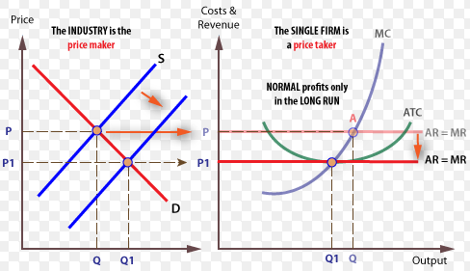
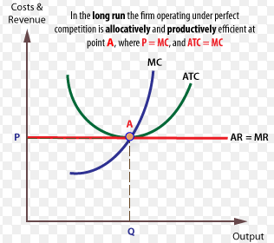
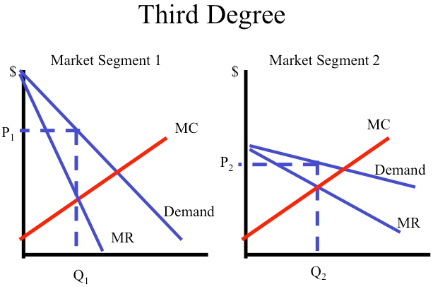
3.1.4.3. COMPETITIVE MARKETS: PERFECT COMPETITION
ASSUMPTIONS | 1. Many buyers & sellers 2. Homogenous goods – Firms are price takers 3. Perfect Information 4. No barriers to entry or exit 5. Firms – profit maximisers/ Consumers – utility maximisers.
EFFICIENCY ANALYSIS | In LR: ALLOCATIVELY EFFICIENT & PRODUCTIVELY EFFICIENT. Not DYNAMICALLY EFFICIENT. NORMAL PROFIT.
SHORT RUN VS LONG RUN OUTCOMES | Supernormal profits/ losses are possible only in the SR. These Supernormal profits act as a signal & an incentive for firms to enter the market. The lack of barriers to entry & therefore the high level of contestability means that as new firms enter this competition will reduce prices. The opposite holds true in the case of Supernormal losses. Firms will leave (no barriers to exit) & prices will rise.
SHUTDOWN RULE | Shutdown condition: AR=/<AVC
3.1.4.4. MONOPOLY & MONOPOLY POWER
ASSUMPTIONS | One single supplier Unique Products – Firms are price makers High entry & exit barriers Imperfect Information Firms – Profit Maximisers.
EFFICIENCY ANALYSIS | NOT ALLOCATIVELY EFFICIENT or PRODUCTIVELY EFFICIENT. DWL Present. They can be DYNAMICALLY EFFICIENT due to SUPERNORMAL PROFITS.
PRICE DISCRIMINATION CONDITIONS | 1 Firms – Have degree of price making power 2 Firms must be able to keep consumers separated 3 There must be consumer groups with varying elasticities of demand
TYPES OF PRICE DISCRIMINATION | First degree price discrimination – every consumer is charged the price they are willing to pay. Consumer surplus is turned into profit. Second degree price discrimination – Eg discounts for buying in bulk. Third degree price discrimination – Charging different prices for Peak & Off-peak travel
NATURAL MONOPOLY | 1 Massive cost advantage – so great that not even a monopolist can fully exploit the available economies of scale. 2 Extremely high fixed costs
 | A | B | C
TR | £80,000 | £120,000 | £150,000
TFC | £100,000 | £100,000 | £100,000
TVC | £100,000 | £140,000 | £140,000
TC | £200,000 | £220,000 | £240,000
LOSS IF SHUT DOWN
LOSS IF CONTINUE
CONTINUE IN SR?
PERFECT COMPETITION VERSUS MONOPOLY (PC are EXACT OPPOSITES)
MONOPOLY BAD POINTS | Monopoly price High & Quantity Low. Restricts choice & exploits consumer DWL, Productive & allocative inefficiency, May suffer from diseconomies of scale.
MONOPOLY GOOD POINTS | Economies of scale benefits, May be in contestable market, Dynamic efficiency gains, Patents create monopolies but offer incentives for expensive R&D – least bad option?
EVALUATION | Level of contestability, Quality of regulator, Objectives of monopolist, Current level of production.

Slide 15
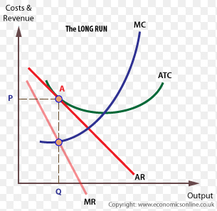
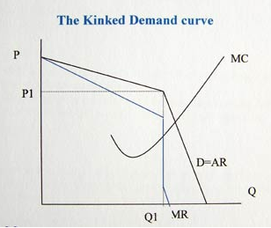
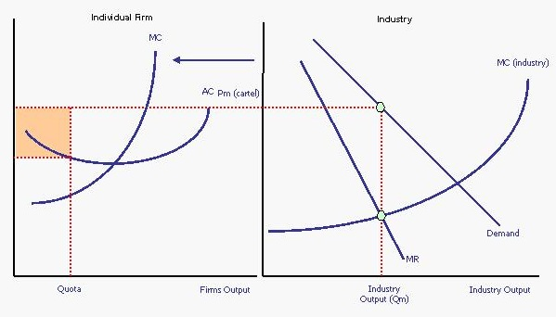
OLIGOPOLY
ASSUMPTIONS | 1 A few large dominant firms 2 High barriers to entry/ exit 3 Product differentiation 4 Interdependence – Price rigidity 5 Non price competition 6 Firms – Profit max & look to gain market share.
EFFICIENCY ANALYSIS | NOT ALLOCATIVELY EFFICIENT OR PRODUCTIVELY EFFICIENT. Oligopolies can be DYNAMICALLY EFFICIENT if they achieve SUPERNORMAL PROFIT.
MARKET CONCENTRATION | Market concentration measures the extent to which sales in a market are dominated by one or more businesses. The concentration ratio measures the combined market share of the top 'n' firms in the industry. n – often 5.
TACIT COLLUSION | Occurs where firms undergo actions that are likely to minimize a response from another firm, e.g. avoiding the opportunity to price cut an opposition.
OVERT COLLUSION | Overt means spoken, open or traceable Collusion is often explained by a desire to achieve joint-profit maximisation within a market or prevent price and revenue instability in an industry.
GAME THEORY & OLIGOPOLIES
The study of strategic interaction where one player's decision depends on what the other player does. It usually involves looking at events where the decisions of others have some influence on your own decisions.
DOMINANT STRATEGY | Where a single strategy is best for a player irrespective of whatever strategy the other firm adopts
NASH EQUILIBRIUM | A stable state of a system involving the interaction of different participants, in which no participant can gain by a unilateral change of strategy if the strategies of the others remain unchanged.
The following payoff matrix, highlights outcomes in both a competitive & an overtly collusive Olgiopoly. The competitive outcome is also a NASH EQUILIBRIUM.
 | B. High Price | B. Unchanged Price
High Price | A 10, B 10 | A -4, B12.
Unchanged Price | A 12, B -4 | A 4, B 4.
MONOPOLISTIC COMPETITION
ASSUMPTIONS | 1. Product differentiation – heterogeneous products. 2. Many buyers & sellers 3. Low barriers to entry & exit 4. Non-price competition 5. Firms – Proift Max
EFFICIENCY ANALYSIS | NOT ALLOCATIVE EFFICIENT & PRODUCTIVELY EFFICIENT nor DYNAMICALLY EFFICIENT. NORMAL PROFIT in LONG RUN.
SHORT RUN VS LONG RUN OUTCOMES | Supernormal profits/ losses are possible only in the SR. These Supernormal profits act as a signal & an incentive for firms to enter the market. The lack of barriers to entry & therefore the high level of contestability means that as new firms enter this competition will reduce prices. The opposite holds true in the case of Supernormal losses. Firms will leave (no barriers to exit) & prices will rise. LR OUTCOME = AC=AR.
SHUTDOWN RULE | Shutdown condition: AR=/<AVC
COMPETITIVE OLIGOPOLY
LIKELY OBERVATIONS IN COMPETITIVE OLIGOPOLIES | Occurrence of price wars Use of non-price competition. May lead to the Kinked demand curve diagram.
FACTORS PROMOTING COMPETITIVE OLIGOPOLIES | Large no. of firms – less highly concentrated oligopoly New market entry possible One firm with significant cost advantages Homogenous goods Saturated goods.
EFFICENCY EVALUATION IN COMPETITIVE OLIGOPOLIES | Market may generate ALLOCATIVE EFFICIENCY – low price, high quantity. PRODUCTIVE EFFICIENCY – More likely. No DYNAMIC EFFICIENCY due to likelihood of NORMAL PROFITS.
COLLUSIVE OLIGOPOLY
LIKELY OBERVATIONS IN COLLUSIVE OLIGOPOLIES | OVERT or EXPLICIT COLLUSION (PRICE LEADERSHIP - the setting of prices in a market by a dominant company, which is followed by others in the same market).
FACTORS PROMOTING COLLUSIVE OLIGOPOLIES | Small no. of firms Similar costs High entry barriers Ineffective competition policy Consumer loyalty Consumer inertia.
EFFICENCY EVALUATION IN COLLUSIVE OLIGOPOLIES | Market NOT ALLOCATIVE EFFICIENCY – High price, low quantity. NOT PRODUCTIVELY EFFICIENT. May achieve DYNAMIC EFFICIENCY due to SUPERNORMAL PROFITS.

Slide 16
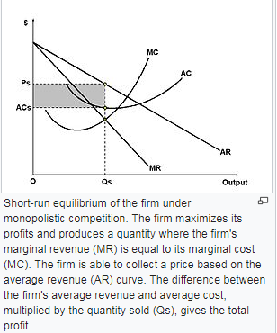
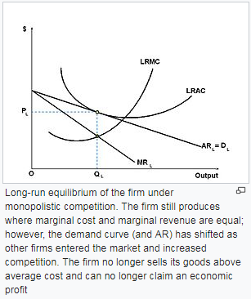
MONOPOLISTIC COMPETITION
These firms combine elements of monopoly & competitive markets. There are low barriers to entry & exit but where firms will differentiate their products.
ASSUMPTIONS | Product Differentiation. Monopolistic firms sell products that have non-price differences. Many firms. Freedom of Entry and Exit. (Low barriers to entry & exit). Price makers Imperfect information
EFFICIENCY ANALYSIS | NOT ALLOCATIVELY EFFICIENT or PRODUCTIVELY EFFICIENT. DWL Present. Not DYNAMICALLY EFFICIENT due to NO SUPERNORMAL PROFITS.
SR Vs LR | It is possible to achieve SUPERNORMAL PROFITS in the SHORT RUN. In the LONG RUN, the low barriers to entry mean that new firms will enter & revenues will fall. Consequently, most monopolistic firms will make NORMAL PROFITS in the LONG RUN.
ANALYSIS | How the building of a brand & associated promotion costs lead to higher price levels for consumers. Yet the brand can That the area of deadweight economic loss reflects excess capacity of the firm. How supernormal profits will be competed away via the entry of other firms resulting ultimately in a ‘tangential’ normal profit position. Within the analysis, yet leading into definite evaluation, may be a discussion as to whether supernormal profits must necessarily be against the best interests of consumers.
EVALUATION | Why is product differentiation important? • The issue concerning whether a monopolist will not use supernormal profits to fund research and development etc./exploit economies of scale etc. and hence might actually be better for consumers? • How monopolistic competition is not a feasible market form in certain circumstances – for example, with ‘natural monopolies’. • How advertising used to try to convince consumers that there are differences between products might be a waste of scarce resources due, in reality, to the extreme similarities between them.
REGULATING A MONOPOLY
Taxes Subsidies Price controls Privatisation & deregulation Breaking up the monopolist Reducing entry barriers Market regulator

Slide 17
3.1.5. THE MARKET MECHANISM, MARKET FAILURE & GOVERNMENT INTERVENTION IN MARKETS
3.1.2.1. THE DETERMINATION OF EQUILIBIRUM MARKET PRICES
THE PRICE MECHANISM | The manner in which the prices of goods affect the demand & supply of goods & services. There are four functions: 1. Allocating. 2. Rationing. 3. Signalling. 4. Incentivising.
MARGINAL ANALYSIS DEFINITIONS
MARGINAL BENEFIT | The additional satisfaction or utility that a person receives from consuming an additional unit of a good or service.
MARGINAL COST | The cost added by producing one additional unit of a product or service.
DEADWEIGHT WELFARE LOSS | A loss of economic efficiency that can occur when equilibrium for a good or service is not achieved or is not achievable.
EFFICIENCY DEFINITIONS
ALLOCATIVE EFFICIENCY | Where DEMAND = SUPPLY maximising society surplus.
PRODUCTIVE EFFICIENCY | Maximising output at the lowest possible average cost.
DYNAMIC EFFICIENCY | Re-investment of SNP into innovation, R&D & new technology to improve future products & lower LRAC. LONG RUN EFFICIENCY.
3.1.5.3. PUBLIC GOODS, PRIVATE GOODS & QUASI-PUBLIC GOODS
PURE PUBLIC GOODS | A good that is both non-excludable and non-rivalrous in that individuals cannot be effectively excluded from use and where use by one individual does not reduce availability to others. May also be non-rejectable e.g National defence.
PRIVATE GOOD | Private goods are those whose ownership is restricted to the group or individual that purchased the good for their own consumption. It is rivalrous and excludable in its consumption.
QUASI-PUBLIC GOODS | A near-public good. It has some of the characteristics of a public good especially when it becomes rival in consumption at peak times.
FREE RIDER PROBLEM | A person who receives PUBLIC GOODS benefits that others have paid for without contributing payment themselves.
Susan Collins | “The first obligation of government is to protect its citizens”.
3.1.5.2. THE MEANING OF MARKET FAILURE
DEFINITION | A situation in which the allocation of goods and services is not ALLOCATIVELY EFFICIENT. Thus, a misallocation of resources takes place.
EXPLANATION | A misallocation of resources takes place.
COMPLETE MARKET FAILURE – A MISSING MARKET | The absence of a market on which to trade a good. It is not possible to trade the full range of future and contingent commodities, and markets are missing for many externalities.
PARTIAL MARKET FAILURE | Occurs when the market does actually function but it produces either the wrong quantity of a product or at the wrong price. This leads to resource misallocation.
MARKET FAILURE EXAMPLES
PUBLIC GOODS | A good that is both non-excludable and non-rivalrous in that individuals cannot be effectively excluded from use and where use by one individual does not reduce availability to others. May also be non-rejectable e.g National defence.
EXTERNALITIES | Are third party effects arising from production and consumption of goods and services for which no appropriate compensation is paid. They arise due to a divergence between private social costs & benefits.
MONOPOLY | Sole provider of a good or resource. They will often restrict output to gain a higher price.
INEQUALITY OF INCOME & WEALTH | The phenomenon of unequal and/or unjust distribution of resources and opportunities among members of a given society.
FACTOR IMMOBILITY | Occurs when it is difficult for factors of production (e.g. labour and capital) to move between different areas of the economy.

Slide 18
3.1.5.4. POSITIVE & NEGATIVE EXTERNALITIES
EXTERNALITIES | Are third party effects arising from production and consumption of goods and services for which no appropriate compensation is paid. They arise due to a divergence between private social costs & benefits.
NEGATIVE PRODUCTION EXTERNALITIES | Production of goods/ services which impose a cost on a third party. Social Cost > Private Cost. E.g. air pollution from a factory.
NEGATIVE CONSUMPTION EXTERNALITIES | Consumption of DEMERIT GOODS which impose a cost upon a third party. Private Benefit > Social Benefit
POSITIVE CONSUMPTION EXTERNALITY | Consumption of MERIT GOODS which give benefit a to a third party e.g. cycling to work may mean less congestion. Social Benefit > Private Benefit
POSITIVE PRODUCTION EXTERNALITY | Provision of MERIT GOODS which give benefit to a third party e.g. Training programmes & apprenticeships which may benefit future employers. Private Cost > Social Cost
NEGATIVE EXTERNALITIES RESULT IN OVER PRODUCTION | The overproduction of goods with negative externalities occurs because the price of the good to the buyer does not cover all of the costs of producing or consuming the good. If all costs were accounted for, the prices of these goods would be higher and people would consume less of them.
POSITIVE EXTERNALITIES RESULT IN UNDER PRODUCTION | The underproduction of goods with positive externalities occurs because the producers of the goods do not capture the extra value the goods create for others in the price they receive for their goods.
3.1.5.6. MARKET IMPERFECTIONS
TRAGEDY OF THE COMMONS | A situation within a shared-resource system where individual users acting independently according to their own self-interest behave contrary to the common good of all users by depleting or spoiling that resource through their collective action.
ASSYMMETRIC INFORMATION - | ASSYMETRIC INFORMATION occurs when somebody knows more than somebody else in the market. This may lead to under-provision or under consumption of merit goods and over-provision of
INFORMATION FAILURE | Where individuals or firms have a lack of information about economic decisions.
AGRICULTURE | MF may occur due to the following: Volatile Prices / volatile supply, Low and volatile income for farmers, Environmental costs of intensive farming (negative externalities), Agriculture key component of rural life (positive externalities), Monopsony power of food purchasers.
PRINCIPAL-AGENT PROBLEM | Occurs when a principal delegates an action to another individual (agent), but the principal does not have full information about how the agent will behave. Secondly, the interests of the principal diverge from that of the agent, meaning that the outcome is less desirable than the principal expects.
MONOPOLY | A pure monopoly is defined as a single seller of a product, i.e. 100% of market share. In the UK a firm is said to have monopoly power if it has more than 25% of the market share. Restricts output to charge a high price.
MONOPOLISTS & MARKET FAILURE | The firm will set a specific price for a good that is available to all consumers. The quantity of the good will be less and the price will be higher (this is what makes the good a commodity). The monopoly pricing creates a deadweight loss because the firm forgoes transactions with the consumers. The deadweight loss is the potential gains that did not go to the producer or the consumer. As a result of the deadweight loss, the combined surplus (wealth) of the monopoly and the consumers is less than that obtained by consumers in a competitive market. A monopoly is less efficient in total gains from trade than a competitive market.
FACTOR IMMOBILITY | The free market can fail to provide an efficient allocation of resources because of the geographical and occupational immobilities. Factor immobility can lead to increased inequality.
3.1.5.5. MERIT & DEMERIT GOODS
CLASSIFICATION OF MERIT & DEMERIT GOODS | This depends upon a normative value judgement – one man’s meat is another man’s poison.
PUBLIC GOODS | A good that is both non-excludable and non-rivalrous in that individuals cannot be effectively excluded from use and where use by one individual does not reduce availability to others. May also be non-rejectable e.g National defence.
QUASI PUBLIC GOODS | A near-public good. It has some of the characteristics of a public good especially when it becomes rival in consumption at peak times.
MERIT GOODS | May have two characteristics: a). People do not realise the true benefit. E.g. people underestimate the benefit of education or vaccinations. b). Usually these goods have POSITIVE EXTERNALITIES.
DEMERIT GOODS | A good which can have a negative impact on the consumer – but these damaging effects may be unknown or ignored by the consumer. They also usually have NEGATIVE EXTERNALITIES– where consumption causes a harmful effect to a third party.
FREE RIDER | A person who receives PUBLIC GOODS benefits that others have paid for without contributing payment themselves.
SUSAN COLLINS | “The first obligation of government is to protect its citizens”.

Slide 19
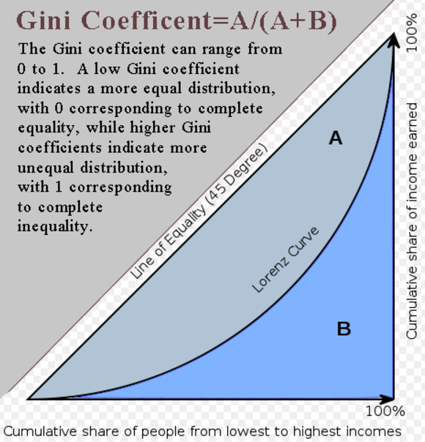
3.1.5.7. INEQUITABLE DISTRIBUTION OF INCOME & WEALTH
Refers to the extent to which income is distributed in an uneven manner among a population
ABSOLUTE POVERTY | Characterised by severe deprivation of basic human needs, including food, safe drinking water, sanitation facilities, health, shelter, education and information
RELATIVE POVERTY | Occurs where people lack the minimum amount of income needed in order to maintain the average standard of living in the society in which they live
INCOME | Flow of income over a given period of time
WEALTH | Ownership of assets with market value.
GINI COEFFICIENT | The Gini coefficient is a commonly-used measure of income inequality that condenses the entire income distribution for a country into a single number between 0 and 1: the higher the number, the greater the degree of income inequality.
LORENZ CURVE | A graph on which the cumulative percentage of total national income (or some other variable) is plotted against the cumulative percentage of the corresponding population (ranked in increasing size of share). The extent to which the curve sags below a straight diagonal line indicates the degree of inequality of distribution.
REASONS FOR DIFFERENTIALS IN INCOME & WEALTH | AGE– wealth accumulated over time, Increased income means increased wealth in LR. Education Ownership of assets – through employer pensions or inheritance Wage differentials
CONSEQUENCES OF HIGH INCOME INEQUALITY | Excessive debts Impact on government finances due to welfare benefits Social costs Lower economic growth (debated).
INCOME REDISTRIBUTION POLICIES | PROGRESSIVE TAX TRANSFER PAYMENTS/ UNIVERSAL BENEFIT Government spending on Education/ health. Minimum or maximum wages Reduce REGRESSIVE INDIRECT TAX Increase child/ staff ratios in nurseries on a par with Germany/ Denmark. Reduce nursery fees Take low paid out of NI contributions. Allow building on greenbelt to ease housing costs.
PROBLEMS OF SUCH POLICIES | Transfer payments through benefits may cause an unemployment trap Conflict with Fiscal deficit of £50b.
EVALUATION | Is a solution really necessary? How great is the degree of inequality? Is freedom of economic opportunity the crucial factor? Does this depend upon parents & education provision?
OVERALL MARKET FAILURE EVALUATION CONSIDERATIONS
Whether or not there should be intervention depends upon the degree of DWL or externality present. How great is the abuse of this demerit good? How toxic is it? Does this suggest a need for intervention? Is there a best solution? Is the risk of GOVERNMENT FAILURE too great? Will there be UNINTENDED CONSEQUENCES? Will the MF require a combination of policy responses? Is a solution really necessary? Are other issues more important? Who decides what merit goods are? Some degree of inequality helps provide incentives to work hard & be productively & dynamically efficient. Consider consequences on distinct stakeholder groups for all MARKET FAILURES

Slide 20
3.1.5.8. GOVERNMENT INTERVENTION IN MARKETS
GOVERNMENT INTERVENTION | Government intervention is regulatory action taken by government that seek to change the decisions made by individuals, groups and organisations about social and economic matters.
AIMS OF GOVERNMENT INTERVENTION | Governments may also intervene in markets to promote general economic fairness. Governments may sometimes intervene in markets to promote other goals, such as national unity, advancement and tackle inequality.
INTERVENTION METHODS TO CORRECT NEGATIVE EXTERNALITIES
 | DEFINITION | ADVANTAGE | DISADVANTAGE
INDIRECT TAXATION | Taxes on NEGATIVE EXTERNALITIES are intended to make consumers / producers pay the full social cost of the good. This reduces consumption and creates a more socially efficient outcome. | Changes in indirect taxes can change the pattern of demand by varying prices Indirect taxes can be used as a means of making the polluter pay and “internalizing the external costs” of production and consumption Indirect taxes can be charged more easily than direct taxes. Earns TAX REVENUE | Difficulty in setting the right value – IMPERFECT INFORMATION REGRESSIVE Little impact when demand is INELASTIC May create a BLACK MARKET Misuse of Government Tax Revenue Impact on firms & jobs?
REGULATION | To overcome NEGATIVE EXTERNALITIES, the government may place laws and regulations which prohibit certain behaviour and actions. | Simple and easy to understand. When the danger is great it may be better to ban it all together, e.g. heroin. When a decision needs to be taken quickly, a tax may be too cumbersome. A legal ban sends a clear signal that it is wrong (e.g. drinking alcohol in city centre) It is fairer than taxes – not REGRESSIVE. | Difficulty in setting the right value – IMPERFECT INFORMATION Firms may shut down/ leave the market– jobs? Cost of REGULATION Enforcement issues. May create a BLACK MARKET.
EXTEND PROPERTY RIGHTS | A way of internalising the externality. By ensuring firm’s pay for pollution to eg. air, water in surrounding areas. | Incentivises private agents to act in a responsible manner & not pollute. May result in more equitable decisions. | Is it possible to exclude people? Cost Enforcement Equitable Concerns
POLLUTION PERMITS | Involve giving firms a legal right to pollute a certain amount e.g. 100 units of Carbon Dioxide per year | If the firm produces less pollution it can sell its pollution permits to other firms. However if it produces more pollution it has to buy permits off other firms. Therefore there will be a market for pollution permits. Therefore there is an incentive for firms to cut pollution & sell permits. | Setting the right cap Cost Enforcement Global agreement needed May concentrate pollution in areas.
INFORMATION PROVISION | Assymmetric info occurs when somebody knows more than somebody else in the market. Information campaigns can help reduce NEG CONs EXTERN. | Markets are at their most efficient, when knowledge is perfect and is evenly shared by all the parties in a transaction. Consumers are now less likely to be exploited. | Quality of provision Targeted at who? Costly Long term – difficult to assess impact No guarantee of success.
REASONS FOR GOVERNMENT INTERVENTION
To correct NEGATIVE & POSITIVE EXTERNALITIES To provide PUBLIC & MERIT goods. To correct FACTOR IMMBILITY To improve UNEQUAL DISTRIBUTION OF INCOME To correct MONOPOLY ABUSE | To correct TRAGEDY OF THE COMMONS To resolve ASSYMERTIC INFORMATION To support AGRICULTURE To resolve the PRINCIPAL-AGENT PROBLEM. To protect industries of STRATEGIC IMPORTANCE.
ARGUMENTS AGAINST GOVERNMENT INTERVENTION | Government failure – when the government creates further inefficiency. This could distort incentives, increase bureaucracy, increase political interference, administrative costs, moral hazard, regulatory capture & unintended consequences.
EXAMPLES OF GOVERNMENT INTERVENTION
Taxation, indirect taxation, subsidies, welfare provision, direct state provision, regulation, price controls.
MIXED ECONOMIES | Allow private enterprise to run most business. Then the governments intervene in certain areas of the economy, such as regulation, and public services – public goods & merit goods.

Slide 21
METHODS TO CORRECT POSITIVE EXTERNALITIES & PROVIDE PUBLIC & MERIT GOODS
 | DEFINITION | ADVANTAGE | DISADVANTAGE
SUBSIDY | A sum of money granted by the government to help an industry or business keep the price of a commodity or service low. | Enables greater social efficiency. Consumers end up paying the socially efficient price which includes the external benefit. Lower price encourages greater consumption. | Setting the right value – imperfect information Cost Promotes inefficiency Inelastic demand Misuse of subsidy
DIRECT STATE PROVISION | Direct provision of PUBLIC & MERIT GOODS by the government. E.g. NHS & state schools. | More productively efficient due to economies of scale & natural monopolies; Better Management!? Which tries to maximise net social benefit; Maximise net social benefit not private profit. A fairer distribution of resources. | Setting the right level – imperfect information Cost Excess demand Necessary? X-inefficiency – failure to be dynamically efficient. Quality arguments.
INFORMATION PROVISION | Information campaigns can resolve ASSYMETRIES OF INFORMATION. | Markets are at their most efficient, when knowledge is perfect and is evenly shared by all the parties in a transaction. Consumers are now less likely to be exploited. | Quality of provision Targeted at who? Costly Long term – difficult to assess impact No guarantee of success.
PRIVATE FINANCE INITIATIVE | Creates "public–private partnerships" by funding public projects with private capital. | The belief that the private sector can be more productively & dynamically efficient through better management. | Debt at higher interest burden. Inflexibility & poor value for money.
3.1.5.9. GOVERNMENT FAILURE, THE LAW OF UNINTENDED CONSEQUENCES
Where government intervention in the economy to correct a market failure creates inefficiency and leads to a misallocation of scarce resources.
REASONS FOR GOVERNMENT FAILURE | Lack of incentives: In the public sector, there is limited or no profit motive. For example, the public sector may be more prone to over-staffing. Poor Information: politicians may have poor information about their intervention. Politicians will not be experts in their department, but concentrate on their political ideology. Political interference & conflicting objectives e.g. politicians may take the short term view rather than considering long term effects. Administration costs of government bureaucracy in running public services Moral hazard. The government may offer a guarantee to all bank deposits to protect financial system, but this could encourage banks to take risks – because they know they can be bailed out by the government. UNINTENDED CONSEQUENCES: Markets are DYNAMIC & intervention can distort existing incentives, signals & result in misallocation of resources.
OVERCOMING GOV’T FAILURE | Give performance targets / profit incentives Competitive tendering – where public sector bodies face competition from the private sector for the right to run a public service. Employing outside private sector consultants to make decisions about how to cut costs.
LAW OF UNINTENDED CONSEQUENCES | The law of unintended consequences refers to how economic decisions may have effects that are unexpected. Usually this refers to an economic law which distorts consumer or producer behaviour in a way that is not expected.
EXAMPLES OF UNINTENDED CONSEQUENCES | - After Exxon Valdes oil Spill many US coastal state enacted a law of placing unlimited liability on tanker spills. This led to many big oil companies sub contracting the delivery of oil to other companies. Oil specialists worried that these smaller companies may have lower standards and poorer insurance than the big companies, so the risk increased. - A maximum price for renting accommodation. A government may respond to public pressure and impose maximum rent levels for accommodation in London. But, a maximum price which lowers the price could lead to less incentive for landlords to supply accommodation. Therefore, there is less supply and more people struggle to get accommodation.

Slide 22
AS Macro Economics

Slide 23
3.2.1 THE NATIONAL ECONOMY IN A GLOBAL CONTEXT
3.2.1.1. THE OBJECTIVES OF GOVERNMENT POLICY- CIGARS
CURRENT ACCOUNT | The focus here should be on ensuring international competitiveness & ensuring that a current account deficit does not become too large.
INFLATION | Inflation should be low & stable. The Bank of England works to a medium term target of 2% inflation on the CPI.
GROWTH | GDP Growth & the benefits that this brings. However, the costs should be carefully managed.
ADVANCES IN PRODUCTIVITY | Employment should be high & ideally their should be productivity & real wage growth.
RATE OF UNEMPLOYMENT | Government policies help to correct inequalities of wealth & income.
STABLE GOVERNMENT FINANCES | The government should seek to pursue sustainable policies
3.2.1.2 MACROECONOMIC INDICATORS
GROSS DOMESTIC PRODUCT (GDP) | Total output of an economy from using the factors of production, based in that country.
REAL GDP | A measure of the value of economic output adjusted for inflation.
GDP Per Capita | GDP per capita represents the average income per person in the economy
GDP Purchasing Power Parity (PPP) | This calculation considers GDP in line with a country’s actual cost of living. E.g. some countries will have lower GDP, but the cost of living is cheaper. PPP adjusts for these different costs of living.
GROSS NATIONAL INCOME (GNI) | Total output produced by UK owned Factors of production wherever this is earnt.
NET NATIONAL PRODUCT | NNP measures GDP minus depreciation
CONSUMER PRICE INDEX (CPI) | Measures changes in the price level of a weighted average market basket of consumer goods and services purchased by households.
RETAIL PRICE INDEX (RPI) | Measures the change in the cost of a representative sample of retail goods and services.
HEADLINE UNEMPLOYMENT RATE | Calculated by dividing the unemployment level for those aged 16 and over by the total number of economically active people aged 16 and over. Economically active is defined as those in employment plus those who are unemployed.
ILO UNEMPLOYMENT DEFINITION | Unemployed people as being: without a job, have been actively seeking work in the past four weeks and are available to start work in the next two weeks. out of work, have found a job and are waiting to start it in the next two weeks
PRODUCTIVITY | A ratio between the output volume and the volume of inputs. In other words, it measures how efficiently production inputs, such as labour and capital, are being used in an economy to produce a given level of output.
BALANCE OF PAYMENTS | The difference in total value between payments into and out of a country over a period. It consists of the capital account & the current account.
THE CAPITAL ACCOUNT | The capital account, in international macroeconomics, is the part of the balance of payments which records all transactions made between entities in one country with entities in the rest of the world.
THE CURRENT ACCOUNT | A country's current account records the value of exports and imports of both goods and services and international transfers of capital.
ANALYSIS OF MACROECONOMIC OBJECTIVES
BENEFITS OF ECONOMIC GROWTH | Higher average income Lower unemployment Lower government borrowing Improved public services Money can be spent on protecting the environment Increased investment Increased research & development
SIMULTANEOUS ACHIEVEMENT OF OBJECTIVES | Economic growth will also help to keep employment high. Investment may help to boost productivity & therefore international competitiveness. This will boost the supply side of the economy.
DRAWBACKS & OBJ CONFLICT | Economic growth often conflicts with inflation, the fact that it can lead to boom/ bust cycles, damage to the environment & rising inequality.
EVALUATION | Do all governments necessarily have the same ultimate objective?/ Does the time scale and the economic situation affect the relative importance? For LEDCs, a small increase in income can generate huge gains in utility. Is economic growth a ‘sufficient’ objective or merely a necessary step towards some other objective, e.g. improved standard of living, improved physical quality of life indicators, happiness? It also depends upon the nature of economic growth. E.g. must not create too many negative externalities & the distribution of economic growth – who benefits from the economic growth. If growth benefits primarily the richest in society, growth may do little to overcome poverty. Why is economic growth the principal objective for a government, instead of the others?

Slide 24
3.2.1.2 ECONOMIC PERFORMANCE
3.2.1.3. USES OF INDEX NUMBERS
INDEX NUMBERS
USES OF INDEX NUMBERS
BASE YEAR
WEIGHTING
CALCULATION
CPI & THE BASKET OF GOODS & SERVICES
INFLATION MEASUREMENT
Living costs & food survey on households | The survey explores the living costs & food survey
Basket of goods | “Currently, around 180,000 separate price quotations are used every month in compiling the indices, covering around 700 representative consumer goods and services. These prices are collected in around 140 locations across the UK and from the internet and over the phone at ONS.” ONS.
Weights are calculated according to % of income spent | The contents of the consumer price inflation basket of goods and services and their associated expenditure weights are updated annually to keep information relevant. Notice bread will be bought more frequently than butter!
As an index a base year must be selected | Remember that calculating from 100 will provide the % increase yet an index rising from 105 – 110 would be a 4.8% change in inflation.
Monthly collection of information | Annual % change is calculated.
INDEX CALCULATION
ITEM | PRICE CHANGE % | INDEX no. | Weight | Product
Bread | +60% | 160 | 80 | 12800
Butter | +10% | 110 | 20 | 2200
 |  |  | 100 | 15000
Weighted index = 15,000/ 100 = 150. 50% increase in price.

Slide 25
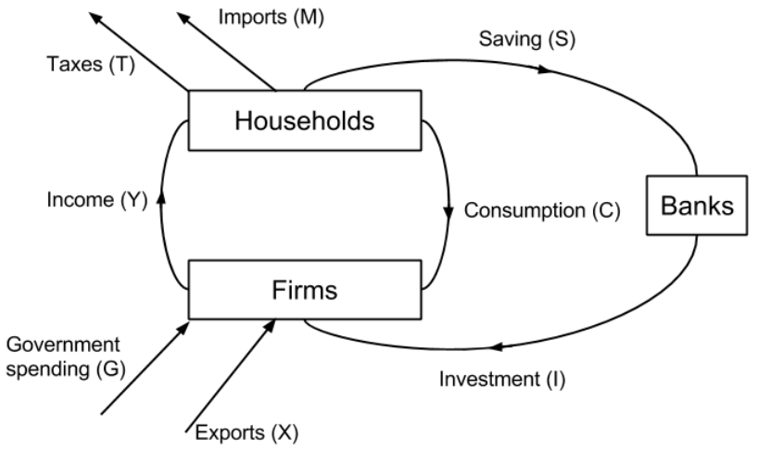
3.2.2.1. CIRCULAR FLOW OF INCOME
Illustrates the basic flows of money in an industry. In a closed economy with no government there are two economic agents – households & firms. Firms produce output. & then pay income to households. Households then use this income to buy goods.
INJECTIONS | Additions to the circular flow through investment, government spending or exports which boost the flow of income leading to a multiplied expansion of output.
WITHDRAWALS | Subtractions through taxation, imports & savings.
CIRCULAR FLOW OF INCOME EQUILIBRIUM | INJECTIONS = WITHDRAWALS
IMPACT OF TRADE | The households of an open economy will spend some of their income on goods from abroad, called imports (M), and this is withdrawn from the circular flow. Meanwhile exports (X) from abroad provide injections into the economy.
AGGREGATE DEMAND: CONSUMPTION & SAVING
This represent spending by households on consumer goods. In the UK Consumption totalled 66% of total GDP in 2016. It is the biggest component of UK AD. In China, consumption represents 39% of GDP.
MARGINAL PROPENSITY TO CONSUME (MPC) | This measures the proportion of extra income spent on consumption. MPC = ∆C / ∆Y E.g if a consumer has £100 disposable income & spends £65 the MPC will be 60/100= 0.6
FACTORS DETERMINING CONSUMPTION | Income levels. When people are poor, any increase in income is likely to be spent to improve their living standards. At higher income levels, people are likely to save the additional income. Interest rates. A lower interest rate will encourage greater consumption rather than saving. Yet, be aware that it may also reduce incomes earned from saving. Consumer confidence. When the economy is growing & unemployment is low, people will be more likely to spend & their MPC will be higher. This could be reinforced with a positive ‘wealth effect’ at such times & vice-versa. Temporary/permanent. If people receive a bonus, then they may be more inclined to save this temporary rise in income. However, if they gain a permanent increase in income, they may have greater confidence to spend it. Supply of credit. The ease of availability of car finance has raised consumption on new cars. Temporary/permanent income changes. A permanent increase in income often correlates with higher general spending. Yet workers, may decide to save a sudden windfall from a bonus.
MPC >1 ? | This is possible when people borrow to supplement their disposable income.
WITHDRAWALS FROM GROSS INCOME | Savings Imports Taxation These withdrawals reduce the size of the MPC & are referred to as the marginal propensity to withdrawal (MPW).
MPC & THE MULTIPLIER | The multiplier means that an injection into the circular flow of income will be associated with a larger final increase in GDP. The initial injection will lead to further consumption spending as a result of the initial spending MPC has a direct impact upon the size of the multiplier. If the MPC is high; the higher the multiplier effect will be & vice-versa.
MULTIPLIER CALCULATION | K = 1/ (1-MPC) = 1/ MPW (MPS+MPT+MPW) E.g. 1 / (1-0.6) = 2.5. Every £1 will lead to £2.50 extra spending.
FISCAL POLICY & THE MULTIPLIER | If the multiplier is small, fiscal policy will be less effective in increasing AD & vice-versa.
MULTIPLIER & CROWDING OUT | Monetarists believe that higher government spending through borrowing ‘crowds out’ private investment by reducing access to finance & increasing its cost. Thus, AD will not increase.
3.2.2.3. AGGREGATE DEMAND
The total demand for goods & services in an economy.
COMPONENTS | Consumption (C) Investment (I) Government expenditure (G) Exports (X) Imports (M)
CALCULATION | AD = C + I + G + (X – M)
DOWNWARD SLOPING | As prices fall, effective disposable income increases, proving wages remain constant If the UK has lower price levels, our exports will be more competitive & thus AD will be higher If prices are low, interest rates will usually be lower & this will increase AD.

Slide 26
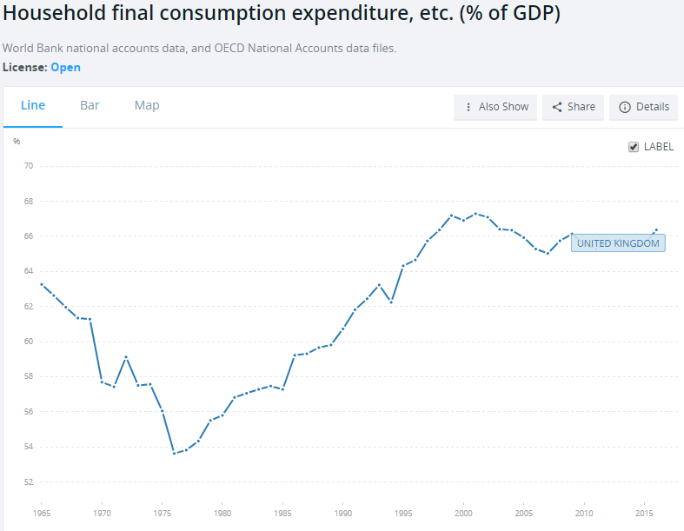
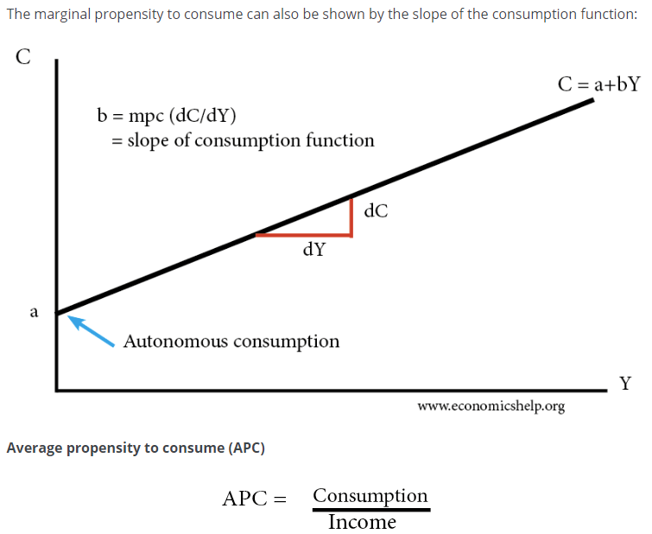
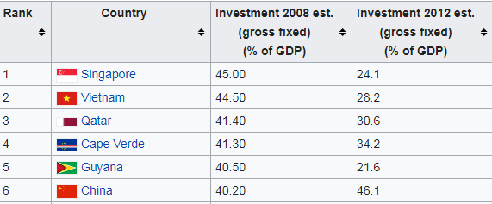
AVERAGE PROPENSITY TO CONSUME
The average propensity to consume = consumption / income.
AGGREGATE DEMAND: INVESTMENT
Investment refers to capital expenditure. That is expenditure in capital goods which can create output. If investment increases AD will increase. In addition, the LRAS of the economy may improve due to the increase in capital goods.
INVESTMENT & THE MULTIPLIER EFFECT | When there is spare capacity in the economy, increased investment will lead to deeper impacts throughout the economy. This will cause higher output and increased income which will lead to greater consumption and another increase in AD. If the MPC & therefore the multiplier is high, the increase in AD will be even greater.
INVESTMENT & THE LRAS | Investment in capital goods improves the productive capacity of the economy leading to a higher level of output & lower price level. A more sustainable level of growth.
EVALUATION | Investment rises & falls with the business cycle. In the UK investment is only around 15% of AD. This partly explains the poor productivity gains seen in the UK in recent times. This could be improved with subsidies & tax breaks. Investment involves opportunity cost. Money spent on investment may means lower dividend payments to shareholders & this may reduce consumption. Yet, in the longer term the economy may benefit. Investment decisions & motives can be questionable. For example, HS2 is a highly expensive, highly questionable government infrastructure project. Private sector investment may be far more efficient.
THE ACCELERATOR EFFECT & INVESTMENT
The accelerator effect states that investment levels are related the rate of change of GDP. Thus, an increase in the rate of economic growth will cause a correspondingly larger increase in the level of investment. But, a fall in the rate of economic growth will cause a fall in investment levels.
WHY DOES THE ACCELERRATOR EFFECT OCCUR? | When firms enjoy increases in demand, they may soon reach full capacity. If they anticipate this demand to continue to increase. They will need to expand their capacity or productivity they will need to invest. Businesses can benefit from greater expansion through financial & technological economies of scale.
OTHER CONSIDERATIONS FOR THE ACCELERATOR EFFECT | Investment in the UK has slumped despite increasing GDP. If GDP falls, or there is a great deal of uncertainty, investment will fall considerably. While GDP may be increasing it could be doing so at a slower rate & this may lead to falling investment. Investment decisions also involve a time lag between decision, financing & implementation Investment levels will depend upon business confidence which will depend upon the political & economic climate. Accelerator Coefficient. Represents the level of induced investment as a proportion of the rise in National income. Accelerator coefficient = Investment/change in income.

Slide 27
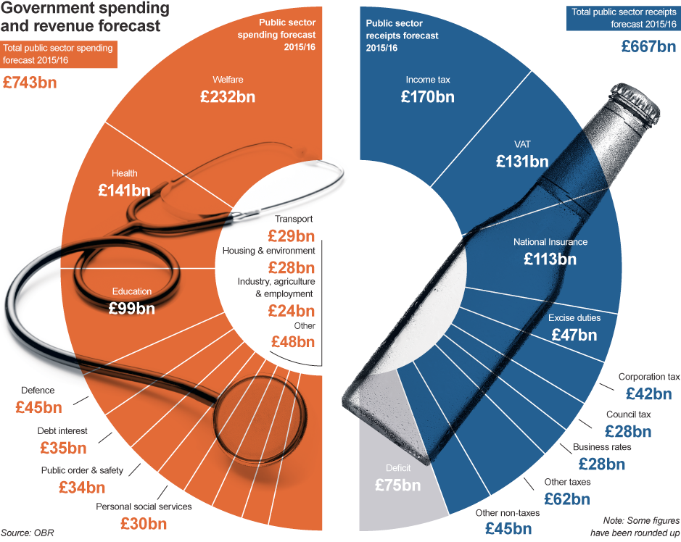
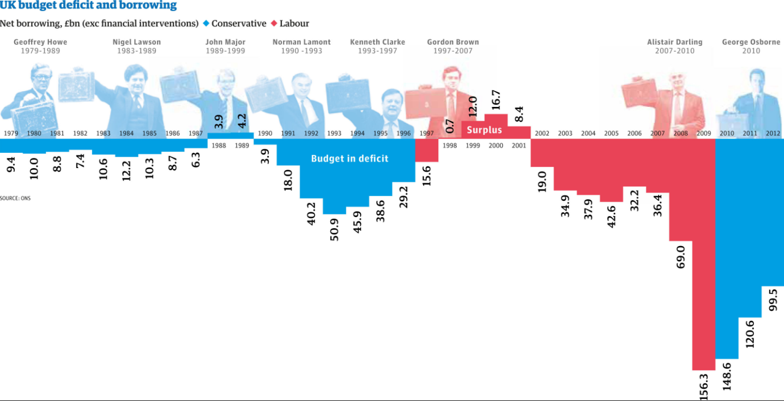
AGGREGATE DEMAND: GOVERNMENT EXPENDITURE
An increase in government expenditure can increase national output.
CATEGORIES OF GOVERNMENT EXPENDITURE | Current expenditure – expenditure on goods & services to directly satisfy individual or collective needs. Capital expenditure – Government spending to generate future benefits through infrastructure investment & research spending Transfer payments – This represents transfers on money through welfare & pension payments.
REASONS FOR GOVERNMENT EXPENDITURE | To correct market failure through missing markets in public & merit goods To implement supply side policies which potentially improve the long term productivity of an economy To inject money into the macro economy to increase AD. To correct market failures through negative externalities. To subsidise the agriculture industry which is subjected to volatile prices To redistribute income more equally.
GOVERNMENT EXPENDITURE & THE MULTIPLIER | The fiscal multiplier occurs when an increase in an injection generates a far greater increase in government economic output. The greater the multiplier, the greater the final increase in output will be & vice versa. This means fiscal expenditure will be most effective when the economy has a high multiplier.
FISCAL REVENUES | The government receives income through taxation. This includes direct taxation placed on income & company profits together with indirect taxation placed on goods and services e.g. Road tax, VAT, fuel duty & sin taxes.
THE FISCAL BUDGET | Tax revenue – Government expenditure
CROWDING IN & OUT | Monetarists believe the fiscal multiplier will be limited by the crowding out effect. E.g. Higher government spending will increase the cost of borrowing through higher bond yields, this will lead to higher borrowing costs for private firms & a decline in private sector investment. Thus AD may fail to increase at all. But Keynesians argue that the private sector typically has a surplus of non-productive savings, thus there will be a positive multiplier effect. Crowding in occurs where a reduction in government spending reduces bond yields & borrowing costs prompting private sector investment.
EVALUATION | How high is the MPC and therefore the multiplier? Thus how effective will expenditure be? Will government spending crowd out the private sector? Will capital expenditure be effective in raising the productive capacity of the economy? What impact will this spending have on the fiscal deficit? & therefore borrowing costs. Will fiscal austerity “crowd in” private sector investment? What are the potential time lags of taxation & expenditure – velocity of circulation?

Slide 28
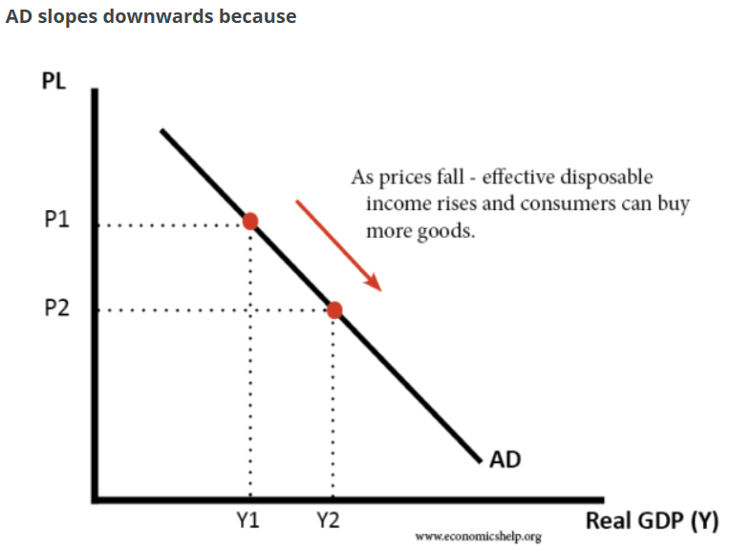
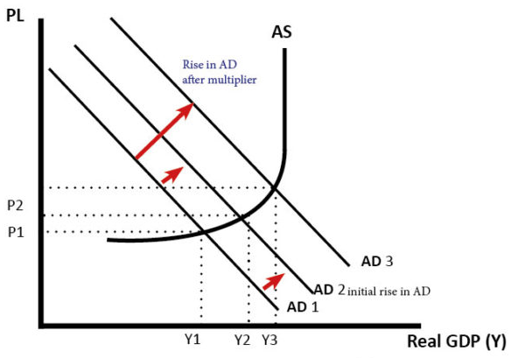
AGGREGATE DEMAND: NET EXPORTS
The net trade balance measures the total value of exported goods & services minus the total value of imported products & services.
TRADE SURPLUS & DEFICIT | A trade surplus means that X>M – therefore aggregate demand (AD) will increase. A trade deficit means that M>X – therefore AD will fall. Thus, there is a net leakage from the circular flow of income. If X=M, then the trade balance is zero, external trade will have a neutral effect on AD.
INCREASE EXPORTS TO IMPROVE TRADE BALANCE | Make the UK economy more competitive. E.g. an increase in labour productivity or better university & private sector links may improve innovation & improve UK export competitiveness. (Supply side policies). Increased economic growth in other countries, may lead to higher demand. Lower value of Sterling, this makes exports cheaper
DECREASE IMPORTS TO IMPROVE TRADE BALANCE | Make the UK more competitive, this makes goods from other countries appear less competitive. Lower value of Sterling, this makes imports more expensive (Expenditure switching policies) By undertaking contractionary monetary & fiscal policy to lower GDP, therefore consumers will have less money to spend. (Expenditure reducing policies).
EVALUATION | How policies may conflict with other MACROECONOMIC OBJECTIVES –which objectives are of greatest importance? J-CURVE, LERNER MARSHALL & TIME LAGS TIME LAGS of SUPPLY SIDE POLICIES–won’t help avoid an impending crisis. Does the TRADE BALANCE really matter? What’s the CAUSE? Are they just investing in capital goods?

Slide 29
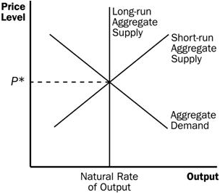
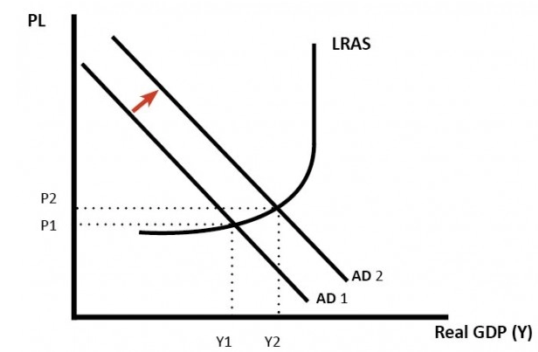
3.2.2.5 DETERMINANTS OF SRAS. 3.2.2.6. DETERMINANTS OF LRAS
This is the total value of goods & services produced in an economy. The aggregate supply curve shows the level of output at different price levels. When the economy reaches its maximum level of capacity (full employment & reflects the economy reaching the PPF boundary) the supply curve become perfectly inelastic. In the short term, firms are unable to produce greater output even at higher prices. The LRAS curve and the PPF are therefore closely linked.
FACTORS DETERMINING LRAS | Broadly speaking this concerns the quantity & quality of the key factors of production: Land Labour Capital The Entrepreneur Together with the ability to generate technological gains through improved capital goods & infrastructure
SRAS CURVE | In the short-run, capital is fixed. Firms can alter variable factors of production, such as labour. The SRAS is viewed as elastic, because in the short-run firms can increase output by getting workers to do overtime.
FACTORS INFLUENCING THE SRAS | Price of raw materials, e.g. oil, food, metals Cost of labour, (wages, taxes, regulation Levels of tax and subsidies
CLASSICAL INTERPRETATION | The classical view sees AS as inelastic in the long term. The classical view sees wages and prices as flexible, therefore, in the long-term the economy will maintain full employment. Classical economist believe economic growth is influenced by long-term factors, such as capital and productivity.
KEYNESIAN INTERPRETATION | Keynesians believe the long run aggregate supply can be upwardly sloping and elastic. They argue that the economy can be below the full employment level, even in the long run. For example, in recession, there is excess saving, leading to a decline in aggregate demand. Keynesians also believe wages and prices can be sticky, and therefore, economies don’t automatically return to full employment equilibrium.

Slide 30
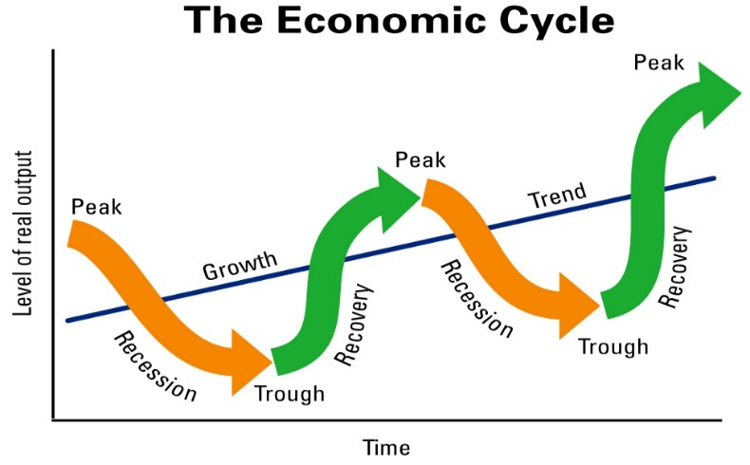
3.2.3. ECONOMIC PERFORMANCE
3.2.3.1 ECONOMIC GROWTH & THE ECONOMIC CYCLE
ECONOMIC GROWTH | In the short run, this is an increase in the country’s output. In the long run, this is an increase in the country’s productive potential. (Shift in LRAS.)
DETERMINANTS OF SHORT RUN GROWTH | Lower interest rates, increased debt, decreased taxation, higher consumer & business confidence, higher government spending, weaker exchange rate.
DETERMINANTS OF LONG RUN GROWTH | Increased factor productivity, increased population, increased competition, improved infrastructure.
ACTUAL GROWTH | An increase in real GDP
POTENTIAL GROWTH | An increase in the productive potential/long term capacity of the economy. .
OUTPUT GAP | The difference between the actual and potential output of an economy.
POSITIVE OUTPUT GAP | Where the actual output of an economy exceeds its potential
NEGATIVE OUTPUT GAP | Where actual output is less than the potential of the economy
TRADE/ECONOMIC CYCLE | Fluctuations in the economic cycle over time
ECONOMIC BOOM | At the top of the economic cycle where output and growth are high
RECESSION | Where economic growth is negative for two consecutive quarters.
PRODUCTION POSSIBILITY FRONTIER | Maximum level of output that an economy can achieve using its existing resources in full
SUSTAINABLE ECONOMIC GROWTH | Maintaining growth over very long time periods, thereby limiting the effects of the economic cycle
CAUSES OF ECONOMIC GROWTH
1. INCREASED AGGREGATE DEMAND | Lower interest rates, Increased labour productivity which will increase wages Increased government spending A depreciation of the currency may boost export earnings Increased consumer confidence may lead to more consumption & borrowing Lower taxation, which will increase disposable income Higher asset prices will give rise to a positive wealth effect & increased consumer & business confidence Financial stability will encourage more lending & borrowing .
2. INCREASED AGGREGATE SUPPLY | Investment in capital goods which increase productivity, Improved education will improve labour productivity in the long run A larger working population through immigration Improved technology which will boost productivity & reduce supply costs Technological improvements.
3. Other factors: | An environment of low inflation which helps to foster business & consumer confidence. Meanwhile exports will be maintained at a competitive level. A stable political & economic climate which promotes low inflation, certainty of business & consumer confidence which may give rise to inward investment.
ANALYSIS OF ECONOMIC GROWTH
BENEFITS | Living standards rise, output increases, lower unemployment which may reduce inequality. Fiscal dividend through the fiscal stabilisers of lower government spending & higher tax revenues, exports can rise, Positive accelerator effect where higher growth leads to higher investment. May attract inward FDI. Development occurs where investment in public & quasi public goods improves. This may give rise to increasing health standards & higher life expectancy.
COSTS | Inflation occurs as demand pull pressures rise & this gives rise to cost push pressures as wage demands increase. Imports may rise as consumption increases due to positive consumer confidence & possible wealth effects Inequality may increase as asset owners benefits from higher asset prices Negative externalities may occur through pollution & depletion of natural resources, boom may be unsustainable.
THE CONCEPT OF SUSTAINABLE ECONOMIC GROWTH & ITS DESIRABILITY
In the 19th Century Malthus believed that rising population & finite resources would lead to huge shortages. However, he failed to predict huge gains in productivity. At the time, Agricultural sectors represented the biggest employers in an economy. Now they represent a few %. Hence, greater economic efficiency can lead to far higher productivity gains. Yet, economic growth does clearly bring negative externalities & complete resource depletion which may have implications future generations.

Slide 31
3.2.3.2. EMPLOYMENT & UNEMPLOYMENT
UNEMPLOYMENT
CLAIMANT COUNT | The claimant count records the number of people receiving unemployment benefits from the government.
ILO/ IFS MEASURE UNEMPLOYMENT | The International Labour Organisation (ILO). The labour force survey is undertaken by the International Labour Organisation (ILO) and is a more direct assessment of unemployment, rather than those who claim benefit.
UNEMPLOYMENT RATE % | This is the % of people in the labour force without a job but registered as being willing and available for work
DEMAND SIDE CAUSES | Global recession Negative multiplier effect Financial crisis High interest rates.
SUPPLY SIDE CAUSES | Structural causes – mismatch of skills for key job roles Geographical immobility Real wage unemployment Technological change Frictional – search based unemployment
COSTS OF UNEMPLOYMENT | Loss of income for unemployed Less tax revenue & higher government borrowing Higher levels of government spending Loss of human capital Inefficient use of resources Opportunity cost Loss of cultural identity/ social & mental health problems.
TYPES OF UNEMPLOYMENT
STRUCTURAL | Occurs due to a changing nature of the structure of the economy. Globalisation has accelerated this process due to the offshoring of manufacturing.
CYCLICAL | When there is a recession or a steep slowdown in growth.
FRICTIONAL | Occurs when people are moving between jobs. Also known as ‘search’ unemployment.
TECHNOLOGICAL | Occurs due to capital goods replacing workers.
REAL WAGE | Where the available supply of workers is greater than the demand. This could be due to a living wage which is set too high.
VOLUNTARY | People choosing to stay on benefits, rather than work.
POLICY RESPONSES TO UNEMPLOYMENT
Expansionary Monetary Policy | Reducing interest rates to stimulate demand through higher consumption & business investment. Promotes borrowing & further spending & investment, while reducing saving. Paradox of thrift – may not stimulate consumption.
Expansionary Fiscal Policy | Reducing taxation to stimulate demand through higher consumption & business investment. Increased government spending. Yet we have a persistent fiscal deficit.
Supply side policies | To improve training & education to upgrade skills of the workforce. Promote business start-ups. But these costly & may not work.
NATURAL RATE OF UNEMPLOYMENT
This occurs when the labour market is in equilibrium yet unemployment persists. This natural rate occurs due to a combination of structural, frictional & even voluntary unemployment. Consequently there will always be a gap between the total labour force available & the market equilibrium.
MONETARIST INTERPRETATION | We can view the natural rate using a monetarists interpretation of the Phillips curve. Here, monetarists believe that the LRAS is inelastic, meaning that further AD increases give rise to only temporary increases in output. Wages rise to help generate higher output & this gives rise to higher inflation. As workers adapt their expectations, they realise that the wage increase is nominal & not real. Consequently, the supply of labour falls & unemployment returns to its natural rate. Monetarists believe that it is only possible to reduce unemployment by increasing the rate of inflation. Thus, the natural rate is known as the NAIRU – Non-Accelerating Inflationary Rate of Unemployment. NAIRU refers to a specific level of unemployment that is evident in an economy that does not cause inflation to rise up Yet monetarists, assume workers fail to predict inflationary changes instead they have adaptive expectations.
YOUTH UNEMPLOYMENT
Cyclical unemployment Financial crisis/ recession Lack of enterprise experience/ entrepreneurial talent Real wage unemployment Lack of graduate jobs or alternatively a lack of qualifications Hysteresis represents the concept that previous unemployment trends may lead to future unemployment. If people are unemployed, their lack of experience, skill & knowledge development makes it more likely that they will fail to find a job later. This downward spiral may mean people become demotivated and fail to undertake further training.
EVALUATION of concept as a whole | Types of unemployment are important but there will be some ‘generic’ problems consequently the size of unemployment might be the important factor. Should policies be aimed at looking to reduce/eradicate unemployment or at looking to deal with the problems caused by the unemployment? How much influence can a government have on unemployment, especially in a global economy, and hence how should this affect its approach? The whole issue of ‘do unemployment figures represent the true case?’ – e.g. unemployment vs underemployment and the issue of full-time vs part-time jobs. Are there possible problems from making unemployment too ‘tolerable’? - ‘make work pay’ etc.

Slide 32
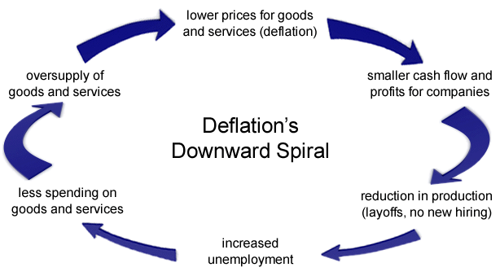
3.2.3.3. INFLATION & DEFLATION
KEY DEFINITIONS
CONSUMER PRICE INDEX (CPI) | Measures changes in the price level of a weighted average of prices of a basket of consumer goods and services purchased by households. It leaves the costs of your home out of the basket.
RETAIL PRICE INDEX (RPI) | A measure of inflation published by the Office for National Statistics monthly. It measures the change in the cost of a representative sample of retail goods and services. It includes housing costs such as mortgage payments, rents & council tax.
INDEX NUMBERS | An economic data figure reflecting price or quantity compared with a base value. The base will equal 100 and the index number is usually expressed as 100 times the ratio to the base value.
THE BASKET OF GOODS | A relatively fixed set of consumer products and services valued on an annual basis and used to track inflation in a specific market or country. The goods in the basket are often adjusted periodically to account for changes in consumer habits
INFLATION | The general rise in prices
CORE INFLATION | Excludes certain items that have volatile prices e.g. oil, gas.
DEFLATION | Reduction in the general level of prices.
HYPER INFLATION | Very high & accelerating rates of inflation where domestic currency becomes worthless.
DEMAND-PULL INFLATION | Occurs when aggregate demand increases at a faster rate than aggregate supply.
COST-PUSH | Inflation caused by rising input costs including staff wages & raw material costs. Causes a leftward shift in SRAS.
STAGFLATION | A stagnant economy with rising prices, may be due to cost push factors in a slump
DEFLATIONARY POLICIES | Policies that may target a reduction in AD.
IMPORTANCE OF INFLATION
GOVERNMENT’S NEED INFLATION | Due to persistent budget deficits and rising national debts. Inflation reduces the real size of national debts.
THE ECONOMY NEEDS INFLATION | High private sector debt means r
BUT INFLATION CAUSES INEQUALITY | Inflation is an effective tax which erodes the real value of currency. This has a disproportionate effect on the poor. Inflation steals the time people have put into earning that currency. This means that unearned income
DEFLATION | Can have some negative consequences but it does mean that people’s purchasing power rises. But in a debt based economic system, deflation increases the real size of debts.
COMMODITY PRICES & INFLATION | Commodities can have a dramatic impact upon inflation. This is particularly true of oil prices which can result in far greater
CHANGES IN OTHER ECONOMIES CAN AFFECT UK INFLATION | Monetary policy decisions by the Federal Reserve or the ECB can have a dramatic impact upon CPI inflation in the UK. E.g. It may cause exchange rates to change and thus import & export prices may fluctuate.

Slide 33
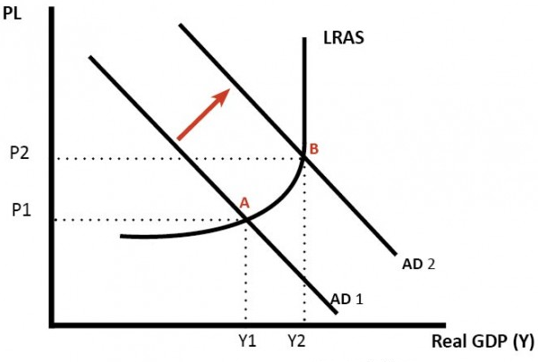
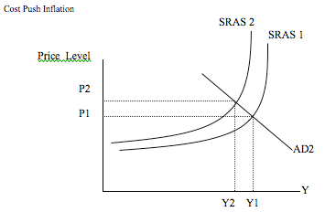
INDEX CALCULATION
ITEM | PRICE CHANGE % | INDEX no. | Weight | Product
Bread | +60% | 160 | 80 | 12800
Butter | +10% | 110 | 20 | 2200
 |  |  | 100 | 15000
Weighted index = 15,000/ 100 = 150. 50% increase in price.
CAUSES OF INFLATION
DEMAND-PULL | Cut in interest rates – raising disposable income & borrowing Increased money supply Higher wages – which will give rise to further cost push pressures Higher government spending
COST-PUSH | Higher wages – meaning that average total costs will rise Depreciation in the exchange rate leading to W£IDEC Increase in VAT Inflation expectations which can become a self-fulfilling prophecy Increased commodity prices – which means prices may be increased.
EFFECTS | Menu costs – costs incurred changing prices Search (shoe leather) costs – switching costs Reduced purchasing power of consumers as disposable incomes fall Uncertainty & lack of investment – due to Psychological effects on consumers – inflation illusion (do people only consider nominal wealth & income rather than real changes?) Redistributional effects – borrowers benefit from inflation as the real value of debt falls & lenders (savers) lose out as the real value of their loans or savings fall. Fiscal drag – as wages rise people are pushed into higher tax brackets on a progressive system. Balance of payments effects – Imports may become more competitive due to domestic inflation & exports will become less competitive in international markets. The trade balance may then deteriorate, & a depreciation of the exchange rate occurs.
EVALUATION | If inflation is anticipated businesses & consumers can plan for this so is this a problem if inflation is stable? Can the inflation actually be controlled? In a globalised economy is this truly possible? High demand pull inflation will bring higher employment levels & perhaps higher firm profits. Are real wages increasing? If so, is there a problem? How severe are the effects of inflation? How long is the anticipated duration? Conflict with other macroeconomic objectives?

Slide 34
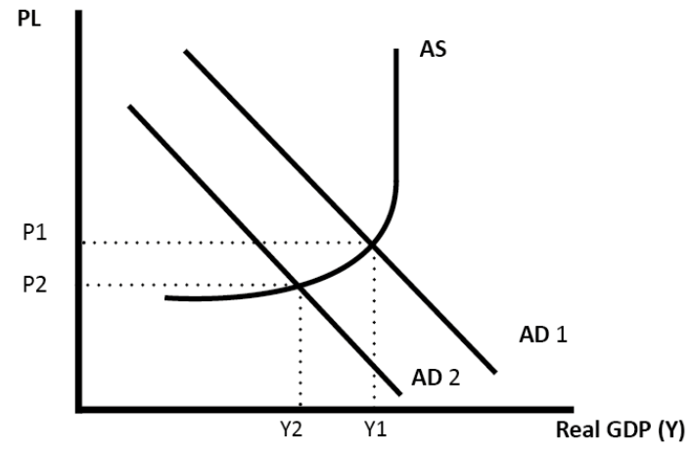
3.2.3.5. THE BALANCE OF PAYMENTS ON CURRENT ACCOUNT
BALANCE OF PAYMENTS
The balance of payments is the record of a country’s transactions / trade with the rest of the world.
THE BALANCE OF PAYMENTS CONSISTS OF: | 1. Current Account (trade in goods, services + investment incomes + transfers) 2. Capital Account / Financial Account (capital and financial flows, net investment, portfolio investment) 3. Errors and omissions. It is hard to collect all data so some is missed out.
WHY IT BALANCES | In theory there should be a balancing between capital and current / financial account. If there is a current account deficit, there should be a surplus on the capital / financial account.
DTS Impact of CA deficit
BALANCE OF PAYMENTS – THE CURRENT ACCOUNT (CA)
Measures the inflow and outflow of goods, services and investment incomes.
COMPONENTS OF THE CA | Trade in goods Trade in services Primary income (e.g. UK earnings from direct investment, shares, debt, bonds) Secondary income (e.g. General government transfers) The TRADE BALANCE measures, 1&2, the trade in goods – the trade in services.
CA DEFICIT | Where the value of imports & investment outflows is greater than the value of exports & investment inflows
CA SURPLUS | Where the value of exports & investment inflows is greater than the value of imports investment outflows.
CAUSES OF A CA DEFICIT | Overvalued exchange rates (SUPPLY SIDE). An overvalued exchange rate means exports are more expensive, but imports are cheaper. This encourages domestic consumers to buy imports. It also makes it hard for exporters because they are relatively uncompetitive. High consumer spending (DEMAND SIDE). If there is rapid growth in consumer spending, then there tends to be an increase in imports causing a deterioration in the current account. Unbalanced economy (DEMAND SIDE). An economy focused on consumer spending rather than investment and exports will tend to have a bigger current account deficit. Competitiveness (SUPPLY SIDE). Less competitive export firms will mean less exports abroad. Growing deficit in investment incomes . The UK has a deficit in trade in goods. But, since 2011 the current account deficit has been increased due to a fall in direct investment income.
CONSEQUENCES OF CA DEFICIT | TRADE DEFICIT will mean imports > exports which will reduce AD. Lower AD will mean reduced economic growth. Less demand for exports will cause a DEPRECIATION in the EXCHANGE RATE – W£IDEC – STAGFLATION! Debt burden – if this becomes unsustainable, it may cause a CURRENCY CRISIS & ECONOMIC CRISIS.
EVALUATION | Does a deficit really matter? If it is caused by DEMAND SIDE factors resulting from high GDP growth, it shouldn’t matter. How is it funded? Via short-term speculative investment or Long-term? Where does the CA deficit feature in importance of macroeconomic objectives?
DOES THE CURRENT ACCOUNT DEFICIT MATTER?
YES | It is a sign of uncompetitiveness, which will lead to lower economic growth and poorer prospects in the long run. If capital / financial flows dry up, it could lead to depreciation in the exchange rate and a fall in living standards It is a sign of an unbalanced economy.
NO | The UK has had a persistent deficit since the mid 1980s. Countries with large current account surplus have not necessarily done better, e.g. Japan had a long period of stagnation. In an era of globalisation, financial flows are easier to attract and therefore the deficit is financed by these capital inflows. If the current account was too large, there should be a depreciation in the exchange rate to restore the balance. A current account deficit is a bigger concern in a fixed exchange rate (like Euro) because there is no option of depreciation.

Slide 35
3.2.3.5. POSSIBLE CONFLICT BETWEEN MACROECONOMIC POLICY OBJECTIVES
2- MACROECONOMIC OBJECTIVES - CIGARS
CURRENT ACCOUNT | The focus here should be on ensuring international competitiveness & ensuring that a current account deficit does not become too large.
INFLATION | Inflation should be low & stable. The Bank of England works to a medium term target of 2% inflation on the CPI.
GROWTH | GDP Growth & the benefits that this brings. However, the costs should be carefully managed.
ADVANCES IN PRODUCTIVITY | Employment should be high & ideally their should be productivity & real wage growth.
RATE OF UNEMPLOYMENT | Government policies help to correct inequalities of wealth & income.
STABLE GOVERNMENT FINANCES | The government should seek to pursue sustainable policies
EVALUATION | Do all governments necessarily have the same ultimate objective?/ Does the time scale and the economic situation affect the relative importance? For LEDCs, a small increase in income can generate huge gains in utility. Is economic growth a ‘sufficient’ objective or merely a necessary step towards some other objective, e.g. improved standard of living, improved physical quality of life indicators, happiness? It also depends upon the nature of economic growth. E.g. must not create too many negative externalities & the distribution of economic growth – who benefits from the economic growth. If growth benefits primarily the richest in society, growth may do little to overcome poverty. Why is economic growth the principal objective for a government, instead of the others?
ANALYSIS OF MACROECONOMIC OBJECTIVES
BENEFITS OF ECONOMIC GROWTH | Higher average income Lower unemployment Lower government borrowing Improved public services Money can be spent on protecting the environment Increased investment Increased research & development
SIMULTANEOUS ACHIEVEMENT OF OBJECTIVES | Economic growth will also help to keep employment high. Investment may help to boost productivity & therefore international competitiveness. This will boost the supply side of the economy.
CONFLICTING ECONOMIC OBJECTIVES | Economic growth often conflicts with inflation, damage to the environment & rising inequality. Meanwhile, short run pursuit of economic growth may lead to debt build up which leads to boom/ bust economic cycles. However, recessions are a real opportunity for implementing change. “Never let a good crisis go to waste.”
OUTPUT GAPS | Negative output gaps will increase unemployment & lead to disinflationary or even deflationary pressures.
3.2.3.5. POSSIBLE CONFLICT BETWEEN MACROECONOMIC POLICY OBJECTIVES
2- MACROECONOMIC OBJECTIVES - CIGARS
CURRENT ACCOUNT | The focus here should be on ensuring international competitiveness & ensuring that a current account deficit does not become too large.
INFLATION | Inflation should be low & stable. The Bank of England works to a medium term target of 2% inflation on the CPI.
GROWTH | GDP Growth & the benefits that this brings. However, the costs should be carefully managed.
ADVANCES IN PRODUCTIVITY | Employment should be high & ideally their should be productivity & real wage growth.
RATE OF UNEMPLOYMENT | Government policies help to correct inequalities of wealth & income.
STABLE GOVERNMENT FINANCES | The government should seek to pursue sustainable policies

Slide 36
3.2.4. MACROECONOMIC POLICY
3.2.4.1. MONETARY POLICY (MP)
Involves using interest rates, the supply of money & credit, & the exchange rate.
MONEY SUPPLY | The total amount of money circulating in an economy. This includes NARROW & BROAD money. NARROW money refers to the notes & coins in circulation & other money equivalents e.g. bank deposits. BROAD money is the total amount of money held by households & companies in an economy.
INTEREST RATE | Represents the cost of borrowing & the reward for saving.
OTHER MONETARY POLICY OPTIONS | CREDIT AVAILABILITY – As the Bank regulator, they can determine the amount of credit availability for mortgages, consumer credit and business loans. QUANATITATIVE EASING– this involves printing currency which is then distributed to banks & pension funds in return for UK government bonds. It has the same impact as reducing interest rates as money supply increases & bond yields decrease. FORWARD GUIDANCE– reflects verbal assurances from the governor of the Bank of England about the intended direction of monetary policy. This is said to help to boost investor & consumer confidence RESERVE REQUIREMENT– reflects the Central Bank’s regulation that determines the minimum amount of reserves that commercial banks must hold.
AIMS OF MP | Low inflation – CPI target is 2% +/- by 1%. With lower inflation business investment is more likely to increase. Stable economic growth -
EXPANSIONARY (LOOSE) MONETARY POLICY | Here interest rates are reduced to stimulate Aggregate Demand, increasing consumption, borrowing & investment. This will also cause a depreciation in the currency: W£IDEC.
CONTRACTIONARY (TIGHT) MONETARY POLICY | Interest rates will be increased, reduce Aggregate Demand, decreasing consumption, borrowing & investment. This will cause an appreciation in the exchange rate: SPICED. This could be accompanied by an increase in reserve requirement ratios to further reduce lending & improve banking sector liquidity.
HOW MP WORKS | MP is set by the Central Bank They have independence from the government but try to met the CPI inflation target of 2% +/- 1%. They set the base rate Base rate changes which affects the savings & borrowing rates for consumers & businesses. This then influences consumption, investment & savings activity.
BANK OF ENGLAND MONETARY POLICY COMMITTEE (MP)
The Committee of members from the Bank of England who determine monetary policy for the UK economy through interest & exchange rates & the money supply.
2% CPI TARGET | The MPC targets a CPI Inflation rate of 2% +/- 1%.
ARGUMENTS IN FAVOUR OF INFLATION TARGET | Importance of controlling inflationary expectations and the impact of these expectations on wage and price-setting To try to control demand pressures within an economy The various causes of inflation and whether it is feasible to target inflation caused by, for example, cost-push pressures. Can a monetary authority not compensate for the factors outside their control? Just because certain contributing factors can’t be controlled, does this mean that all intervention is meaningless?
ARGUMENTS AGAINST AN INFLATION TARGET | Does the setting of a target in itself serve any purpose? The difference between having a target that is unattainable and not having a target at all. There are a wide range of factors outside of the control of the monetary authorities due to fluctuating commodity prices, globalisation & exchange rate changes. Would core inflation be a better target? This measures the long run trend in the price level and excludes the more volatile goods such as food and energy prices which the MPC cannot control anyway.
EVALUATION OF INFLATION TARGETTING | Potential conflicts in terms of inflationary targets and other macroeconomic objectives. Just because a target cannot be achieved, does this make its existence a waste of time? What purpose does an inflation target serve? Does it matter if it is not met? Differing relative importance of outside factors over time. The extent to which the Monetary Policy Committee can realistically be expected to see far enough into the future to realistically be able to set the correct level of interest rates. How successful has inflation targeting been & who determines what success really means? How credible is the MPC?

Slide 37
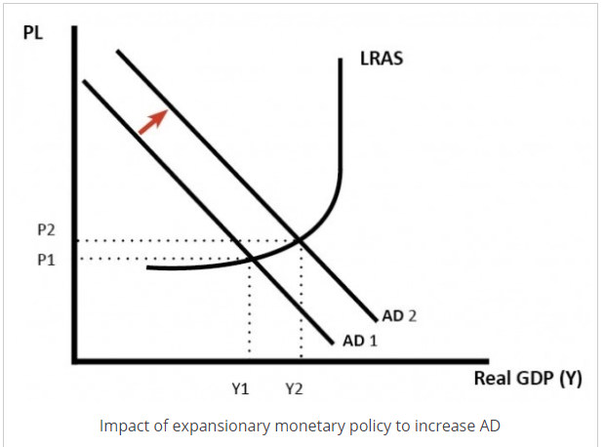
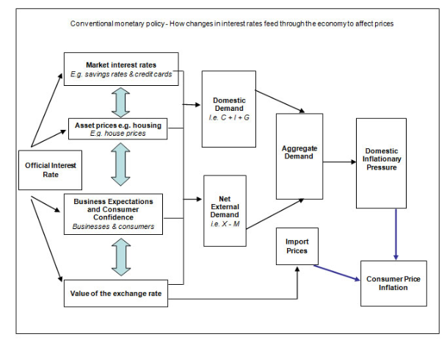
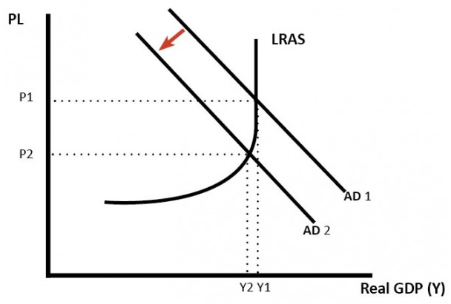
How Monetary Policy works.
Impact of Contractionary Monetary policy.

Slide 38
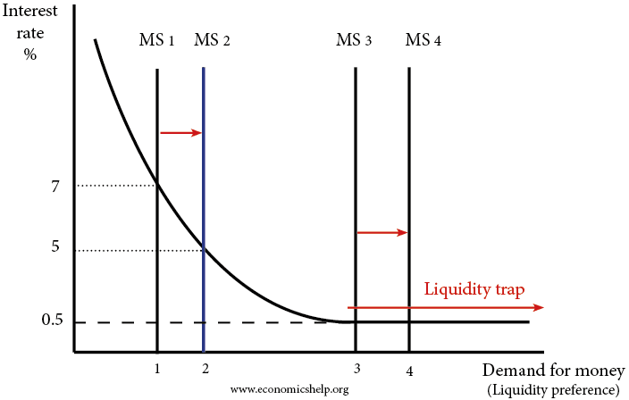

MONETARY POLICY & THE MULTIPLIER
An important implication of marginal propensity to save is measurement of the multiplier. A multiplier measures the magnified change in aggregate product i.e. the gross domestic product, resulting from a change in an autonomous variable (for example, government expenditure, investment expenditures, etc.). Multiplier (k) = 1 / MPS = 1 / (1-MPC) The effect of a change in production creates a multiplied impact because it creates income which further creates consumption. Therefore, interest rate changes may influence the MPS & thereby the potential impact of the multiplier.
LIQUIDITY PREFERENCE SCHEDULE
Is the demand for money, which is downward sloping because the higher the rate of interest, the more households & firms will wish to hold non-money assets
THREE TYPES OF DEMAND FOR MONEY
1. TRANSACTIONS DEMAND FOR MONEY | Where money is used for everyday purchases.
2. PRECAUTIONARY DEMAND FOR MONEY | Where money is used to pay for unexpected events.
3. SPECULATIVE DEMAND FOR MONEY. | Where money is used to buy government bonds.
MONEY MULTIPLIER
Refers to how an initial deposit can lead to a bigger final increase in the total money supply. For example, if the commercial banks gain deposits of £1 million and this leads to a final money supply of £10 million. The money multiplier is 10. The money multiplier is a key element of the fractional banking system. There is an initial increase in bank deposits (monetary base) The bank holds a fraction of this deposit in reserves and then lends out the rest. This bank loan will, in turn, be re-deposited in banks allowing a further increase in bank lending and a further increase in the money supply. The Reserve Ratio The reserve ratio is the % of deposits that banks keep in liquid reserves. For example 10% or 20% Formula for money multiplier In theory, we can predict the size of the money multiplier by knowing the reserve ratio. If you had a reserve ratio of 5%. You would expect a money multiplier of 1/0.05 = 20 This is because if you have deposits of £1 million and a reserve ratio of 5%. You can effectively lend out £20 million.
THE LIQUIDITY TRAP
A situation at relatively low rates of interest when changes in the money supply will have no effect on the rate of interest & where the demand for money is perfectly elastic.
REASONS FOR LOW INTEREST ELASTICITY OF DEMAND
OTHER FACTORS AFFECT INVESTMENT | A fall in interest rates in theory makes some capital investment projects profitable “at the margin” but interest rates are not the only factor affecting the willingness and ability of businesses to go ahead with planned investment projects
REDUCED BUSINESS CONFIDENCE | Changes in business confidence (animal spirits) can have a powerful effect on planned investment – for example, a deterioration of sentiment causes an inward shift in the investment demand curve

Slide 39
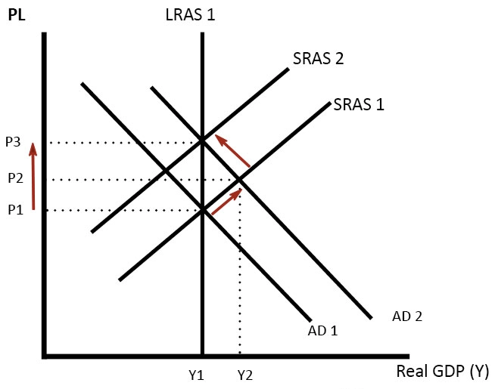
QUANTITY THEORY OF MONEY
Shows the relationship between the money supply, the general level of prices & the level of output in an economy. It is based on the equation of exchange, that increases in the money supply, M, will lead to increases in the price level, P.
EQUATION OF EXCHANGE (The Fisher Equation) | Distinguishes between the real & the money side of the economy. MV ≡ PT M is the total amount of money in the economy (the money supply). V is the velocity of circulation of money. P is the average price of each transaction made in the economy. T is the total number of transactions made over a period. T is difficult to measure so it is often substituted for Y = National Income MV = PY where Y = national output The above equation must hold the value of expenditure on goods and services must equal the value of output.
EXAMPLE | If M = £100 where it has changed hands 4 times (V) over a period of time. Thus M X V = £400. If P (avg. price) is £2 there will have been 200 separate transactions (T) over the period.
WHY MONEY SUPPLY LEADS TO INFALTION | According to monetarists, in the short term, V is fixed. Due to V being determined by institutional factors such as regularity of pay days. They also believe that Y is fixed in the short run (remember the vertical, inelastic LRAS curve). Consequently, increasing the money supply will lead to inflation.
OTHER POINTS | Milton Friedman predicted an increase in the money supply would take about 9-12 months to lead to higher output. Friedman placed great emphasis on the role of price expectations. If there are expectations of higher inflation, it becomes self-fulfilling – workers demand higher wages to meet rising living costs. Firms put up prices to meet rising costs. Strict monetarist policies would help reduce expectations. After another year output will return to its initial equilibrium causing prices to rise to accommodate the rise in money supply
FRIEDMAN’S K-PERCENT RULE | Milton Friedman argued that the money supply should rise by a fixed k-percent each year. This rate of increase should depend on institutional factors and be determined independently of policymakers. Friedman believed this rule would avoid the extremes of deflation (Falling money supply, e.g. Great Depression) and inflation due to rising money supply. It would give business strong expectations of what would happen to money supply and inflation.
DIAGRAM ANALYSIS | Following a rise in the Money Supply, consumers have more money and therefore spend more money on goods; this shifts AD to the right. AD1 to AD 2. Firms respond by increasing output along SRAS. Real output increases from Y1 to Y2. National output now exceeds the equilibrium level of output. Therefore there is an inflationary gap. Firms need to hire more workers, so wages rise leading to an increase in costs and hence prices. Initially, workers agree to work more hours because they see an increase in nominal wages. As prices rise money can buy less, therefore, there is a movement to the left along the new AD. Also, workers realise the increase in nominal wage is not a real wage increase. Therefore, workers also demand higher nominal wages to produce more output and to compensate them for rising prices, therefore SRAS shifts to the left. The economy has returned to the equilibrium level of output (Y1), but at a higher price level (P3). Therefore the rise in the Money Supply cause a rise in AD, But because the LRAS is inelastic there is no increase in real output, but inflation rises. It is a form of demand-pull inflation.
MILTON FRIEDMAN | “Inflation is always & everywhere a monetary phenomenon”.

Slide 40
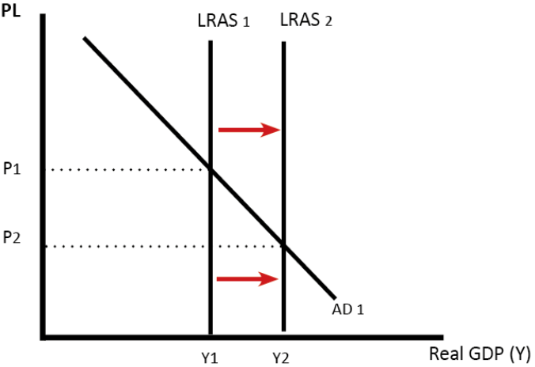
MONETARY POLICY CRITICISMS
Some limitations of monetary policy include: Liquidity Trap – This occurs when a cut in interest rates fail to stimulate economic activity. e.g. because of low confidence or banks don’t want to pass base rate cut onto consumers. Difficult to control many objectives with one tool – interest rates. For example, a rise in oil prices causes cost-push inflation and lower growth. The Bank could increase interest rates to reduce inflation, but, it would cause economic growth to fall as well. In 2009, inflation rose to rising oil prices, but the economy was also in recession; the Bank decided to ‘allow’ the temporary inflation and concentrate on economic recovery. Changing interest rates affects the exchange rate. Tight monetary policy causes an appreciation in the exchange rate which will make exports less competitive. Interest rates may affect some parts of the economy more than others. e.g. higher interest rates increase the disposable income of people with savings. But, could cause homeowners to be unable to afford their mortgages. Time lags – If the Bank of England change base rates, it can take up to 18 months for the effects to filter through the economy. For example, if people have a two-year fixed mortgage, they will not notice until they re-mortgage. This means the Bank needs to predict future inflation so that they can change interest rates in anticipation.
INTENDED IMPACT OF SUPPLY SIDE POLICIES

Slide 41
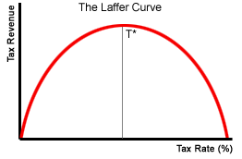
3.2.4. MACROECONOMIC POLICY cont’d
3.2.4.2. FISCAL POLICY
DEFINITION | The manipulation of government spending, taxation & borrowing to influence aggregate demand & provide public goods. It can also influence Aggregate Supply by changing the incentives to work. Stimulate economic growth in a period of a recession. Keep inflation low (UK government has a target of 2%) Fiscal policy aims to stabilise economic growth, avoiding a boom and bust economic cycle.
FISCAL BUDGET | A statement of the spending & income plans of an individual, firm or government.
BUDEGT SURPLUS | Arises due to spending being less than tax receipts.
BUDGET DEFICIT | Arises due to spending being greater than tax receipts.
NATIONAL DEBT | Accumulated budget deficits amounting to a nation’s debt.
PUBLIC SECTOR BORROWING REQUIREMENT | Where the government runs a budget deficit it will be financed by the PSBR. It will sell national savings certificates and securities such as gilts or treasury bills and bonds.
DEMAND MANAGEMENT | Government use of fiscal & other policies to manipulate the level of aggregate demand.
EXPANSIONARY FISCAL POLICY | Increased government spending & decreased taxation to increase aggregate demand via G, I & C. While T is reduced. This helps combat a NEGATIVE OUTPUT GAP.
CONTRACTIONARY FISCAL POLICY | Decreased government spending & increased taxation to decrease aggregate demand due to potential overheating or a positive output gap.
FISCAL AUSTERITY | Reduced government spending & increased taxation to correct a persistent budget deficit. (Often used together with expansionary monetary policy).
TYPES OF GOVERNMENT EXPENDITURE | Current expenditure – expenditure on goods & services to directly satisfy individual or collective needs. Capital expenditure – Government spending to generate future benefits through infrastructure investment & research spending Transfer payments – This represents transfers on money through welfare & pension payments.
LAFFER CURVE | Increasing taxes from a low level will mean tax revenues will increase. However, beyond a given point, tax increases will lead to falling tax receipts, as people have less incentive to work.
DIRECT TAXATION | Taxation placed directly upon incomes & company profits e.g. National Insurance, income tax & corporation tax.
INDIRECT TAXATION | Taxation placed upon goods & services e.g. VAT, Sin taxes.
REGRESSIVE TAXATION | Where the tax rate decreases as the amount subject to taxation rises. Indirect taxes represent regressive taxation due to the fact that poorer people will lose more of their disposable income to such charges.
CROWDING OUT | Government spending may fail to increase overall aggregate demand because higher government spending causes an equivalent fall in private sector spending and investment. This can be due to the opportunity cost of finance being used by the government rather than the private sector.
CROWDING IN | Where private sector investment increases in response to changes in government spending. E.g. with austerity, it is often cited that this may improve private sector incentives or frees capital for private sector investment.
AUTOMATIC FISCAL STABILISERS | When the economy grows tax revenues will increase from direct taxation and indirect taxation as people & firms earn more & consume more. This helps to dampen demand. While welfare benefits will be lower. The Opposite happens in a recession.
MARGINAL RATE OF TAXATION | The amount of tax paid on an additional £ of income
AVERAGE RATE OF TAXATION | Percentage of total income deducted for taxation.
FISCAL POLICY & the MULTIPLIER | Increasing Government spending can be particularly beneficial when the multiplier is high. When low government spending will have less impact on AD.

Slide 42
RECENT UK FISCAL POLICY (FISCAL AUSTERITY)
Cutting government spending when economic growth is relatively weak. It is a contractionary or deflationary policy which may lead to lower rates of GDP growth & higher unemployment.
ARGUMENTS IN FAVOUR OF AUSTERITY | That budget deficits are too high & the country’s national debt is increasing. At its peak, the UK budget deficit amounted to 10% of GDP. That borrowing costs (bond yields) to finance the deficit will rise. This can prompt a fiscal crisis. That continued fiscal deficits increase the debt burden upon the unborn & those who are too young to vote and that the government should not be spending money it does not have. That government expenditure CROWDS OUT private sector investment, due to less profitable opportunities for capital expansion & higher borrowing costs. Thus, austerity may CROWD IN private sector investment.
ARGUMENTS AGAINST | Liquidity trap – austerity has been complemented by a programme of expansionary monetary policy. A situation at relatively low rates of interest when changes in the money supply will have no effect on the rate of interest & where the demand for money is perfectly elastic. A recession is not time for austerity. The Keynesian argument poses that the government should increase spending during a recession. Yet Keynes suggested that they should run a budget surplus when the economy is growing. It causes an Internal devaluation where wages & domestic prices must correct downwards. Yet this is painful & takes a long time – e.g. Greece. Austerity can be self defeating, due to lower GDP growth reducing fiscal tax revenues & the existence of fiscal stabilisers.
EVALUATION | If the fiscal multiplier is small, then increased government spending would be less effective. Debt as a percentage of GDP – the deficit may shrink while debt as a % of GDP may increase as seen in the UK. The need to run a fiscal surplus when times are good was advocated by Keynes & Monetarists.
CODE FOR FISCAL STABILITY (GOLDEN RULE)
The Golden Rule states that over the economic cycle, the government will borrow only to invest & not to fund current spending. The key reason for the Golden Rule is to avoid the government increasing spending which crowds out investment as borrowing costs rise and a higher rate of return is necessary to make the investment profitable.
THE SUSTAINABLE INVESTMENT RULE
The Sustainable Investment rule states that public sector net debt as a proportion of GDP will be held over the economic cycle at a stable & prudent level. This ‘rule’ is however merely a stated aim with no sanctions against the incumbent government if broken, unlike some balanced budget provisions used in other countries.
DISCRETIONARY FISCAL POLICY
Discretionary fiscal policy is when the government makes changes to tax rates (e.g. cutting rate of VAT). This is opposed to automatic fiscal stabilisers. For example, where in a recession a government automatically spends more because there are more claiming unemployment benefits.
RECENT UK MONETARY POLICY
Loose monetary policy with base rates reduced to 0.5% in 2009. Quantitative easing undertaken in 2016 of £70b.
IMPACT ON EXCHANGE RATE
This has caused the £ exchange rate to depreciate.
FACTORS OUTSIDE OF THE UK GOVERNMENT CONTROL
The global economy and its health Commodity prices such as oil Global financial markets The Federal Reserve & its monetary policy decisions The EU BREXIT Negotiation of trading agreements The EU MNCs Rise of China OBOR.

Slide 43
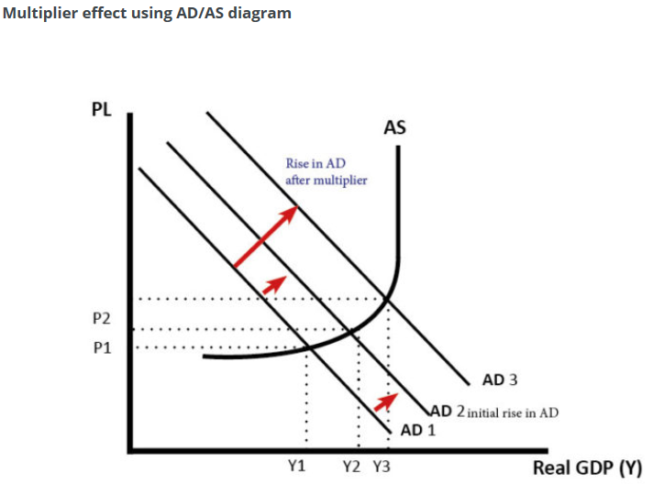
FISCAL POLICY – STRANDS OF EVALUATION
FISCAL POLICY & INCENTIVES | How different taxes affect different people in varying ways – e.g. with varying tax rates it possibly acts as an incentive for some and a disincentive for others. • Does the benefit depend upon the state of the economy? If there are no jobs available, benefits can hardly act as a disincentive to work. • Is it not the way in which tax revenue is raised that is all important? For example, a tax on expenditure would hardly act as a disincentive to work.
FISCAL POLICY & ITS ABILITY TO IMPROVE INEQUALITY | The extent to which reduction of the inequality of income is still a macroeconomic objective. • Whether fiscal policy is the only way that inequality can be reduced. Are there supply-side alternatives? Might industrial policy help? • The degree to which fiscal policy will be successful in tackling inequality depends upon correctly identifying the causes of inequality. • Reasons why making the tax and benefit system more progressive may not have as large an effect on inequality as expected. • Contextualising this within the context of the UK’s recent economic history – the extent to which this might have been tackled in the 16 years of unbroken growth and the extent to which this is unlikely to happen in the near future with the public finances in their current state.
GENERAL POINTS | It depends on the size of the multiplier. If the multiplier effect is large, then changes in government spending will have a bigger effect on overall demand. It depends on the state of the economy. Fiscal policy is most effective in a deep recession where monetary policy is insufficient to boost demand. In a deep recession (liquidity trap). Higher government spending will not cause crowding out because the private sector saving has increased substantially. See: Liquidity trap and fiscal policy – why fiscal policy is more important during a liquidity trap. It depends on other factors in the economy. For example, if the government pursue expansionary fiscal policy, but interest rates rise, and the global economy is in a recession, it may be insufficient to boost demand. Bond yields. If there is concern over the state of government finances, the government may not be able to borrow to finance fiscal policy. Countries in the Eurozone experienced this problem in the 2008-13 recession.
FISCAL POLICY CRITICISMS
The government may have poor information about the state of the economy and struggle to have the best information about what the economy needs. Time lags. To increase government spending will take time. It could take several months for a government decision to filter through into the economy and actually affect AD. By then it may be too late. Crowding out. Some economists argue that expansionary fiscal policy (higher government spending) will not increase AD because the higher government spending will crowd out the private sector. This is because the government have to borrow from the private sector who will then have lower funds for private investment. Government spending is inefficient. Free market economists argue that higher government spending will tend to be wasted on inefficient spending projects. Also, it can then be difficult to reduce spending in the future because interest groups put political pressure on maintaining stimulus spending as permanent. Higher borrowing costs. Under certain conditions, expansionary fiscal policy can lead to higher bond yields, increasing the cost of debt repayments.

Slide 44
3.2.4.3. SUPPLY SIDE POLICIES
How changes in the aggregate supply will affect variables such as national income; in particular, how government micro-economic policy might change aggregate supply through individual markets.
CAPITAL MARKET SUPPLY SIDE POLICIES | Corporation tax cut Improving access to finance
LABOUR MARKET SUPPLY SIDE POLICIES | Lower benefits Lower minimum wages Reduce Trade Union power Income tax cut – reduced marginal tax rates Improving occupational & geographical mobility of labour Promoting education, training & apprenticeships
GOODS MARKET SUPPLY SIDE POLICIES | Privatisation Deregulation Trade liberalisation Promoting entrepreneurship
INTERVENTIONIST SUPPLY SIDE POLICIES | Government expenditure on education & training Government expenditure on infrastructure Subsidies to firms for R&D.
DESIRED IMPACT OF SUPPLY SIDE POLICIES | The economy’s trend rate of growth may well increase. Reduced price level (lower inflation) Increased economic growth Increased innovation, productivity & Total Factor Productivity growth Improved international competitiveness
EVALUATION | Issues of opportunity cost, government failure and distributional issues as they relate to specific policies. Consideration of the fiscal deficit/ current pursuit of fiscal austerity. The time frame involved – policies to tackle unemployment may take a considerable period of time to have an effect. Whether or not the market will eventually improve the situation Whether the government might not want to reduce unemployment below a particular level because of other macroeconomic objectives. Supply side policies are often very expensive.

