Slide 1
4. AQA A LEVEL ECONOMICS

Slide 2
Contents
4.1.1-8 Microeconomics
4.2.1-6 Microeconomics
Unit | Page
4.1.1 Individuals, firms, markets & market failure | 3-4
4.1.2 Individual economic decision making | 5-6
4.1.3 Price determination in a competitive market | 7-11
4.1.4 Production, costs and revenue | 12-14
4.1.5 Perfect competition, imperfectly competitive markets & monopoly | 15-21
4.1.6 The labour market | 22-27
4.1.7 the distribution of income & wealth: poverty & inequality | 28-29
4.18 the market mechanism, market failure & government intervention in markets | 30-34
Unit | Page
4.2.1 the national & international economy | 35-36
4.2.2 AD AS analysis | 37-41
4.2.3 economic performance | 42-47
4.2.4 financial markets & monetary policy | 48-53
4.2.5 fiscal policy & supply-side policies | 54-56
4.2.6 globalisation | 57-68

Slide 3
4.1. INDIVIDUALS, FIRMS, MARKETS & MARKET FAILURE
4.1.1. ECONOMIC METHODOLOGY & THE ECONOMIC PROBLEM
4.1.1.1 ECONOMIC METHODOLOGY
WHY IS ECONOMICS A SOCIAL SCIENCE? | It uses scientific methods to build theories that can help explain the behaviour of individuals, groups and organisations. Economics attempts to explain economic behaviour, which arises when scarce resources are exchanged.
WHAT ABOUT EMPIRICAL EVIDENCE? | Economic theory is to be judged by its predictive power supported by empirical regularity. Only factual or empirical evidence can make a theory go from a “meaningless” hypotheses to part of man's accumulated knowledge.
SIMILARITIES TO NATURAL SCIENCES | Economics shares the combination of qualitative and quantitative elements common to all social sciences.
DIFFERENCES TO NATURAL SCIENCES | Some critics of the field argue that economics falls short of the definition of a science for a number of reasons, including a lack of testable hypotheses, lack of consensus, and inherent political overtones. Despite these arguments,
POSITIVE ECONOMIC STATEMENTS | Objective and fact-based where the statements are precise, descriptive, and clearly measurable. E.g. GDP rose by 2.5% in 2021.
NORMATIVE ECONOMIC STATEMENTS | These are opinions or value judgements which are not based on real economic data.
USE OF VALUE JUDGEMENTS IN ECONOMICS | Economists often demonstrate a lack of consensus and inherent political overtones.
THE INFLUENCE ON PEOPLE’S MORAL & POLITICAL JUDGEMENTS | The first rule of economics is scarcity. The first rule of politics is to ignore the first rule of economics. As such politics has a profound impact upon economic policy.
4.1.1.3. ECONOMIC RESOURCES
FACTORS OF PRODUCTION | These are the key economic resources of Land, labour, capital, enterprise.
LAND | Land includes all natural physical resources. Some nations are richly endowed with natural resources and then specialise in the their extraction and production. Other countries such as Japan are heavily reliant on importing these resources.
LABOUR | Labour is the human input into production e.g. the supply of workers available and their productivity. An increase in the size and the quality of the labour force is vital if a country wants to achieve growth. In recent years the issue of the migration of labour has become important. Can migrant workers help to solve labour shortages? What are the long-term effects on the countries who suffer a drain or loss of workers through migration?
CAPITAL | CAPITAL GOODS are used to produce other consumer goods and services in the future Fixed capital includes machinery, equipment, new technology, factories and other buildings New items of capital machinery or technology are used to boost the productivity of labour.
ENTERPRISE | Regarded by some as a specialised form of labour input An entrepreneur is an individual who supplies products to a market to make a profit Entrepreneurs will usually invest their own financial capital in a business and take on the risks. Their main reward is the profit made from running the business.
4.1.1.4 SCARCITY, CHOICE & THE ALLOCATION OF RESOURCES
FUNDAMENTAL ECONOMIC PROBLEM | Limited resources and unlimited wants.
SCARCITY & CHOICE | Choices must be made about how scarce resources are allocated between different uses.
CHOICES & OPPORTUNITY COST | Choices have an opportunity cost.
OPPORTUNITY COST | The next best alternative foregone.
4.1.1.2 THE NATURE & PURPOSE OF ECONOMIC ACTIVITY
THE CENTRAL PURPOSE | The production of goods & services to satisfy needs and wants
KEY ECONOMIC DECISIONS | What to produce? How to produce? Who is to benefit?
Activities
Research to find an example of a competitive market which benefits the consumer.
Are there any markets where consumers suffer from competition?
Which markets in the UK are not competitive? Why might this be the case?
Ext. Do you think markets should be more open or command style?

Slide 4
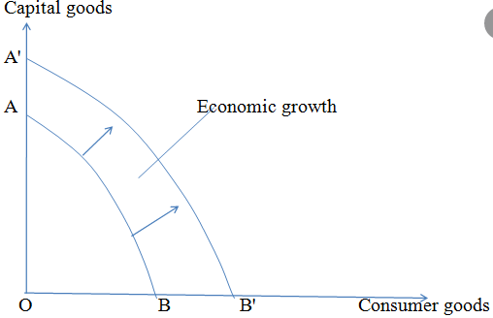
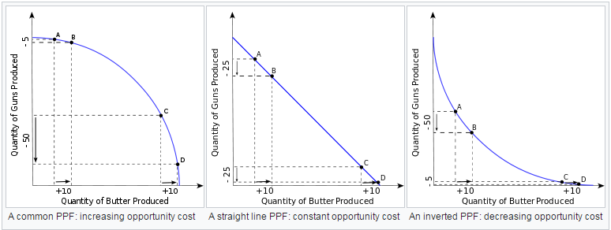
4.1.1.5. PRODUCTION POSSIBILITY DIAGRAMS
PRODUCTION POSSIBILITY DIAGRAMS | Illustrates the possible combinations of two goods that can be produced with existing resources, such that more of one good could be produced only by diverting resources from the other good, resulting in less production of it.
Why does it slope downwards? | Because resources are LIMITED.
Why does it bow outwards? | This is due to the fact that some resources will be better suited to the production of good X & some good Y. eg. Guns & butter. DECREASING RETURNS TO SCALE.
Why is it a straight line? | Because resources are equally well-suited to the production of both goods X & Y. CONSTANT RETURNS TO SCALE
Why does it bow inwards? | Because resources are focused upon SPECIALISATION which generates ECONOMIES OF SCALE. Or INCREASING RETURNS TO SCALE.
How does it illustrate efficiency? | Any point achieved on the PPC is PRODUCTIVELY EFFICIENT. Yet not all points are allocatively efficient as this is determined by supply & demand.
SPECIALISATION & DIVISION OF LABOUR
ADVANTAGES | Will lead to an increase in labour productivity and firms will be able to benefit from ECONOMIES OF SCALE (lower average costs with increased output) and increased efficiency.
DISADVANTAGE | However, workers do specific tasks which may become boring and their productivity may fall as a result. High levels of specialisation could lead to possible DISCECONOMIES OF SCALE.
Activities
Draw a
Ext. Do you think markets should be more open or command style?

Slide 5
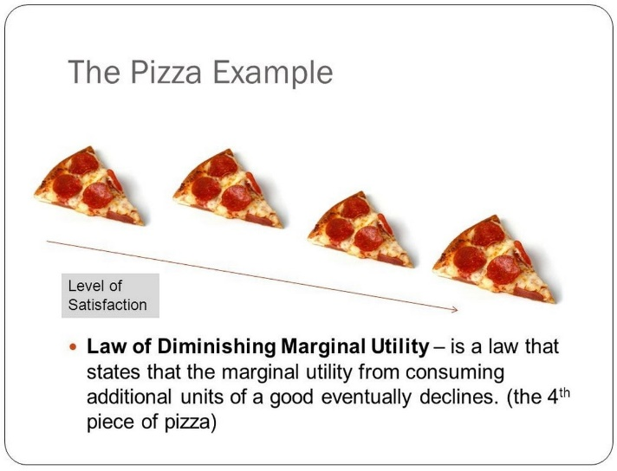
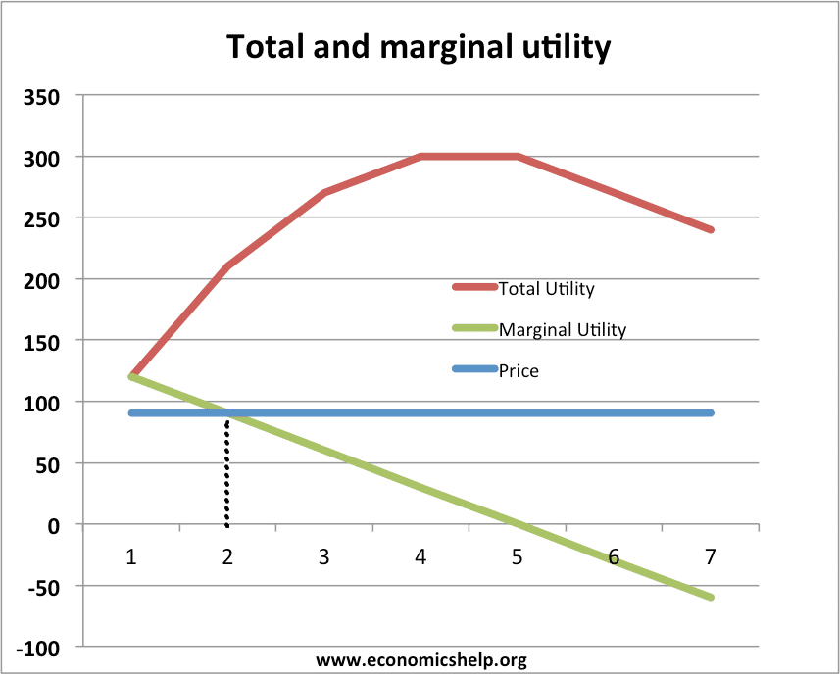
4.1.2. INDIVIDUAL ECONOMIC DECISION MAKING
4.1.2.1 CONSUMER BEHAVIOUR
RATIONAL ECONOMIC DECISION MAKING | The cornerstone of rational choice theory, a theory of economics that assumes that individuals always make decisions that provide them with the highest amount of personal utility. These decisions provide people with the greatest benefit or satisfaction given the choices available.
ECONOMIC INCENTIVES | For competitive markets to work efficiently economic agents (i.e. consumers and producers) must respond to price signals in the market. What is an incentive? It is something that motivates or encourages someone to do something, engage in a particular course of action.
UTILITY THEORY | Explain behaviour of individuals based on the premise people can consistently rank order their choices depending upon their preferences.
TOTAL UTILITY | The aggregate amount of satisfaction or fulfilment that a consumer receives through the consumption of a specific good or service.
MARGINAL UTILITY | The added satisfaction a consumer gets from having one more unit of a good or service. The concept of marginal utility is used by economists to determine how much of an item consumers are willing to purchase.
THE LAW OF DIMINISHING MARGINAL UTILITY | The Law Of Diminishing Marginal Utility states that all else equal as consumption increases the marginal utility derived from each additional unit declines.
UTILITY MAXIMISATION | Utility maximisation refers to the concept that individuals and firms seek to get the highest satisfaction from their economic decisions.
IMPORTANCE OF THE MARGIN WHEN MAKING CHOICES | It refers to the effects of consuming and/or producing one extra unit of a good or service. Marginal benefit – is the change in total private benefit from one extra unit. Marginal cost – is the change in total private cost from one extra unit
4.1.2.3. ASPECTS OF BEHAVIOURAL ECONOMIC THEORY
BOUNDED RATIONALITY | A human decision-making process in which we attempt to satisfice, rather than optimize. In other words, we seek a decision that will be good enough, rather than the best possible decision.
BOUNDED SELF CONTROL | Consumers know when the price of a good/service exceeds the marginal utility they gain from consuming that good/service – in this rational world of homo economicus, consumers stop consuming.
BIASES: RULES OF THUMB, ANCHORING, AVAILABILITY & SOCIAL NORMS | Rules of Thumb: an approximate method for doing something, based on practical experience rather than theory. Anchoring: describes the subconscious use of irrelevant information, such as the purchase price of a security, as a fixed reference point (or anchor) for making subsequent decisions about that security. Availability: is a mental shortcut that relies on immediate examples that come to a given person's mind when evaluating a specific topic, concept, method or decision. Social norms: signal appropriate behaviour and are classed as behavioral expectations or rules within a group of people
IMPORTANCE OF ALTRUISM & PERCEPTIONS OF FAIRNESS | Behaviour is normally described as altruistic when it is motivated by a desire to benefit someone other than oneself for that person's sake. Perceptions of fairness refer to any element of the environment perceived by individuals or collectives as fair according to previous norms or standards.
4.1.1.2. IMPERFECT INFORMATION
IMPORTANCE OF INFORMATION FOR DECISION MAKING | With perfect information in a market, all consumers and producers have perfect and instantaneous knowledge of all market prices, their own utility, and own cost functions.
ASSYMMETRIC INFORMATION | Occurs when somebody knows more than somebody else in the market. This may lead to under-provision or under consumption of merit goods and over-provision of

Slide 6
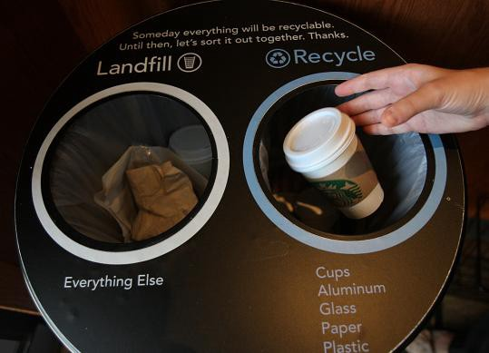

4.1.2.4 BEHAVIOURAL ECONOMICS & ECONOMIC POLICY
CHOICE ARCHITECTURE | A method to retain consumer sovereignty (the right to choose) but nudging consumers to make certain choices.
FRAMING | A cognitive bias where people decide on options based on whether the options are presented with positive or negative connotations; e.g. as a loss or as a gain. People tend to avoid risk when a positive frame is presented but seek risks when a negative frame is presented.
NUDGE THEORY | A concept in behavioural economics, political theory, and behavioural sciences that proposes positive reinforcement and indirect suggestions as ways to influence the behaviour and decision-making of groups or individuals.
DEFAULT CHOICE | The default choice or default option is the option that a consumer “selects” if he or she does nothing. Studies have shown that consumers rarely change the default settings. Strong default choices can make demand price inelastic (PED<1)
RESTRICTED CHOICE | The existence of bounded rationality, consumers can find it really difficult to make effective decisions when the number of choices or options is large; this may result in them failing to make any decision. Therefore, restricting the number of available choices may be more likely to cause consumers to act and actually make a decision, resulting in a more efficient outcome.
MANDATED CHOICE | A situation or scenario in which people must decide in advance to whether they wish to participate in a particular action – they are required by law to make that choice.

Slide 7
4.1.3. PRICE DETERMINATION IN A COMPETITIVE MARKET
4.1.3. PRICE DETERMINATION IN A COMPETITIVE MARKET
4.1.2.1 CONSUMER BEHAVIOUR
RATIONAL ECONOMIC DECISION MAKING | The cornerstone of rational choice theory, a theory of economics that assumes that individuals always make decisions that provide them with the highest amount of personal utility. These decisions provide people with the greatest benefit or satisfaction given the choices available.
ECONOMIC INCENTIVES | For competitive markets to work efficiently economic agents (i.e. consumers and producers) must respond to price signals in the market. What is an incentive? It is something that motivates or encourages someone to do something, engage in a particular course of action.
UTILITY THEORY | Explain behaviour of individuals based on the premise people can consistently rank order their choices depending upon their preferences.
TOTAL UTILITY | The aggregate amount of satisfaction or fulfilment that a consumer receives through the consumption of a specific good or service.
MARGINAL UTILITY | The added satisfaction a consumer gets from having one more unit of a good or service. The concept of marginal utility is used by economists to determine how much of an item consumers are willing to purchase.
THE LAW OF DIMINISHING MARGINAL UTILITY | The Law Of Diminishing Marginal Utility states that all else equal as consumption increases the marginal utility derived from each additional unit declines.
UTILITY MAXIMISATION | Utility maximisation refers to the concept that individuals and firms seek to get the highest satisfaction from their economic decisions.
IMPORTANCE OF THE MARGIN WHEN MAKING CHOICES | It refers to the effects of consuming and/or producing one extra unit of a good or service. Marginal benefit – is the change in total private benefit from one extra unit. Marginal cost – is the change in total private cost from one extra unit
4.1.3.1. THE DETERMINANTS OF THE DEMAND FOR GOODS & SERVICES
EFFECTIVE DEMAND | The level of demand that represents a real intention to purchase by people with the means to pay.
JOINT DEMAND | When the demand for one product is directly and positively related to market demand for a related good or service. e.g. with 2 complements.
COMPOSITE DEMAND | When goods or services have more than one use so that an increase in the demand for one product leads to a fall in supply of the other.
FACTORS DERTERMINING DEMAND | Price Income Tastes & Trends Expectations Complementary goods
THE DEMAND CURVE | a graphical representation of the relationship between the price of a good or service and the quantity demanded for a given period of time.
FACTORS THAT CAN SHIFT DEMAND | W - Weather I – Income & Interest rates F - Fashion C – Complementary goods & Credit A – Advertising (Promotion) PS – Price of Substitutes
THE NATURE & PURPOSE OF ECONOMIC ACTIVITY
THE CENTRAL PURPOSE | The production of goods & services to satisfy needs and wants
KEY ECONOMIC DECISIONS | What to produce? How to produce? Who is to benefit?
4.1.1.2. IMPERFECT INFORMATION
IMPORTANCE OF INFORMATION FOR DECISION MAKING | With perfect information in a market, all consumers and producers have perfect and instantaneous knowledge of all market prices, their own utility, and own cost functions.
ASSYMMETRIC INFORMATION | Occurs when somebody knows more than somebody else in the market. This may lead to under-provision or under consumption of merit goods and over-provision of

Slide 8
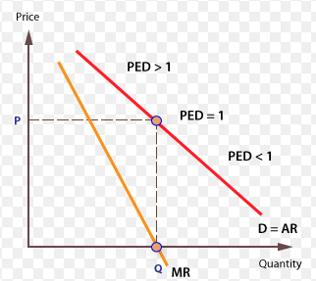
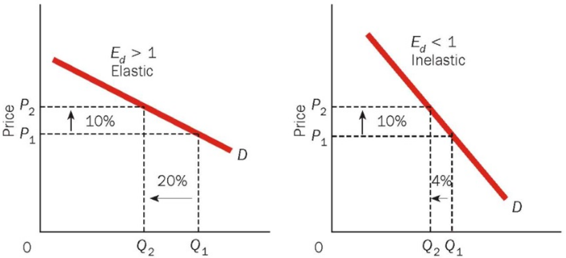
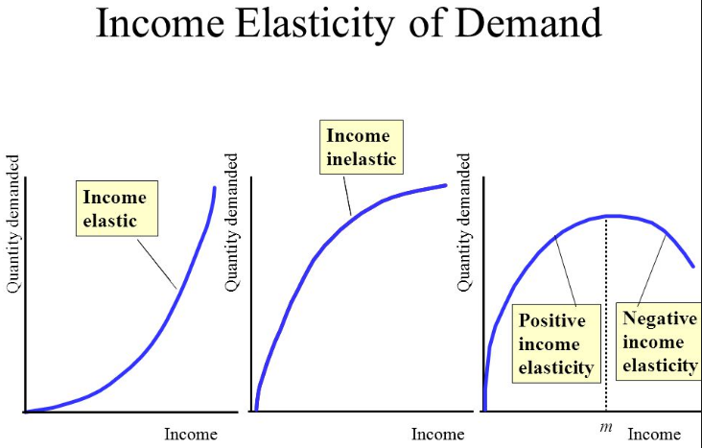
4.1.3.2. PRICE ELASTICITY OF DEMAND (PED)
Measures the responsiveness of demand following a change in price. INVERSE relationship means NEGATIVE PED. Measured by the % change in QD / % change in price.
CO EFFICIENT VALUES | > -1 means price elastic (sensitive). A small change in price causes a large change in QD. 0 to -1 means price inelastic (insensitive). A change in prices causes a smaller impact on QD.
IMPACT ON DEMAND | PRICE CHANGES CAUSE A MOVEMENT ALONG THE DEMAND CURVE
DETERMINANTS OF PED - SPLAT | The number of close substitutes for a good The % of a consumer's income allocated to spending on the good The degree of necessity or whether the good is a luxury Whether the good is addictive The time period allowed following a price change Peak and off-peak demand The cost of switching between products.
BUSINESS USE OF PED | The effect of a change in price on the total revenue & expenditure on a product The effect of a change in an indirect tax (e.g VAT, fuel or other duties) on price and quantity demanded and also whether the business is able to pass on some or all of the tax onto the consumer. Information on the PED can be used by a business as part of a policy of price discrimination. This is where a business decides to charge different prices for the same product to different segments of the market e.g. peak and off peak rail travel. To estimate the impact of price discounts on given products
4.1.3.2. INCOME ELASTICITY OF DEMAND (YED)
Measures the responsiveness of demand following a change in income. Measured by the % change in QD / % change in income.
CO EFFICIENT VALUES | POSITIVE YED represents NORMAL GOODS. E.g. Branded consumer goods. So as consumers' income rises more is demanded at each price i.e. there is an outward shift of the demand curve NEGATIVE YED represents INFERIOR GOODS. Here, demand falls as income rises. E.g. Value brand products. A YED value between 0 & +1 is likely to mean necessity products e.g. fuel.
IMPACT ON DEMAND | An increase or decrease in income will lead to A SHIFT IN DEMAND
LUXURY GOODS & YED | The income elasticity of demand is usually strongly positive for luxury goods such as Fine wines and spirits, high quality chocolates and luxury holidays overseas. Sports cars, Consumer durables - audio visual equipment, smart-phones Sports and leisure facilities (including gym membership and exclusive sports clubs).
NESCESSITY GOODS & YED | In contrast, income elasticity of demand is lower for Staple food products such as bread, vegetables and frozen foods, Mass transport (bus and rail), Beer and takeaway pizza!
INFERIOR GOODS | Income elasticity of demand is negative (inferior) for cigarettes and urban bus services.
BUSINESS USE OF YED | Helps firms predict the effect of an economic cycle on sales. Luxury products with high income elasticity see greater sales volatility over the business cycle than necessities where demand from consumers is less sensitive to changes in the cycle. They could also choose to locate in areas of high or low incomes depending upon whether they sell LUXURY or INFERIOR GOODS or expand their product range to cater for a different consumer group e.g. Lidl Deluxe.

Slide 9
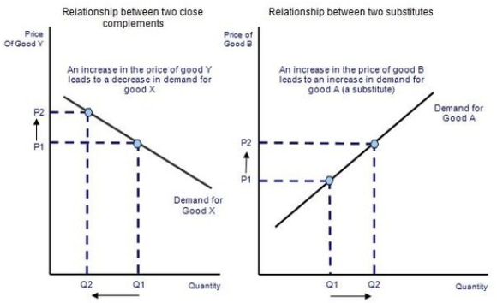
4.1.3.2. CROSS PRICE ELASTICITY OF DEMAND (XED)
Measures the responsiveness of demand for good A following a change in price of good B. Measured by the % change in QD A / % change in price B.
SUBSTITUTES & XED | POSITIVE VALUE means the products are SUBSTITUTES. If the price of one product goes up the QD of another will fall e.g. Beef & lamb. >1 means close substitutes, <1 weak substitutes.
COMPLEMENTS & XED | NEGATIVE VALUE means the products are COMPLEMENTS. If the price of one product goes up the demand for the other falls e.g. Tennis racquets & tennis balls.
IMPACT ON DEMAND | A price change of a substitute or complement will lead to a SHIFT IN DEMAND.
BUSINESS USE OF XED | When setting prices firms will have to look at what alternatives the consumer has, if there are no close substitutes they will be able to increase the price. Therefore, firms spend a lot of money on advertising to differentiate their products and reduce XED. A firm may offer a loss leader to attract complementary sales. E.g, a firm may offer a printer, at a low price, because it knows this will lead to increased sales for the highly profitable ink cartridges.
4.1.3.3. SUPPLY
SUPPLY | Output is provided by businesses in the pursuit of profits. Higher profits mean greater incentives to increase supply.
SUPPLY CURVE | A graphic representation of the correlation between the cost of a good or service and the quantity supplied for a given period.
FACTORS CAUSING A SHIFT IN SUPPLY | S - Subsidies P - Productivity Gains E - Efficiency N - Number of firms T - Technology
4.1.3.4. PRICE ELASTICITY OF SUPPLY (PES)
Measures the responsiveness of supply to a change in price. POSITIVE RELATIONSHIP = POSITIVE PES Measured by the % change in QS / % change in Price.
CO EFFICIENT VALUES | >1 Price elastic (sensitive). A small change in price causes a large change in QS. <1 means Price inelastic (insensitive). A change in prices causes a smaller impact on QS.
IMPACT ON SUPPLY CURVE | Price changes cause A MOVEMENT ALONG A SUPPLY CURVE.
DETERMINANTS OF PES | Production lag: Supply is more price elastic the longer the time period that a firm is allowed to adjust its production levels. Stocks of finished products and components: If stocks of raw materials and finished products are at a high level then a firm is able to respond to a change in demand - supply will be elastic. Conversely when stocks are low, dwindling supplies force prices higher. Spare production capacity: If there is plenty of spare capacity then a business can increase output without a rise in costs and supply will be elastic in response to a change in demand. Therefore, supply of goods and services is most elastic during a recession. The ease and cost of factor substitution/mobility: If both capital & labour are occupationally mobile then the elasticity of supply for a product is higher than if capital and labour cannot easily be switched. E.g. a printing press which can switch easily between printing magazines and greetings cards. Time lag- In some agricultural markets the momentary supply is fixed and is determined mainly by planting decisions made months before, and also climatic conditions, which affect the production yield. In contrast the supply of milk is price elastic because of a short time span from cows producing milk and products reaching the market place.
EVALUATION OF COMMERCIAL APPLICATION OF ELASTICITIES
Do firms really know their Elasticities? Who uses them effectively? Different Elasticities are of use for different firm related decisions. Elasticities vary dramatically across consumer groups/ regions/ even time of day etc. Difficult to calculate! Elasticities & rational behaviour. Irrational consumption may mean more inelastic demand.

Slide 10
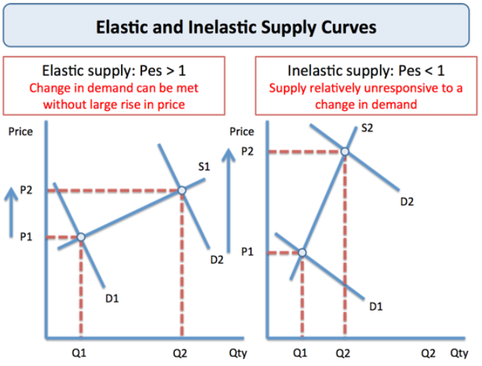
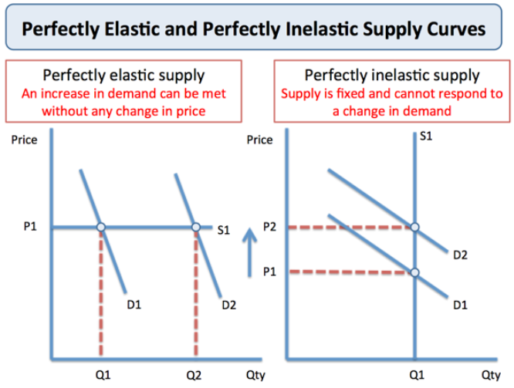

Slide 11
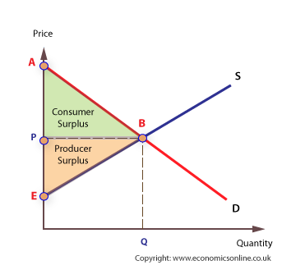
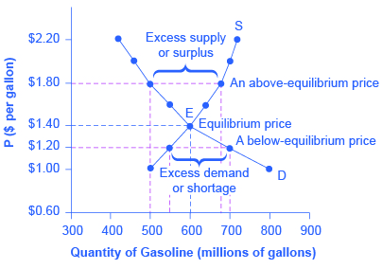
4.1.3.5. THE DETERMINATION OF EQUILIBIRUM MARKET PRICES
THE PRICE MECHANISM | The manner in which the prices of goods affect the demand & supply of goods & services. There are four functions: 1. Allocating. 2. Rationing. 3. Signalling. 4. Incentivising.
CONSUMER SURPLUS | is an economic measurement of consumer benefits. A consumer surplus happens when the price that consumers pay for a product or service is less than the price they're willing to pay.
PRODUCER SURPLUS | is the total amount that a producer benefits from producing and selling a quantity of a good at the market price. The total revenue that a producer receives from selling their goods minus the total cost of production equals the producer surplus.
MARKET EQUILIBIRUM | Economic equilibrium is a situation in which economic forces such as supply and demand are balanced and in the absence of external influences the values of economic variables will not change.
MARKET DISEQUILIBRIUM | Disequilibrium is a situation where internal and/or external forces prevent market equilibrium from being reached or cause the market to fall out of balance. This can be a short-term byproduct of a change in variable factors or a result of long-term structural imbalances.
EXCESS DEMAND | occurs when the Price of a good is lower than the Equilibrium Price, meaning more consumers will want to buy the good than suppliers are willing to sell. The difference between the Quantity Demanded (QD) and the Quantity Supplied (QS) is the Excess Demand.
EXCESS SUPPLY | an excess supply, economic surplus market surplus or briefly surply is a situation in which the quantity of a good or service supplied is more than the quantity demanded, and the price is above the equilibrium level determined by supply and demand
4.1.3.6. THE INTERRELATIONSHIP BETWEEN MARKETS
INTERDEPENDENCE | The dependence of two or more people or things on each other.
MARKETS ARE OFTEN INTERDEPENDENT | For example, the availability of timber from the lumber industry will affect the housing market.
FIRMS ARE OFTEN INTERDEPENDENT | For example, the decisions of airbus will have a direct impact upon the results of Boeing.
JOINT DEMAND | When the demand for one product is directly and positively related to market demand for a related good or service. e.g. with 2 complements.
DEMAND FOR SUBSTITUTES | Substitutes are goods where you can consume one in place of the other. The prices of complementary or substitute goods also shift the demand curve. ... When the price of a substitute good decreases, the quantity demanded for that good increases, but the demand for the good that it is being substituted for decreases.
COMPOSITE DEMAND | When goods or services have more than one use so that an increase in the demand for one product leads to a fall in supply of the other.
DERIVED DEMAND | Refers to the demand for any goods or services, which is derived from any related goods, services, or intermediate goods or services. In the case of derived demand, a market can exist for both intermediate and related goods or services.
EFFECTIVE DEMAND | The level of demand that represents a real intention to purchase by people with the means to pay.
JOINT SUPPLY | Is an economic term referring to a product or process that can yield two or more outputs. Common examples occur within the livestock industry: cows can be utilized for milk, beef, and hide.

Slide 12
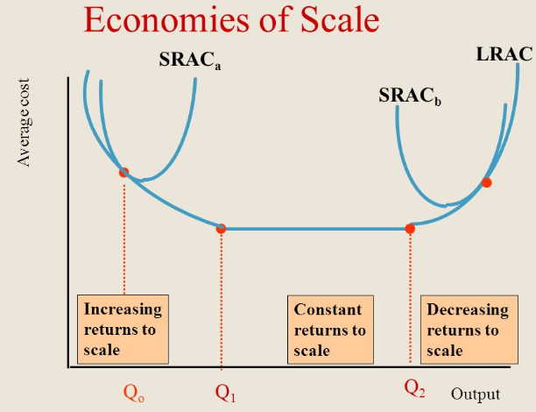
4.1.4. PRODUCTION, COSTS AND REVENUE
4.1.4.1. PRODUCTION & PRODUCTIVITY
PRODUCTION | Converting inputs, or the services of factors of production such as capital and labour into final output.
LABOUR PRODUCTIVITY | Labour productivity is concerned with the amount (volume) of output that is obtained from each employee.
4.1.4.3. THE LAW OF DIMINISHING RETURNS & RETURNS TO SCALE
LAW OF DIMINISHING MARGINAL RETURNS | At a certain point, employing an additional factor of production causes a relatively smaller increase in output.
SHORT RUN | In the short run, at least, one factor of production is fixed.
LONG RUN | In the long run all factors of production are variable.
TOTAL PRODUCT | The quantity of output produced by a given number of inputs
AVERAGE PRODUCT | The quantity of output per unit of input. Calculated by TP/ Quantity of inputs.
MARGINAL PRODUCT | The addition to the output produced by an extra unit of input. Calculated by Change in Total Product/ Change in quantity of inputs.
RETURNS TO SCALE | Explains the behavior of the rate of increase in output (production) relative to the associated increase in the inputs (the factors of production) in the long run.
INCREASING RETURNS TO SCALE | Occur when the % change in output > % change in inputs
CONSTANT RETURNS TO SCALE | Occur when the % change in output = % change in inputs
DECREASING RETURNS TO SCALE | Occur when the % change in output < % change in inputs
4.1.4.2. SPECIALISATION, DIVISION OF LABOUR & EXCHANGE
SPECIALISATION | The process of concentrating on and becoming expert in a particular subject or skill.
DIVISION OF LABOUR | The separation of tasks in any economic system or organisation so that participants may specialise
SPECIALISATION & TRADE | Specialisation requires trade. Specialisation and trade mean that countries that produce no oil can consume oil products and countries with large reserves of raw materials can export them in exchange for other goods that they need.
SPECIALISATION & DIVISION OF LABOUR
ADVANTAGES | Will lead to an increase in labour productivity and firms will be able to benefit from ECONOMIES OF SCALE (lower average costs with increased output) and increased efficiency.
DISADVANTAGE | However, workers do specific tasks which may become boring and their productivity may fall as a result. High levels of specialisation could lead to possible DISCECONOMIES OF SCALE.

Slide 13
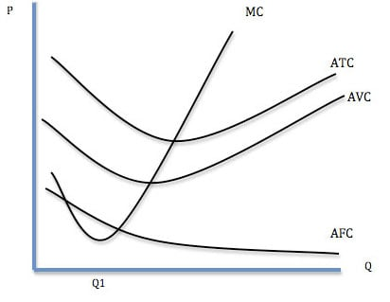
4.1.4.4. COSTS OF PRODUCTION
FIXED COSTS | Costs that remain constant at any level of output e.g. rent, insurance. Average Fixed Costs = FC / Q
VARIABLE COSTS | Costs that rise with output. Directly involved in the production of a good or service. e.g. stock. Average Variable Costs = VC / Q
TOTAL COSTS | Sum total of Fixed + Variable costs.
AVERAGE TOTAL COSTS | Average unit costs calculated by: Total costs/ quantity produced
MARGINAL COSTS | Represent the change in total costs from the next unit produced. Change in TC / change in Total Output
SHORT RUN | At least one factor of production is fixed
LONG RUN | All factors of production are variable
4.1.4.5. ECONOMIES OF SCALE
Advantages that arise for a firm because of its larger size, or scale of operation. This translates into lower unit costs & increased productive efficiency.
RISK BEARING | A larger firm can be safer from the risk of failure if it has a more diversified product range. A larger firm may have greater resilience in the case of a downturn in its market because of larger reserves.
FINANCIAL | There is a wider range of finance options available to larger firms, such as the stock market, bonds and other kinds of bank lending.
MARKETING | More options are available for larger firms, such as television and other national media, which would not be cost-effective for smaller producers.
TECHNICAL | More cost-effective to invest in advanced production machinery, IT & software when operating on a larger scale.
MANAGERIAL | Larger firms can afford to have specialist managers for different functions within a business.
PURCHASING | Firms producing on a larger scale should be able to bulk buy raw materials or products for resale in larger quantities.
EXTERNAL ECONOMIES OF SCALE
External economies of scale arise from firms in related industries operating in a concentrated geographical area; suppliers of services and raw materials to all these firms can do so more efficiently. Infrastructure such as roads and sophisticated telecommunications are easier to justify. There is also likely to be a growing local pool of skilled labour as other local firms in the industry also train workers. This gives a larger and more flexible labour market in the area.
DISECONOMIES OF SCALE
LACK OF MOTIVATION | In larger firms, workers can feel that they are not appreciated or valued as individuals.
POOR COMMUNICATION | It can be easier for smaller firms to communicate with all staff in a personal way. In larger firms, there is likely to be greater use written notes rather than by explaining personally.
CO-ORDINATION | A very large business takes a lot of organising, leading to an increase in meetings and planning to ensure that all staff know what they are supposed to be doing. New layers of management may be required.

Slide 14
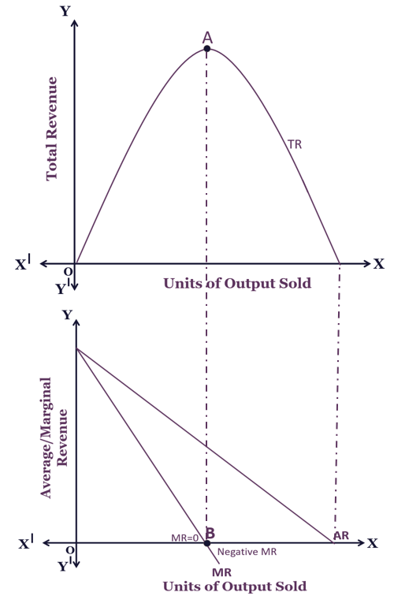
4.1.4.6. MARGINAL, AVERAGE & TOTAL REVENUE
REVENUE | Represents money earnt through sales of goods or services.
TOTAL REVENUE | Calculated by PRICE X QUANTITY
AVERAGE REVENUE | Calculated by TOTAL REVENUE/ QUANTITY. AR=PRICE=DEMAND
MARGINAL REVENUE | Revenue earnt from the last unit sold. Calculated by CHANGE IN TR / CHANGE IN Q
WHY D=AR | AR is average revenue, and the calculation for average revenue is Total Revenue / Quantity. Total Revenue = Price X Quantity Therefore AR = Price X Quantity / Quantity => Price (as the Quantity is cancelled out) Hence AR = P, and D = P so we can say that D = AR.
PROFIT | Where TR > TC
4.1.4.8. TECHNOLOGICAL CHANGE
INVENTION | A unique or novel device, method, composition or process.
INNOVATION | the action or process of innovating.
IMPACT OF TECHNOLOGICAL CHANGE ON BUSINESS | Can affect method of production Can influence productivity Improved efficiency & lower unit costs of production.
TECHNOLOGICAL CHANGE ON PRODUCTS & MARKETS | Ease of consumption On demand services Improved delivery services e.g. Deliveroo.
TECHNOLOGICAL CHANGE ON MARKET STRUCTURE | Lower barriers to entry Increased perfectly competitive markets e.g. ebay. Increased monopolistic competition e.g. Air B&B Platforms are the new monopolies.
4.1.4.7. PROFIT
PROFIT | The difference between total revenue & total costs.
SUPERNORMAL PROFITS | The difference between normal & abnormal (supernormal) profits.
IMPORTANCE OF PROFIT | Profit is a result of providing a good or service to benefit others. The profit motive is a key incentive for economic agents.

Slide 15
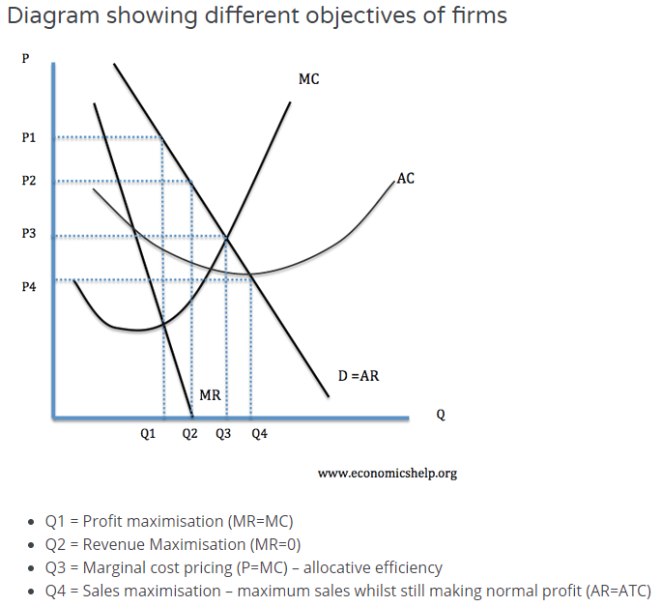
4.1.5. PERFECT COMPETITION, IMPERFECTLY COMPETITIVE MARKETS & MONOPOLY
4.1.5.1. COMPETITIVE & CONCENTRATED MARKETS
MARKET STRUCTURES | Refers to how different industries are classified and differentiated based on their degree and nature of competition for services and goods.
DETERMINANTS OF MARKET STRUCTURES | Number of firms Degree of product differentiation Ease of entry and exit Degree of information assymmetry
4.1.5.2. THE OBJECTIVES OF FIRMS
OBJECTIVES OF FIRMS |  | EXPLANATION
PROFIT MAXIMISATION | Produce where MC=MR | As long as MR> MC, total profits will be increasing. Maximising total profit. However, it is difficult to know your marginal revenue and marginal cost of last goods sold. E.g. Difficult for firms to know PED for their good – which determines the MR. This may enable dynamic efficiency to be achieved which is in the long run interests of all. Yet economies of scale are not fully realised. However, some consumers will not be able to make purchases & DWL exists. Firms may also have other objectives and considerations. For example, increasing price to maximise profits in the short run could encourage more firms to enter the market; therefore firms may decide to make less than maximum profits and pursue a higher market share e.g. Amazon.
REVENUE MAXIMISATION | Produce where MR=0 | Revenue maximisation is a theoretical objective of a firm which attempt to sell at a price which achieves the greatest sales revenue. Enables greater exploitation of economies of scale. May be more appropriate for recessionary periods. May help to establish market presence and later dominance to enable the firm to pursue long run profit maximisation. E.g. Amazon, Netflix.
SALES MAXIMISATION | Produce where AC=AR | Firms often seek to increase their market share – even if it means less profit. This could occur for various reasons: Increased market share increases monopoly power and may enable the firm to put up prices and make more profit in the long run. Managers prefer to work for bigger companies as it leads to greater prestige and higher salaries. Increasing market share may force rivals out of business. E.g. the growth of supermarkets have lead to the demise of many local shops. Some firms may actually engage in predatory pricing which involves making a loss to force a rival out of business.
PROFIT SATISFICING | Produce BETWEEN MC=MR & AC=AR AR>AC | In many firms, there is a separation of ownership and control. Those who own the company (shareholders) often do not get involved in the day to day running of the company. This is a problem because although the owners may want to maximise profits, the managers have much less incentive to maximise profits because they do not get the same rewards, (share dividends). Therefore managers may create a minimum level of profit to keep the shareholders happy, but then maximise other objectives, such as enjoying work, getting on with other workers. (e.g. not sacking them) This is the problem of separation between owners and managers. This is known as the Principal-agent problem.

Slide 16
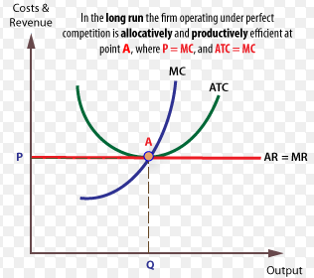
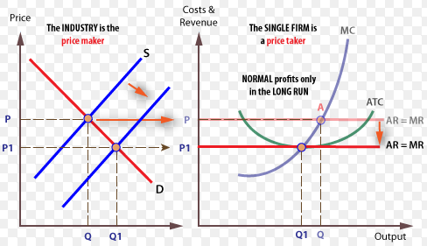
OTHER OBJECTIVES & CONSIDERATIONS
GROWTH MAXIMISATION | This is similar to sales maximisation and may involve mergers and takeovers. With this objective, the firm may be willing to make lower levels of profit in order to increase in size and gain more market share.
LONG RUN PROFIT MAX | In some cases, firms may sacrifice profits in the short term to increase profits in the long run. For example, by investing heavily in new capacity, firms may make a loss in the short run but enable higher profits in the future. E.g. Amazon network effects.
BHEAVIOURAL THEORIES | This principle argues that many different stakeholders influence business decision making.
MANAGERIAL THEORIES | Shareholders and managers can be completely different people and as such they have different objectives from the firm. They are interested in their own gains.
DTS Long Run Equilibrium in Perfect Competition
EVALUATION OF OBJECTIVES OF THE FIRM
Who truly controls the firm & therefore determines the objectives? What impact do the objectives have on efficiencies – Allocative, Productive, Dynamic & X? What is the most important objective & for whom? By producing quarterly results are firms encouraged to be short run profit maximisers & thereby not achieve true dynamic efficiency? Are the largest firms too complicated to truly understand & therefore really achieve Profit Max? Are all Supernormal Profits equal – do they provide a social good?
DTS Short Run Supernormal Profits in Perfect Competition, Long Run Equilibrium
4.1.5.3. COMPETITIVE MARKETS: PERFECT COMPETITION
ASSUMPTIONS | 1. Many buyers & sellers 2. Homogenous goods – Firms are price takers 3. Perfect Information 4. No barriers to entry or exit 5. Firms – profit maximisers/ Consumers – utility maximisers.
EFFICIENCY ANALYSIS | In LR: ALLOCATIVELY EFFICIENT & PRODUCTIVELY EFFICIENT. Not DYNAMICALLY EFFICIENT. NORMAL PROFIT.
SHORT RUN VS LONG RUN OUTCOMES | Supernormal profits/ losses are possible only in the SR. These Supernormal profits act as a signal & an incentive for firms to enter the market. The lack of barriers to entry & therefore the high level of contestability means that as new firms enter this competition will reduce prices. The opposite holds true in the case of Supernormal losses. Firms will leave (no barriers to exit) & prices will rise.
SHUTDOWN RULE | Shutdown condition: AR=/<AVC

Slide 17
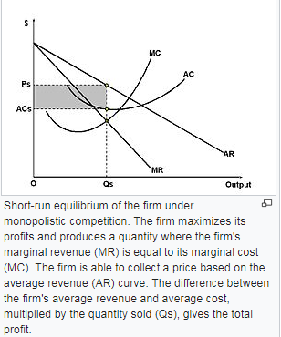
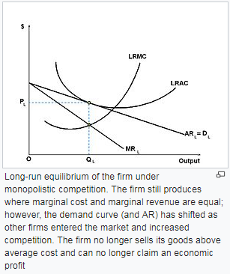
4.1.5.4. MONOPOLISTIC COMPETITION
These firms combine elements of monopoly & competitive markets. There are low barriers to entry & exit but where firms will differentiate their products.
ASSUMPTIONS | Product Differentiation. Monopolistic firms sell products that have non-price differences. Many firms. Freedom of Entry and Exit. (Low barriers to entry & exit). Price makers Imperfect information
EFFICIENCY ANALYSIS | NOT ALLOCATIVELY EFFICIENT or PRODUCTIVELY EFFICIENT. DWL Present. Not DYNAMICALLY EFFICIENT due to NO SUPERNORMAL PROFITS.
SR Vs LR | It is possible to achieve SUPERNORMAL PROFITS in the SHORT RUN. In the LONG RUN, the low barriers to entry mean that new firms will enter & revenues will fall. Consequently, most monopolistic firms will make NORMAL PROFITS in the LONG RUN.
ANALYSIS | How the building of a brand & associated promotion costs lead to higher price levels for consumers. Yet the brand can That the area of deadweight economic loss reflects excess capacity of the firm. How supernormal profits will be competed away via the entry of other firms resulting ultimately in a ‘tangential’ normal profit position. Within the analysis, yet leading into definite evaluation, may be a discussion as to whether supernormal profits must necessarily be against the best interests of consumers.
EVALUATION | Why is product differentiation important? • The issue concerning whether a monopolist will not use supernormal profits to fund research and development etc./exploit economies of scale etc. and hence might actually be better for consumers? • How monopolistic competition is not a feasible market form in certain circumstances – for example, with ‘natural monopolies’. • How advertising used to try to convince consumers that there are differences between products might be a waste of scarce resources due, in reality, to the extreme similarities between them.
Stretch and Challenge:
1.
EFFICIENCY ANALYSIS | NOT ALLOCATIVE EFFICIENT & PRODUCTIVELY EFFICIENT nor DYNAMICALLY EFFICIENT. NORMAL PROFIT in LONG RUN.

Slide 18
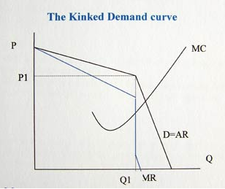
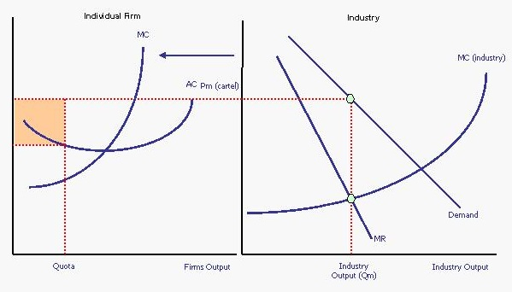
4.1.5.5. OLIGOPOLY
ASSUMPTIONS | 1 A few large dominant firms 2 High barriers to entry/ exit 3 Product differentiation 4 Interdependence – Price rigidity 5 Non price competition 6 Firms – Profit max & look to gain market share.
EFFICIENCY ANALYSIS | NOT ALLOCATIVELY EFFICIENT OR PRODUCTIVELY EFFICIENT. Oligopolies can be DYNAMICALLY EFFICIENT if they achieve SUPERNORMAL PROFIT.
MARKET CONCENTRATION | Market concentration measures the extent to which sales in a market are dominated by one or more businesses. The concentration ratio measures the combined market share of the top 'n' firms in the industry. n – often 5.
TACIT COLLUSION | Occurs where firms undergo actions that are likely to minimize a response from another firm, e.g. avoiding the opportunity to price cut an opposition.
OVERT COLLUSION | Overt means spoken, open or traceable Collusion is often explained by a desire to achieve joint-profit maximisation within a market or prevent price and revenue instability in an industry.
GAME THEORY & OLIGOPOLIES
The study of strategic interaction where one player's decision depends on what the other player does. It usually involves looking at events where the decisions of others have some influence on your own decisions.
DOMINANT STRATEGY | Where a single strategy is best for a player irrespective of whatever strategy the other firm adopts
NASH EQUILIBRIUM | A stable state of a system involving the interaction of different participants, in which no participant can gain by a unilateral change of strategy if the strategies of the others remain unchanged.
The following payoff matrix, highlights outcomes in both a competitive & an overtly collusive Olgiopoly. The competitive outcome is also a NASH EQUILIBRIUM.
 | B. High Price | B. Unchanged Price
High Price | A 10, B 10 | A -4, B12.
Unchanged Price | A 12, B -4 | A 4, B 4.
OLIGOPOLIES PROS & CONS
PROS | It simplifies the market for consumers, it creates higher profits, it can still offer competitive pricing, need for dynamic efficiency due to creative destruction.
CONS | Fewer choices is not a good thing, desire to create barriers to entry and promote consumer inertia may lead to monopoly power, price fixing may be common, market success may translate to political power.
COMPETITIVE OLIGOPOLY
LIKELY OBERVATIONS IN COMPETITIVE OLIGOPOLIES | Occurrence of price wars Use of non-price competition. May lead to the Kinked demand curve diagram.
FACTORS PROMOTING COMPETITIVE OLIGOPOLIES | Large no. of firms – less highly concentrated oligopoly New market entry possible One firm with significant cost advantages Homogenous goods Saturated goods.
EFFICENCY EVALUATION IN COMPETITIVE OLIGOPOLIES | Market may generate ALLOCATIVE EFFICIENCY – low price, high quantity. PRODUCTIVE EFFICIENCY – More likely. No DYNAMIC EFFICIENCY due to likelihood of NORMAL PROFITS.
COLLUSIVE OLIGOPOLY
LIKELY OBERVATIONS IN COLLUSIVE OLIGOPOLIES | OVERT or EXPLICIT COLLUSION (PRICE LEADERSHIP - the setting of prices in a market by a dominant company, which is followed by others in the same market).
FACTORS PROMOTING COLLUSIVE OLIGOPOLIES | Small no. of firms Similar costs High entry barriers Ineffective competition policy Consumer loyalty Consumer inertia.
EFFICENCY EVALUATION IN COLLUSIVE OLIGOPOLIES | Market NOT ALLOCATIVE EFFICIENCY – High price, low quantity. NOT PRODUCTIVELY EFFICIENT. May achieve DYNAMIC EFFICIENCY due to SUPERNORMAL PROFITS.

Slide 19
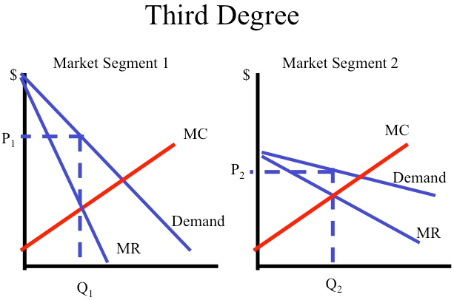
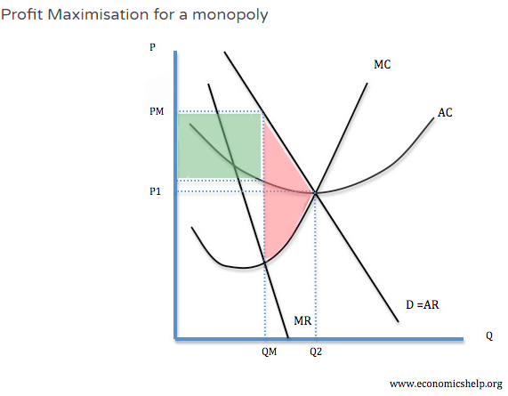
4.1.5.6. MONOPOLY & MONOPOLY POWER
ASSUMPTIONS | One single supplier Unique Products – Firms are price makers High entry & exit barriers Imperfect Information Firms – Profit Maximisers.
EFFICIENCY ANALYSIS | NOT ALLOCATIVELY EFFICIENT or PRODUCTIVELY EFFICIENT. DWL Present. They can be DYNAMICALLY EFFICIENT due to SUPERNORMAL PROFITS.
NATURAL MONOPOLY | 1 Massive cost advantage – so great that not even a monopolist can fully exploit the available economies of scale. 2 Extremely high fixed costs
4.1.5.7. PRICE DISCRIMINATION
TYPES OF PRICE DISCRIMINATION | First degree price discrimination – every consumer is charged the price they are willing to pay. Consumer surplus is turned into profit. Second degree price discrimination – Eg discounts for buying in bulk. Third degree price discrimination – Charging different prices for Peak & Off-peak travel
NECESSARY CONDITIONS | 1 Firms – Have degree of price making power 2 Firms must be able to keep consumers separated 3 There must be consumer groups with varying elasticities of demand
PROS | Some groups benefits from cheaper services, spreads demand across time & avoids congestion, increased cash flow in off peak periods – great investment.
CONS | Some group pay higher prices, decline in consumer surplus for some, administration costs, inequity.
PERFECT COMPETITION VERSUS MONOPOLY (PC are EXACT OPPOSITES)
MONOPOLY BAD POINTS | Monopoly price High & Quantity Low. Restricts choice & exploits consumer DWL, Productive & allocative inefficiency, May suffer from diseconomies of scale.
MONOPOLY GOOD POINTS | Economies of scale benefits, May be in contestable market, Dynamic efficiency gains, Patents create monopolies but offer incentives for expensive R&D – least bad option?
EVALUATION | Level of contestability, Quality of regulator, Objectives of monopolist, Current level of production.
REGULATING A MONOPOLY
Taxes Subsidies Price controls Privatisation & deregulation Breaking up the monopolist Reducing entry barriers Market regulator

Slide 20
4.1.5.8. THE DYNAMICS OF COMPETITION & COMPETITIVE MARKET PROCESSES
SHORT RUN BENEFITS OF COMPETITION | Increased competition, improved choice, improved quality.
LONG RUN BENEFITS OF COMPETITION | Greater innovation, further research and development may facilitate a shift in the LRAS curve and lead to improved dynamic efficiency
NON PRICE COMPETITION | Branding, quality, customer service, post sale service, Warranty.
CREATIVE DESTRUCTION | The "process of industrial mutation that continuously revolutionizes the economic structure from within, incessantly destroying the old one, incessantly creating a new one".
4.1.5.10. MARKET STRUCTURE, STATIC EFFICIENCY, DYNAMIC EFFICIENCY & RESOURCE ALLOCATION
MARKET STRUCTURES | Refers to how different industries are classified and differentiated based on their degree and nature of competition for services and goods.
STATIC EFFICIENCY | concerned with the most efficient combination of existing resources at a given point in time. For example, static efficiency involves the concept of productive efficiency – producing at the lowest point on the short run average cost curve – given existing resources and factor inputs.
EFFICIENCY | DEFINITION | CONDITION | CONSUMER ANALYSIS | PRODUCER ANALYSIS
ALLOCATIVE | Where DEMAND = SUPPLY maximising society surplus. | P=MC | 1. Resources follow consumer demand. 2. Low prices. 3. Max Consumer Surplus. 4. High choice. 5. High quality. | 1. Retain or increase market share. 2. Stay ahead of rivals. 3. Increase profit.
PRODUCTIVE | Maximising output at the lowest possible average cost. | Min of AC MC = AC | 1. Low prices. 2. High consumer surplus. 3. Full exploitation of Economies of scale. | 1. More production at lower AC. 2. Higher profit. 3. Lower prices & greater market share.
DYNAMIC | Re-investment of SNP into innovation, R&D & new technology to improve future products & lower LRAC. | Supernormal profit in LR | 1. New innovative products. 2. Lower prices over time. 3. High consumer surplus. | 1. LR profit max. 2. Lower costs over time. 3. Retain/ increase market share. 4.
X | Production with no waste. | Production on AC curve | 1. Low prices. 2. Higher consumer surplus. | 1. Lower costs. 2. Higher profits. 3. Lower prices & increased market share.
4.1.5.9. CONTESTABLE MARKETS
CHARACTERISTICS OF CONTESTABLE MARKETS | Absence of entry or exit barriers (sunk costs) Pool of potential entrants Perfect Information Incumbents vulnerable to ‘hit & run’ competition.
ADVANTAGES | Low price & high quantity, allocative & potentially productively efficient, Increase in consumer surplus.
DISADVANTAGES | Unlikely to attain DYNAMIC EFFICIENCY.
EVALUATION | A perfectly contestable market is defined by normal profits.

Slide 21
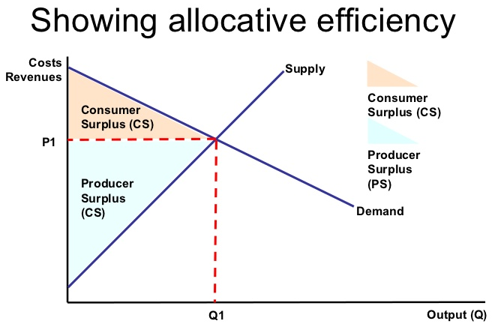
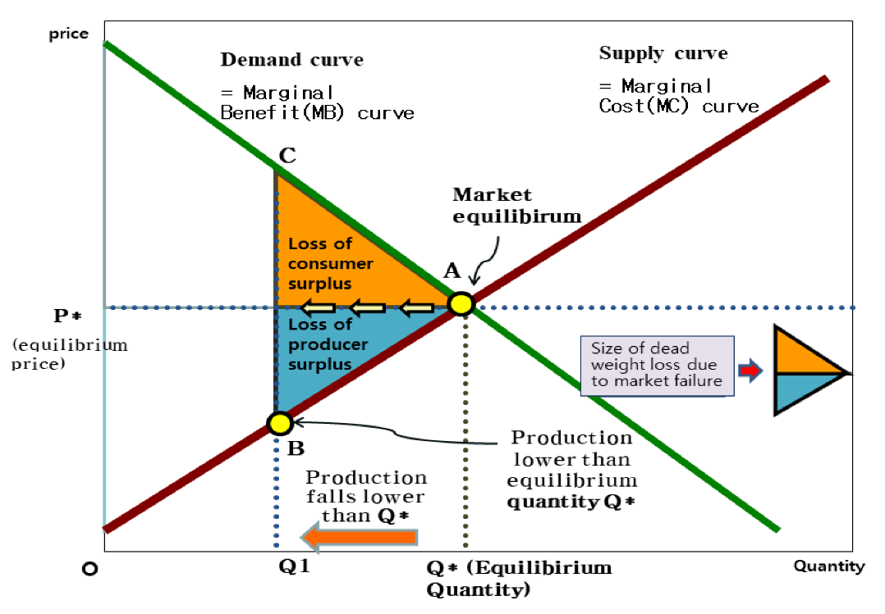
4.1.5.11. CONSUMER & PRODUCER SURPLUS
CONSUMER SURPLUS | An economic measurement of consumer benefits. A consumer surplus happens when the price that consumers pay for a product or service is less than the price they're willing to pay.
PRODUCER SURPLUS | The total amount that a producer benefits from producing and selling a quantity of a good at the market price. The total revenue that a producer receives from selling their goods minus the total cost of production equals the producer surplus.
ECONOMIC EFFICIENCY | Is when all goods and factors of production in an economy are distributed or allocated to their most valuable uses and waste is eliminated or minimized.
WELFARE ISSUES | Extreme poverty versus middle class welfare. Cash versus in-kind benefits. Complexity, of multiple programs and "red tape" versus simplified system. Consistent treatment of all low-income individuals in qualification, delivery and benefits. “Make Work Pay” so that welfare encourages work.
DEADWEIGHT LOSS | a measure of the dollar value of consumers' surplus lost (but not transferred to producers) as a consequence of a price increase.
IMPACT OF MARKET FAILURE ON CONSUMER & PRODUCER SURPLUS
CONSUMER SURPLUS | Fewer consumers consume as price is too high. This will give rise to lower consumption and lower tax revenue.
PRODUCER SURPLUS | Loss of profit, lower sales, smaller market, lower employment.

Slide 22
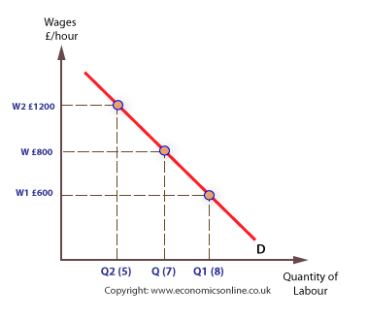
4.1.6. THE LABOUR MARKET
4.1.6.1. LABOUR DEMAND & MRP THEORY
LABOUR DEMAND CURVE | Shows how many workers will be hired at any given wage rate over a period of time. LABOUT is a DERIVED DEMAND – derived from demand for the final good or service.
INVERSE RELATIONSHIP | There is an INVERSE (NEGATIVE) relationship between wage & quantity of workers. In the SHORT RUN due to the LAW OF DIMINISHING MARGINAL RETURNS. In the LONG RUN due to the SUBSTITUTABILTY OF LABOUR & CAPITAL.
MRP CALCULATION | MPP X MR = MRP
FACTORS THAT CAN SHIFT THE DEMAND CURVE FOR LABOUR | Change in the final price of the product the labour makes Change in demand for the final product Changes in labour productivity Change in the price of capital.
FACTORS INFLUENCING THE ELASTICTY OF DEMAND FOR LABOUR | Labour costs as a % of total costs: When labour expenses are a high proportion of total costs, then labour demand is more elastic than a business where fixed costs of capital are the dominant business expense. The ease and cost of factor substitution: Labour demand will be more elastic when a firm can substitute quickly and easily between labour and capital inputs. Difficult for labour intensive firms e.g. Brompton bikes. The price elasticity of demand for the final output produced by a business: If a firm is operating in a highly competitive market where final demand for the product is price elastic, they may have little market power to pass on higher wage costs to consumers through a higher price.
MRP CRITICISMS | Difficulties in measuring MRP Teamwork makes it difficult to measure MRP individually Calculation for the self employed can be problematic Imperfect labour markets – where MRP theory breaks down.

Slide 23
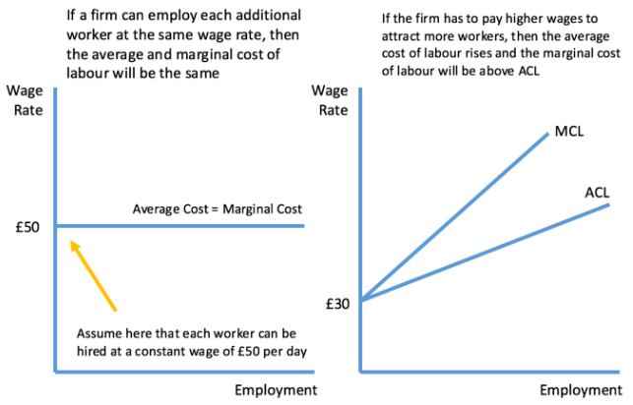
4.1.6.2. LABOUR SUPPLY CURVE
LABOUR SUPPLY CURVE | Higher wages usually will encourage a worker to supply more labour because work is more attractive compared to leisure. Therefore the supply curve for labour tends to be upwardly sloping.
POSITIVE RELATIONSHIP | As wages increase, this attracts a greater supply of labour
FACTORS THAT CAN SHIFT THE SUPPLY CURVE FOR LABOUR | Wage on offer in substitute occupations. Barriers to entry Non-monetary characteristics of the job Improvements in the occupational mobility of labour Overtime Size of working population Value of leisure time
FACTORS INFLUENCING THE ELASTICITY OF SUPPLY FOR LABOUR | Nature of skills and qualifications required to work in an industry Specific skills and educational requirements make supply inelastic Lengthy and costly training periods makes labour supply inelastic When the minimum skill factor needed is relatively low, then the pool of available labour will be large, making labour supply elastic Vocational nature of work - in vocational jobs such as nursing, people are less sensitive to changes in wages when deciding whether to work and how many hours to work Time period – In the short run, the supply curve for labour to a particular occupation tends to be relatively inelastic It takes time for people to respond to changes in relative wages and earnings – especially if people need to be re-trained to enter a new occupation
SUPPLY OF LABOUR TO AN ECONOMY | Can be influenced by: In the UK, only about 75% of people 16-64 are in employment; Some of the retired could be brought back to work if there were incentives for them; Immigration can expand the supply of labour. So the supply of labour to the economy as a whole is not perfectly inelastic.

Slide 24
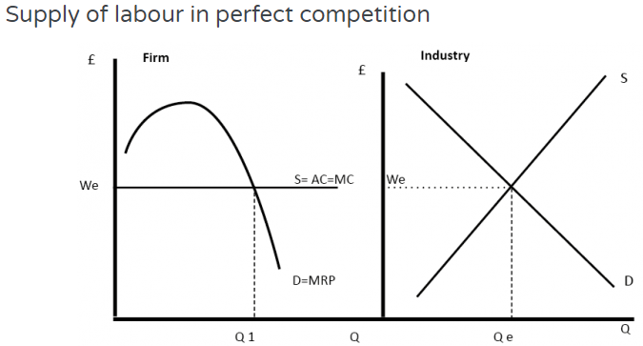
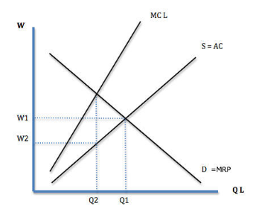
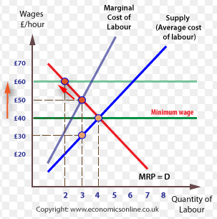
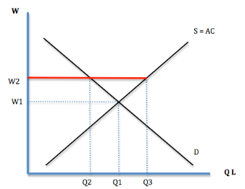
4.1.6.3. WAGE DETERMINATION IN A COMPETITIVE LABOUR MARKET
COMPETITIVE LABOUR MARKET ASSUMPTIONS | There are many potential workers & employers Labour is HOMOGENOUS There is PERFECT INFORMATION Firms are wage takers There are no BARRIERS TO ENTRY / EXIT
WAGE DETERMINATION | The equilibrium wage rate in the industry is set by the meeting point of the industry supply and industry demand curves. In a competitive market firms are wage takers because if they set lower wages, workers would not accept the wage. Therefore they have to set the equilibrium wage We. Because firms are wages takers the supply curve of labour is perfectly elastic therefore AC = MC The firm will maximise profits by employing at Q1 where MRP of Labour = MC of Labour.
HENRY FORD | “We want to get full value out of labour so that we may be able to pay it full value”.
4.1.6.4. WAGE DETERMINATION IN IMPERFECTLY COMPETITIVE LABOUR MARKETS
EXPLANATION | Wage differentials do not exist in a perfectly competitive labour market. That they do exist implies that there are IMPERFECT LABOUR MARKETS.
EXAMPLES OF IMPERFECT LABOUR MARKETS | Labour is not HOMOGENOUS – Different MRPs, different supplies of labour, Discrimination. Non-Monetary considerations – COMPENSATING WAGE DIFFERENTIALS Labour is not perfectly mobile – Occupationally immobility, geographical immobility, lack of PERFECT KNOWLEDGE TRADE UNIONS & supply restrictions. MONOPSONIES & WAGE SETTING ability.
ADVANTAGES OF DIFFERENTIALS | Incentives to work hard, achieve good qualifications, skills, training. Trickle down effect – Jobs – spending – Tax. Encourages enterprise Encourages work not welfare Promotes efficient resource allocation
DISADVANTAGES OF DIFFERENTIALS | Income inequality – Impact on fiscal budget, welfare, growth & social costs. Trickle down effect may not occur Government solutions are limited if they are the MONOPSONIST
EVALUATION | How much INEQUALITY will be evident Risks of GOVERNMENT FAILURE SHORT RUN vs LONG RUN impact TU or NMW impact upon firms’ DYNAMIC EFFICIENCY. Could TU’s actually improve firm productivity by raising morale?
MONOPSONY & TU/ NMW impact at different levels
MONOPSONY
TU/ NMW in a COMPETITIVE MARKET

Slide 25
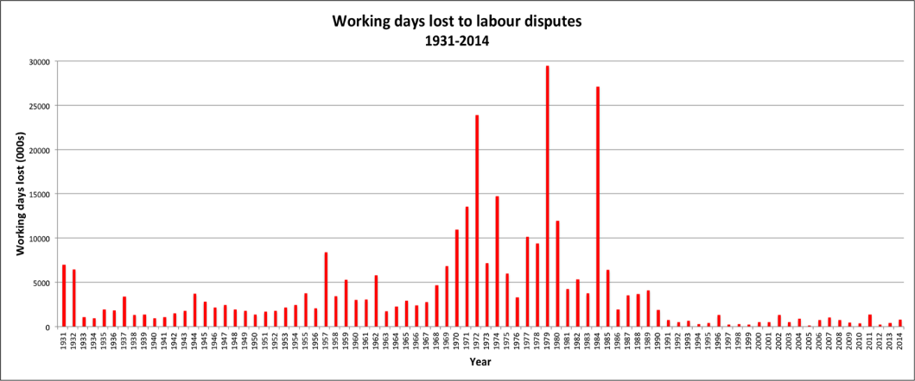
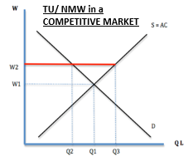
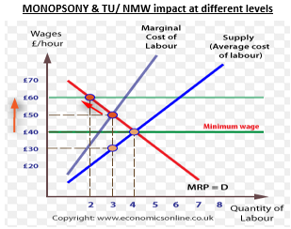
4.1.6.5. THE INFLUENCE OF TRADE UNIONS IN DETERMINING WAGES & EMPLOYMENT (TU)
Provide an organisation for workers to have joint representation with their employers.
EXPLANATION | Trade unions act as MONOPOLY SUPPLIERS OF LABOUR; Critics argue that unions force up wages and therefore increase unemployment; However, neo classical theory also suggests unions can increase employment for MONOPSONIST employers.
COLLECTIVE BARGAINING | Negotiation of wages and other conditions of employment by a TU
ANALYSIS: TU IN A COMPETITIVE MARKET | Economic theory suggests that Wages will increase Meanwhile, employment will decrease In the Long run firms, may SUBSTITUTE CAPITAL for LABOUR
ANALYSIS: TU IN AN IMPERFECT MARKET | Economic theory suggests that a TU will increase both wages and employment where a MONOPSONY employer negotiates with a MONOPOLY SUPPLIER OF LABOUR (the TU). Furthermore some economists believe unions raise efficiency because they lower costs of production to the firm – here the Trade Union almost works as the personnel department for the firm. Improving working conditions may also improve worker motivation. However, if the TU demands too high a wage, employment will begin to fall. Therefore, they should only negotiate modest rises in wages.
EVALUATION | Impact likely to depend upon strength of TU power Membership & militancy which may be influenced by whether the demand curve for labour is relatively inelastic, the Profitability of the employer, TU concentration. TU & impact upon ALLOCATIVE EFFICIENCY depends upon their ‘mark-up’. Which labour markets dominate the UK economy & therefore will TU impact be favourable? Real world evidence suggest TU power has been greatly reduced due to a). Legislation, b). Restructuring of UK economy, c). Competitive pressures. Could a TU mark up reduce a MONOPSONISTS DYNAMIC EFFICIENCY? GOV FAILURE TUs rarely survive in the private sector – why? Do they price their workers out of a market?

Slide 26
4.1.6.6. THE NATIONAL MINIMUM WAGE (NMW)
Introduced to help increase incomes of the low paid. It has become more important in a labour market characterised by a decline in trade unions and growth of low paid service sector jobs.
EXPLANATION | The Low Pay Commission is an independent body that advises the government about the National Living Wage and the National Minimum Wage.
ANALYSIS: NMW IN A COMPETITIVE MARKET | Economic theory suggests that Wages will increase Meanwhile, employment will decrease In the Long run firms, may SUBSTITUTE CAPITAL for LABOUR
ANALYSIS: NMW IN AN IMPERFECT MARKET | Economic theory suggests that a NMW will increase both wages and employment. However, if the NMW is set too high, employment will begin to fall. Therefore, the NMW should only be set slightly above the equilibrium rate.
NMW ADVANTAGES/ DISADVANTAGES | Poverty alleviation Reduce differentials Incentive to work reduces ‘voluntary unemployment’ Fiscal benefit to government Increased productivity – morale boost. Incentive for firms to train up staff & increase their human capital. Counter MONOPSONIST employers | Unemployment but extent will depend upon elasticity Youth lose out the most Those not on NMW may ask for increased wages to keep differential Costs to businesses – shutting down, lack of competitiveness Regional variations Impact upon government finances given state employees
EVALUATION | Impact will depend upon type of labour market & elasticities E.g. little or no impact on bankers, with little or no union membership, minimum wage earners etc. How easily can low paid be substituted for capital goods? Will NMW just benefit second earners? Are in work benefits a better means of support for the poor? Which labour markets dominate UK scene monopsony vs competitive? Could the NMW reduce a MONOPSONISTS DYNAMIC EFFICIENCY? GOV FAILURE?

Slide 27
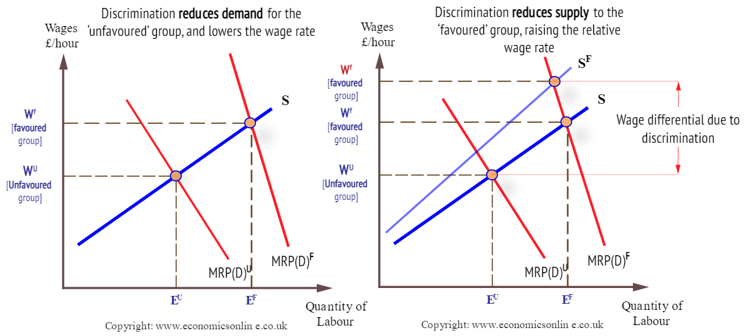
4.1.6.7. DISCRIMINATION IN THE LABOUR MARKET
Labour market discrimination is defined as a situation where workers or groups of workers are treated differently in terms of recruitment, pay, benefits and promotion from other workers or groups due to their non-economic characteristics, including gender, race, religion and age.
IMPACT ON DEMAND | Negative discrimination will lead to employers downgrading the expected value of employment of a particular group, and hence reducing the expected MRP, and shifting the demand curve to the left. The effect of this is to reduce the wage rate of the group discriminated against, as well as reducing employment prospects.
IMPACT ON SUPPLY | Some workers who fear they may be discriminated against may not seek employment in those firms that they perceive practice discrimination. Hence they do not supply their labour to those types of firms. This shifts the potential supply curve to the left, and raises the relative wage rate of the favoured group.
POLICIES TO ADDRESS DICRIMINATION | Long-term investment in education and training to prepare people better for the labour market. Structural reforms to promote stronger and more sustainable economic growth which can boost demand for workers, creating a more competitive environment that forces managers to drop discriminatory hiring and promotion practices. Specific anti-discrimination legislation backed up by effective enforcement. Enforcement agencies should be empowered, even in the absence of individual complaints, to investigate companies and sanction employers when they find evidence of discrimination.
ANOTHER PERSPECTIVE | Do firms willingly break the law & run the risk of punishment & brand damage in order to discriminate? A labour market with good information will help to avoid discrimination as the best workers will seek out the best employers & avoid the worst employers. Thus, do we only really see wage differentials rather than discrimination?
PROS OF WAGE DIFFERENTIALS | Incentives. May fuel higher consumption. Encourages upskilling. Promotes work rather than welfare. Promotes efficient resource allocation.
CONS OF WAGE DIFFERENTIALS | Income inequality. No trickle down effect on economy. Government solutions are limited if they are monopsonist employers.

Slide 28
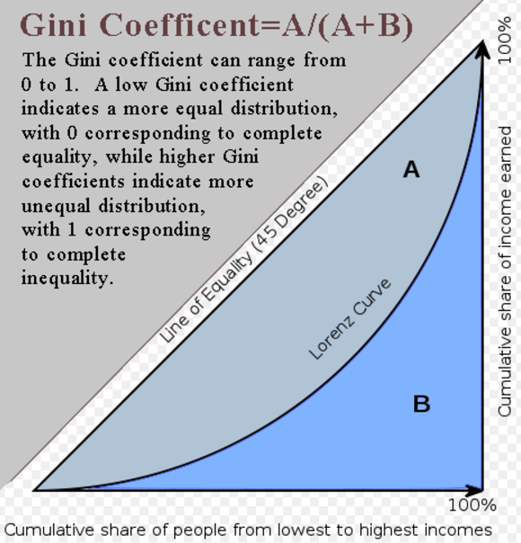
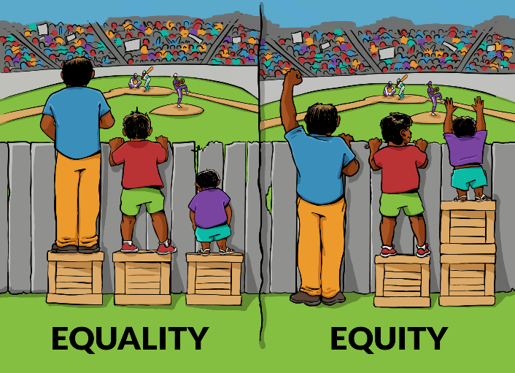
4.1.7. THE DISTRIBUTION OF INCOME & WEALTH: POVERTY & INEQUALITY
4.1.7.1 THE DISTRIBUTION OF INCOME & WEALTH
Refers to the extent to which income is distributed in an uneven manner among a population
INCOME | Flow of income over a given period of time
WEALTH | Ownership of assets with market value.
EQUALITY | The state of being equal, especially in status, rights, or opportunities.
EQUITY | The quality of being fair and impartial.
GINI COEFFICIENT | The Gini coefficient is a commonly-used measure of income inequality that condenses the entire income distribution for a country into a single number between 0 and 1: the higher the number, the greater the degree of income inequality.
LORENZ CURVE | A graph on which the cumulative percentage of total national income (or some other variable) is plotted against the cumulative percentage of the corresponding population (ranked in increasing size of share). The extent to which the curve sags below a straight diagonal line indicates the degree of inequality of distribution.
REASONS FOR DIFFERENTIALS IN INCOME & WEALTH | AGE– wealth accumulated over time, Increased income means increased wealth in LR. Education Ownership of assets – through employer pensions or inheritance Wage differentials
CONSEQUENCES OF HIGH INCOME INEQUALITY | Excessive debts Impact on government finances due to welfare benefits Social costs Lower economic growth (debated).

Slide 29
4.1.7.2 THE PROBLEM OF POVERTY
ABSOLUTE POVERTY | Characterised by severe deprivation of basic human needs, including food, safe drinking water, sanitation facilities, health, shelter, education and information
RELATIVE POVERTY | Occurs where people lack the minimum amount of income needed in order to maintain the average standard of living in the society in which they live
CAUSES OF POVERTY | 1. Lack of good jobs/job growth. 2: Lack of good education. The second root cause of poverty is a lack of education. 3: Warfare/conflict. 4: Weather/climate change. 5: Social injustice.
EFFECTS OF POVERTY | Substandard housing, homelessness, inadequate nutrition and food insecurity, inadequate child care, lack of access to health care, unsafe neighborhoods, and underresourced schools which adversely impact our nation's children.
OVERALL MARKET FAILURE EVALUATION CONSIDERATIONS
Whether or not there should be intervention depends upon the degree of DWL or externality present. How great is the abuse of this demerit good? How toxic is it? Does this suggest a need for intervention? Is there a best solution? Is the risk of GOVERNMENT FAILURE too great? Will there be UNINTENDED CONSEQUENCES? Will the MF require a combination of policy responses? Is a solution really necessary? Are other issues more important? Who decides what merit goods are? Some degree of inequality helps provide incentives to work hard & be productively & dynamically efficient. Consider consequences on distinct stakeholder groups for all MARKET FAILURES
4.1.7.3. GOVERNMENT POLICIES TO ALLEVIATE POVERTY & TO INFLUENCE THE DISTRIBUTION OF INCOME & WEALTH
INCOME REDISTRIBUTION POLICIES | PROGRESSIVE TAX TRANSFER PAYMENTS/ UNIVERSAL BENEFIT Government spending on Education/ health. Minimum or maximum wages Reduce REGRESSIVE INDIRECT TAX Increase child/ staff ratios in nurseries on a par with Germany/ Denmark. Reduce nursery fees Take low paid out of NI contributions. Allow building on greenbelt to ease housing costs.
PROBLEMS OF SUCH POLICIES | Transfer payments through benefits may cause an unemployment trap Conflict with large Fiscal deficit & ever-increasing national debt.
EVALUATION | Is a solution really necessary? How great is the degree of inequality? Is freedom of economic opportunity the crucial factor? Does this depend upon parents & education provision?

Slide 30
4.1.8. THE MARKET MECHANISM, MARKET FAILURE & GOVERNMENT INTERVENTION IN MARKETS
4.1.8.1. THE DETERMINATION OF EQUILIBIRUM MARKET PRICES
THE PRICE MECHANISM | The manner in which the prices of goods affect the demand & supply of goods & services. There are four functions: 1. Allocating. 2. Rationing. 3. Signalling. 4. Incentivising.
MARGINAL ANALYSIS DEFINITIONS
MARGINAL BENEFIT | The additional satisfaction or utility that a person receives from consuming an additional unit of a good or service.
MARGINAL COST | The cost added by producing one additional unit of a product or service.
DEADWEIGHT WELFARE LOSS | A loss of economic efficiency that can occur when equilibrium for a good or service is not achieved or is not achievable.
EFFICIENCY DEFINITIONS
ALLOCATIVE EFFICIENCY | Where DEMAND = SUPPLY maximising society surplus.
PRODUCTIVE EFFICIENCY | Maximising output at the lowest possible average cost.
DYNAMIC EFFICIENCY | Re-investment of SNP into innovation, R&D & new technology to improve future products & lower LRAC. LONG RUN EFFICIENCY.
4.1.8.3. PUBLIC GOODS, PRIVATE GOODS & QUASI-PUBLIC GOODS
PURE PUBLIC GOODS | A good that is both non-excludable and non-rivalrous in that individuals cannot be effectively excluded from use and where use by one individual does not reduce availability to others. May also be non-rejectable e.g National defence.
PRIVATE GOOD | Private goods are those whose ownership is restricted to the group or individual that purchased the good for their own consumption. It is rivalrous and excludable in its consumption.
QUASI-PUBLIC GOODS | A near-public good. It has some of the characteristics of a public good especially when it becomes rival in consumption at peak times.
FREE RIDER PROBLEM | A person who receives PUBLIC GOODS benefits that others have paid for without contributing payment themselves.
Susan Collins | “The first obligation of government is to protect its citizens”.
4.1.8.2. THE MEANING OF MARKET FAILURE
DEFINITION | A situation in which the allocation of goods and services is not ALLOCATIVELY EFFICIENT. Thus, a misallocation of resources takes place.
EXPLANATION | A misallocation of resources takes place.
COMPLETE MARKET FAILURE – A MISSING MARKET | The absence of a market on which to trade a good. It is not possible to trade the full range of future and contingent commodities, and markets are missing for many externalities.
PARTIAL MARKET FAILURE | Occurs when the market does actually function but it produces either the wrong quantity of a product or at the wrong price. This leads to resource misallocation.
MARKET FAILURE EXAMPLES
PUBLIC GOODS | A good that is both non-excludable and non-rivalrous in that individuals cannot be effectively excluded from use and where use by one individual does not reduce availability to others. May also be non-rejectable e.g National defence.
EXTERNALITIES | Are third party effects arising from production and consumption of goods and services for which no appropriate compensation is paid. They arise due to a divergence between private social costs & benefits.
MONOPOLY | Sole provider of a good or resource. They will often restrict output to gain a higher price.
INEQUALITY OF INCOME & WEALTH | The phenomenon of unequal and/or unjust distribution of resources and opportunities among members of a given society.
FACTOR IMMOBILITY | Occurs when it is difficult for factors of production (e.g. labour and capital) to move between different areas of the economy.

Slide 31
4.1.8.4. POSITIVE & NEGATIVE EXTERNALITIES
EXTERNALITIES | Are third party effects arising from production and consumption of goods and services for which no appropriate compensation is paid. They arise due to a divergence between private social costs & benefits.
NEGATIVE PRODUCTION EXTERNALITIES | Production of goods/ services which impose a cost on a third party. Social Cost > Private Cost. E.g. air pollution from a factory.
NEGATIVE CONSUMPTION EXTERNALITIES | Consumption of DEMERIT GOODS which impose a cost upon a third party. Private Benefit > Social Benefit
POSITIVE CONSUMPTION EXTERNALITY | Consumption of MERIT GOODS which give benefit a to a third party e.g. cycling to work may mean less congestion. Social Benefit > Private Benefit
POSITIVE PRODUCTION EXTERNALITY | Provision of MERIT GOODS which give benefit to a third party e.g. Training programmes & apprenticeships which may benefit future employers. Private Cost > Social Cost
NEGATIVE EXTERNALITIES RESULT IN OVER PRODUCTION | The overproduction of goods with negative externalities occurs because the price of the good to the buyer does not cover all of the costs of producing or consuming the good. If all costs were accounted for, the prices of these goods would be higher and people would consume less of them.
POSITIVE EXTERNALITIES RESULT IN UNDER PRODUCTION | The underproduction of goods with positive externalities occurs because the producers of the goods do not capture the extra value the goods create for others in the price they receive for their goods.
4.1.8.6. MARKET IMPERFECTIONS
TRAGEDY OF THE COMMONS | A situation within a shared-resource system where individual users acting independently according to their own self-interest behave contrary to the common good of all users by depleting or spoiling that resource through their collective action.
ASSYMMETRIC INFORMATION - | ASSYMETRIC INFORMATION occurs when somebody knows more than somebody else in the market. This may lead to under-provision or under consumption of merit goods and over-provision of
INFORMATION FAILURE | Where individuals or firms have a lack of information about economic decisions.
AGRICULTURE | MF may occur due to the following: Volatile Prices / volatile supply, Low and volatile income for farmers, Environmental costs of intensive farming (negative externalities), Agriculture key component of rural life (positive externalities), Monopsony power of food purchasers.
PRINCIPAL-AGENT PROBLEM | Occurs when a principal delegates an action to another individual (agent), but the principal does not have full information about how the agent will behave. Secondly, the interests of the principal diverge from that of the agent, meaning that the outcome is less desirable than the principal expects.
MONOPOLY | A pure monopoly is defined as a single seller of a product, i.e. 100% of market share. In the UK a firm is said to have monopoly power if it has more than 25% of the market share. Restricts output to charge a high price.
MONOPOLISTS & MARKET FAILURE | The firm will set a specific price for a good that is available to all consumers. The quantity of the good will be less and the price will be higher (this is what makes the good a commodity). The monopoly pricing creates a deadweight loss because the firm forgoes transactions with the consumers. The deadweight loss is the potential gains that did not go to the producer or the consumer. As a result of the deadweight loss, the combined surplus (wealth) of the monopoly and the consumers is less than that obtained by consumers in a competitive market. A monopoly is less efficient in total gains from trade than a competitive market.
FACTOR IMMOBILITY | The free market can fail to provide an efficient allocation of resources because of the geographical and occupational immobilities. Factor immobility can lead to increased inequality.
4.1.8.5. MERIT & DEMERIT GOODS
CLASSIFICATION OF MERIT & DEMERIT GOODS | This depends upon a normative value judgement – one man’s meat is another man’s poison.
PUBLIC GOODS | A good that is both non-excludable and non-rivalrous in that individuals cannot be effectively excluded from use and where use by one individual does not reduce availability to others. May also be non-rejectable e.g National defence.
QUASI PUBLIC GOODS | A near-public good. It has some of the characteristics of a public good especially when it becomes rival in consumption at peak times.
MERIT GOODS | May have two characteristics: a). People do not realise the true benefit. E.g. people underestimate the benefit of education or vaccinations. b). Usually these goods have POSITIVE EXTERNALITIES.
DEMERIT GOODS | A good which can have a negative impact on the consumer – but these damaging effects may be unknown or ignored by the consumer. They also usually have NEGATIVE EXTERNALITIES– where consumption causes a harmful effect to a third party.
FREE RIDER | A person who receives PUBLIC GOODS benefits that others have paid for without contributing payment themselves.
SUSAN COLLINS | “The first obligation of government is to protect its citizens”.

Slide 32
4.1.8.7. COMPETITION POLICY
COMPETITION POLICY | The structures governments have in place for the regulation of markets and monopolies.
PRINCIPLES OF UK & EU COMPETITION POLICY | Regulation by CMA (Competition and Markets Authority). This used to be managed by the OFT and Competition Commission. The CMA area of influence includes: 1. Regulation of Cartels/Collusion. Based on the Competition Act 1998 2. Market liberalisation to promote more competitive markets. 3. State aid control – to ensure other firms are not disadvantaged. 4. Merger Control – The CMA must be notified of mergers and they can investigate if they think they might be against public interest. Investigate particular industries and see whether they are run in the public interest.
BENEFITS | Rules to make sure businesses and companies compete fairly with each other. This encourages enterprise and efficiency, creates a wider choice for consumers and helps reduce prices and improve quality.
COSTS | Additional red tape and bureaucracy Regulatory capture by industry. Additional cost & burden to taxpayers.
4.1.8.8. PUBLIC OWNERSHIP, PRIVATISATION, REGULATION & DEREGULATION OF MARKETS
INTERVENTION | DEF | ADVANTAGES | DISADVANTAGES | EVALUATION
PRIVATISATION | The sale of state owned assets to the private sector. | To lower costs & increase incentives; Improve choice & quality; Improve innovation & DYNAMIC EFFICIENCY; Invisible hand of the market improves allocation. Wider share ownership; Reduced FISCAL BURDEN. | Can turn state monopolies run for SOCIAL BENEFIT into private run Monopolies run for PRIVATE BENEFIT this can give rise to NEGATIVE EXTERNALITIES & DWL. EQUITY concerns that poorer members of society can no longer good | Need to create competition & reduce BARRIERS TO ENTRY; The need for Regulation of the industry Potential for REGULATORY CAPTURE Has Privatisation been successful overall?
NATIONALISATION | Occurs when the gov’t take control of an industry previously owned by private firms. | More productively efficient, ECONOMIES OF SCALE & NATURAL MONOPOLIES; Management tries to maximise NET SOCIAL BENEFIT; Control of monopolies; Maximise social benefit not private profit. Limit externalities!? LR Projects unlikely to reward SHORT RUN PROFIT MAXIMISING firms. A fairer distribution of resources – WELFARE. | Misdirection of investments to Low-Value activities Potential CROWDING OUT of private investment Not DYNAMICALLY EFFICIENT DIRECT PROVISION gives rise to EXCESS DEMAND. DISECONOMIES OF SCALE | Which sector is more efficient? Does the Private sector exploit workers? Is state control necessary to REGULATE MONOPOLIES Is PROFIT seen as exploitation of MONOPOLY POWER?
DEREGULATION | Removing barriers to competition | Increased competition means greater efficiency, leading to lower costs & prices for consumers. Gov’t regulation often costly & bureaucratic. | Difficult to create effective competition in an industry which is a NATURAL MONOPOLY – high BARRIERS TO ENTRY. May create a private firm with MONOPOLY POWER. May lead to a compromise of public services with poor quality
ADD REGULATION PROS & CONS
DANGER OF REGULATORY CAPTURE

Slide 33
INTERVENTION METHODS TO CORRECT NEGATIVE EXTERNALITIES
 | DEFINITION | ADVANTAGE | DISADVANTAGE
INDIRECT TAXATION | Taxes on NEGATIVE EXTERNALITIES are intended to make consumers / producers pay the full social cost of the good. This reduces consumption and creates a more socially efficient outcome. | Changes in indirect taxes can change the pattern of demand by varying prices Indirect taxes can be used as a means of making the polluter pay and “internalizing the external costs” of production and consumption Indirect taxes can be charged more easily than direct taxes. Earns TAX REVENUE | Difficulty in setting the right value – IMPERFECT INFORMATION REGRESSIVE Little impact when demand is INELASTIC May create a BLACK MARKET Misuse of Government Tax Revenue Impact on firms & jobs?
REGULATION | To overcome NEGATIVE EXTERNALITIES, the government may place laws and regulations which prohibit certain behaviour and actions. | Simple and easy to understand. When the danger is great it may be better to ban it all together, e.g. heroin. When a decision needs to be taken quickly, a tax may be too cumbersome. A legal ban sends a clear signal that it is wrong (e.g. drinking alcohol in city centre) It is fairer than taxes – not REGRESSIVE. | Difficulty in setting the right value – IMPERFECT INFORMATION Firms may shut down/ leave the market– jobs? Cost of REGULATION Enforcement issues. May create a BLACK MARKET.
EXTEND PROPERTY RIGHTS | A way of internalising the externality. By ensuring firm’s pay for pollution to eg. air, water in surrounding areas. | Incentivises private agents to act in a responsible manner & not pollute. May result in more equitable decisions. | Is it possible to exclude people? Cost Enforcement Equitable Concerns
POLLUTION PERMITS | Involve giving firms a legal right to pollute a certain amount e.g. 100 units of Carbon Dioxide per year | If the firm produces less pollution it can sell its pollution permits to other firms. However if it produces more pollution it has to buy permits off other firms. Therefore there will be a market for pollution permits. Therefore there is an incentive for firms to cut pollution & sell permits. | Setting the right cap Cost Enforcement Global agreement needed May concentrate pollution in areas.
INFORMATION PROVISION | Assymmetric info occurs when somebody knows more than somebody else in the market. Information campaigns can help reduce NEG CONs EXTERN. | Markets are at their most efficient, when knowledge is perfect and is evenly shared by all the parties in a transaction. Consumers are now less likely to be exploited. | Quality of provision Targeted at who? Costly Long term – difficult to assess impact No guarantee of success.
4.1.8.9. GOVERNMENT INTERVENTION IN MARKETS
GOVERNMENT INTERVENTION | Government intervention is regulatory action taken by government that seek to change the decisions made by individuals, groups and organisations about social and economic matters.
AIMS OF GOVERNMENT INTERVENTION | Governments may also intervene in markets to promote general economic fairness. Governments may sometimes intervene in markets to promote other goals, such as national unity, advancement and tackle inequality.
REASONS FOR GOVERNMENT INTERVENTION
To correct NEGATIVE & POSITIVE EXTERNALITIES To provide PUBLIC & MERIT goods. To correct FACTOR IMMBILITY To improve UNEQUAL DISTRIBUTION OF INCOME To correct MONOPOLY ABUSE | To correct TRAGEDY OF THE COMMONS To resolve ASSYMERTIC INFORMATION To support AGRICULTURE To resolve the PRINCIPAL-AGENT PROBLEM. To protect industries of STRATEGIC IMPORTANCE.
ARGUMENTS AGAINST GOVERNMENT INTERVENTION | Government failure – when the government creates further inefficiency. This could distort incentives, increase bureaucracy, increase political interference, administrative costs, moral hazard, regulatory capture & unintended consequences.
EXAMPLES OF GOVERNMENT INTERVENTION
Taxation, indirect taxation, subsidies, welfare provision, direct state provision, regulation, price controls.
MIXED ECONOMIES | Allow private enterprise to run most business. Then the governments intervene in certain areas of the economy, such as regulation, and public services – public goods & merit goods.

Slide 34
METHODS TO CORRECT POSITIVE EXTERNALITIES & PROVIDE PUBLIC & MERIT GOODS
 | DEFINITION | ADVANTAGE | DISADVANTAGE
SUBSIDY | A sum of money granted by the government to help an industry or business keep the price of a commodity or service low. | Enables greater social efficiency. Consumers end up paying the socially efficient price which includes the external benefit. Lower price encourages greater consumption. | Setting the right value – imperfect information Cost Promotes inefficiency Inelastic demand Misuse of subsidy
DIRECT STATE PROVISION | Direct provision of PUBLIC & MERIT GOODS by the government. E.g. NHS & state schools. | More productively efficient due to economies of scale & natural monopolies; Better Management!? Which tries to maximise net social benefit; Maximise net social benefit not private profit. A fairer distribution of resources. | Setting the right level – imperfect information Cost Excess demand Necessary? X-inefficiency – failure to be dynamically efficient. Quality arguments.
INFORMATION PROVISION | Information campaigns can resolve ASSYMETRIES OF INFORMATION. | Markets are at their most efficient, when knowledge is perfect and is evenly shared by all the parties in a transaction. Consumers are now less likely to be exploited. | Quality of provision Targeted at who? Costly Long term – difficult to assess impact No guarantee of success.
PRIVATE FINANCE INITIATIVE | Creates "public–private partnerships" by funding public projects with private capital. | The belief that the private sector can be more productively & dynamically efficient through better management. | Debt at higher interest burden. Inflexibility & poor value for money.
4.1.8.10. GOVERNMENT FAILURE, THE LAW OF UNINTENDED CONSEQUENCES
Where government intervention in the economy to correct a market failure creates inefficiency and leads to a misallocation of scarce resources.
REASONS FOR GOVERNMENT FAILURE | Lack of incentives: In the public sector, there is limited or no profit motive. For example, the public sector may be more prone to over-staffing. Poor Information: politicians may have poor information about their intervention. Politicians will not be experts in their department, but concentrate on their political ideology. Political interference & conflicting objectives e.g. politicians may take the short term view rather than considering long term effects. Administration costs of government bureaucracy in running public services Moral hazard. The government may offer a guarantee to all bank deposits to protect financial system, but this could encourage banks to take risks – because they know they can be bailed out by the government. UNINTENDED CONSEQUENCES: Markets are DYNAMIC & intervention can distort existing incentives, signals & result in misallocation of resources.
OVERCOMING GOV’T FAILURE | Give performance targets / profit incentives Competitive tendering – where public sector bodies face competition from the private sector for the right to run a public service. Employing outside private sector consultants to make decisions about how to cut costs.
LAW OF UNINTENDED CONSEQUENCES | The law of unintended consequences refers to how economic decisions may have effects that are unexpected. Usually this refers to an economic law which distorts consumer or producer behaviour in a way that is not expected.
EXAMPLES OF UNINTENDED CONSEQUENCES | - After Exxon Valdes oil Spill many US coastal state enacted a law of placing unlimited liability on tanker spills. This led to many big oil companies sub contracting the delivery of oil to other companies. Oil specialists worried that these smaller companies may have lower standards and poorer insurance than the big companies, so the risk increased. - A maximum price for renting accommodation. A government may respond to public pressure and impose maximum rent levels for accommodation in London. But, a maximum price which lowers the price could lead to less incentive for landlords to supply accommodation. Therefore, there is less supply and more people struggle to get accommodation.

Slide 35
4.2. THE NATIONAL & INTERNATIONAL ECONOMY
4.2.1. THE MEASUREMENT OF MACROECONOMIC PERFORMANCE
4.2.1.1. THE OBJECTIVES OF GOVERNMENT POLICY- CIGARS
CURRENT ACCOUNT | The focus here should be on ensuring international competitiveness & ensuring that a current account deficit does not become too large.
INFLATION | Inflation should be low & stable. The Bank of England works to a medium term target of 2% inflation on the CPI.
GROWTH | GDP Growth & the benefits that this brings. However, the costs should be carefully managed.
ADVANCES IN PRODUCTIVITY | Employment should be high & ideally their should be productivity & real wage growth.
RATE OF UNEMPLOYMENT | Government policies help to correct inequalities of wealth & income.
STABLE GOVT FINANCES | The government should seek to pursue sustainable policies
4.2.1.2 MACROECONOMIC INDICATORS
GROSS DOMESTIC PRODUCT (GDP) | Total output of an economy from using the factors of production, based in that country.
REAL GDP | A measure of the value of economic output adjusted for inflation.
GDP Per Capita | GDP per capita represents the average income per person in the economy
GDP Purchasing Power Parity (PPP) | This calculation considers GDP in line with a country’s actual cost of living. E.g. some countries will have lower GDP, but the cost of living is cheaper. PPP adjusts for these different costs of living.
GROSS NATIONAL INCOME (GNI) | Total output produced by UK owned Factors of production wherever this is earnt.
NET NATIONAL PRODUCT | NNP measures GDP minus depreciation
CONSUMER PRICE INDEX (CPI) | Measures changes in the price level of a weighted average market basket of consumer goods and services purchased by households.
RETAIL PRICE INDEX (RPI) | Measures the change in the cost of a representative sample of retail goods and services.
HEADLINE UNEMPLOYMENT RATE | Calculated by dividing the unemployment level for those aged 16 and over by the total number of economically active people aged 16 and over. Economically active is defined as those in employment plus those who are unemployed.
ILO UNEMPLOYMENT DEFINITION | Unemployed people as being: without a job, have been actively seeking work in the past four weeks and are available to start work in the next two weeks. out of work, have found a job and are waiting to start it in the next two weeks
PRODUCTIVITY | A ratio between the output volume and the volume of inputs. In other words, it measures how efficiently production inputs, such as labour and capital, are being used in an economy to produce a given level of output.
BALANCE OF PAYMENTS | The difference in total value between payments into and out of a country over a period. It consists of the capital account & the current account.
THE CAPITAL ACCOUNT | The capital account, in international macroeconomics, is the part of the balance of payments which records all transactions made between entities in one country with entities in the rest of the world.
THE CURRENT ACCOUNT | A country's current account records the value of exports and imports of both goods and services and international transfers of capital.
ANALYSIS OF MACROECONOMIC OBJECTIVES
BENEFITS OF ECONOMIC GROWTH | Higher average income Lower unemployment Lower government borrowing Improved public services Money can be spent on protecting the environment Increased investment Increased research & development
SIMULTANEOUS ACHIEVEMENT OF OBJECTIVES | Economic growth will also help to keep employment high. Investment may help to boost productivity & therefore international competitiveness. This will boost the supply side of the economy.
DRAWBACKS & OBJ CONFLICT | Economic growth often conflicts with inflation, the fact that it can lead to boom/ bust cycles, damage to the environment & rising inequality.
EVALUATION | Do all governments necessarily have the same ultimate objective?/ Does the time scale and the economic situation affect the relative importance? For LEDCs, a small increase in income can generate huge gains in utility. Is economic growth a ‘sufficient’ objective or merely a necessary step towards some other objective, e.g. improved standard of living, improved physical quality of life indicators, happiness? It also depends upon the nature of economic growth. E.g. must not create too many negative externalities & the distribution of economic growth – who benefits from the economic growth. If growth benefits primarily the richest in society, growth may do little to overcome poverty. Why is economic growth the principal objective for a government, instead of the others?

Slide 36
4.2.1.3. USES OF INDEX NUMBERS
INDEX NUMBERS | An index starts in a given year, the base year, at an index number of 100. In subsequent years, percentage increases push the index number above 100, and percentage decreases push the figure below 100. An index number of 102 means a 2% rise from the base year, and an index number of 98 means a 2% fall.
USES OF INDEX NUMBERS | Allow easy comparison of figures.
WEIGHTING | Different items may be given different weightings according to their relative importance. E.g. Bread should receive a higher weighting than a toothbrush in a basket of consumer goods.
CPI & THE BASKET OF GOODS & SERVICES | Measures changes in the price level of a weighted average market basket of consumer goods and services purchased by households.
RETAIL PRICE INDEX | A measure of inflation published monthly by the Office for National Statistics. It measures the change in the cost of a representative sample of retail goods and services.
4.2.1.4. USES OF NATIONAL INCOME DATA
DEFINITION | Measures the monetary value of the flow of output of goods & services produced in an economy over a period of time.
USE ON ASSESSING LIVING STANDARDS | GDP does not give any indication of the distribution of income. Therefore, two countries with similar GDPs per capita may have different distributions which lead to different living standards in the country. GDP may need to be recalculated in terms of purchasing power, so that it can account for international price differences. The purchasing power is determined by the cost of living in each country, and the inflation rate. There are also large hidden economies, such as the black market, which are not accounted for in GDP. This can make GDP comparisons misleading and difficult to compare. GDP gives no indication of welfare. Other measures, such as the happiness index, might be used to compare living standards instead or in conjunction with GDP.
USING PPP | This is a theory that estimates how much the exchange rate needs adjusting so that an exchange between countries is equivalent, according to each currency’s purchasing power. For example, if a car cost £15,000 and the exchange rate between the UK and the US is 1.5 £ per $, then in the US, the car should cost $10,000. This means both cars cost the same number of US dollars, and the same number of pounds Sterling. This helps to minimise misleading comparisons between countries.
INFLATION MEASUREMENT
Living costs & food survey on households | The survey explores the living costs & food survey
Basket of goods | “Currently, around 180,000 separate price quotations are used every month in compiling the indices, covering around 700 representative consumer goods and services. These prices are collected in around 140 locations across the UK and from the internet and over the phone at ONS.” ONS.
Weights are calculated according to % of income spent | The contents of the consumer price inflation basket of goods and services and their associated expenditure weights are updated annually to keep information relevant. Notice bread will be bought more frequently than butter!
As an index a base year must be selected | Remember that calculating from 100 will provide the % increase yet an index rising from 105 – 110 would be a 4.8% change in inflation.
Monthly collection of information | Annual % change is calculated.
INDEX CALCULATION
ITEM | PRICE CHANGE % | INDEX no. | Weight | Product
Bread | +60% | 160 | 80 | 12800
Butter | +10% | 110 | 20 | 2200
 |  |  | 100 | 15000
Weighted index = 15,000/ 100 = 150. 50% increase in price.

Slide 37
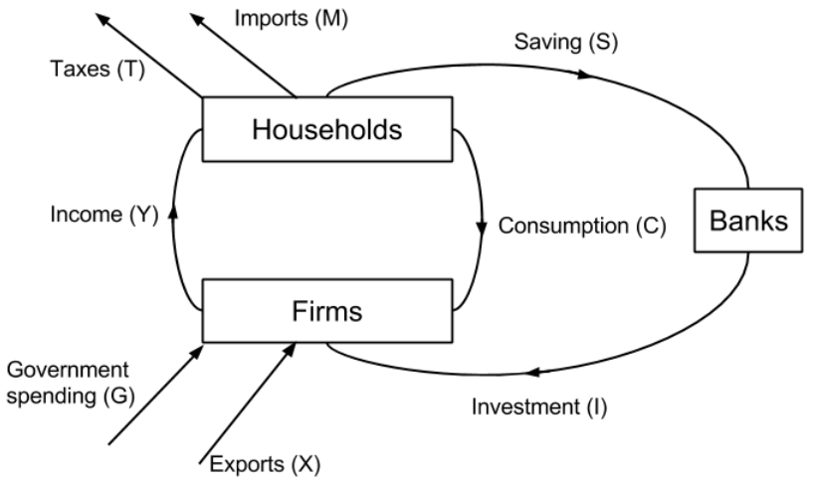
4.2.2.1. CIRCULAR FLOW OF INCOME
Illustrates the basic flows of money in an industry. In a closed economy with no government there are two economic agents – households & firms. Firms produce output. & then pay income to households. Households then use this income to buy goods.
INJECTIONS | Additions to the circular flow through investment, government spending or exports which boost the flow of income leading to a multiplied expansion of output.
WITHDRAWALS | Subtractions through taxation, imports & savings.
CIRCULAR FLOW OF INCOME EQUILIBRIUM | INJECTIONS = WITHDRAWALS
IMPACT OF TRADE | The households of an open economy will spend some of their income on goods from abroad, called imports (M), and this is withdrawn from the circular flow. Meanwhile exports (X) from abroad provide injections into the economy.
4.2.2.3. AGGREGATE DEMAND: CONSUMPTION & SAVING
This represent spending by households on consumer goods. In the UK Consumption totalled 66% of total GDP in 2016. It is the biggest component of UK AD. In China, consumption represents 39% of GDP.
MARGINAL PROPENSITY TO CONSUME (MPC) | This measures the proportion of extra income spent on consumption. MPC = ∆C / ∆Y E.g if a consumer has £100 disposable income & spends £65 the MPC will be 60/100= 0.6
FACTORS DETERMINING CONSUMPTION | Income levels. When people are poor, any increase in income is likely to be spent to improve their living standards. At higher income levels, people are likely to save the additional income. Interest rates. A lower interest rate will encourage greater consumption rather than saving. Yet, be aware that it may also reduce incomes earned from saving. Consumer confidence. When the economy is growing & unemployment is low, people will be more likely to spend & their MPC will be higher. This could be reinforced with a positive ‘wealth effect’ at such times & vice-versa. Temporary/permanent. If people receive a bonus, then they may be more inclined to save this temporary rise in income. However, if they gain a permanent increase in income, they may have greater confidence to spend it. Supply of credit. The ease of availability of car finance has raised consumption on new cars. Temporary/permanent income changes. A permanent increase in income often correlates with higher general spending. Yet workers, may decide to save a sudden windfall from a bonus.
MPC >1 ? | This is possible when people borrow to supplement their disposable income.
WITHDRAWALS FROM GROSS INCOME | Savings Imports Taxation These withdrawals reduce the size of the MPC & are referred to as the marginal propensity to withdrawal (MPW).
MPC & THE MULTIPLIER | The multiplier means that an injection into the circular flow of income will be associated with a larger final increase in GDP. The initial injection will lead to further consumption spending as a result of the initial spending MPC has a direct impact upon the size of the multiplier. If the MPC is high; the higher the multiplier effect will be & vice-versa.
MULTIPLIER CALCULATION | K = 1/ (1-MPC) = 1/ MPW (MPS+MPT+MPW) E.g. 1 / (1-0.6) = 2.5. Every £1 will lead to £2.50 extra spending.
FISCAL POLICY & THE MULTIPLIER | If the multiplier is small, fiscal policy will be less effective in increasing AD & vice-versa.
MULTIPLIER & CROWDING OUT | Monetarists believe that higher government spending through borrowing ‘crowds out’ private investment by reducing access to finance & increasing its cost. Thus, AD will not increase.
4.2.2.2. AGGREGATE DEMAND
The total demand for goods & services in an economy.
COMPONENTS | Consumption (C) Investment (I) Government expenditure (G) Exports (X) Imports (M)
CALCULATION | AD = C + I + G + (X – M)
DOWNWARD SLOPING | As prices fall, effective disposable income increases, proving wages remain constant If the UK has lower price levels, our exports will be more competitive & thus AD will be higher If prices are low, interest rates will usually be lower & this will increase AD.

Slide 38
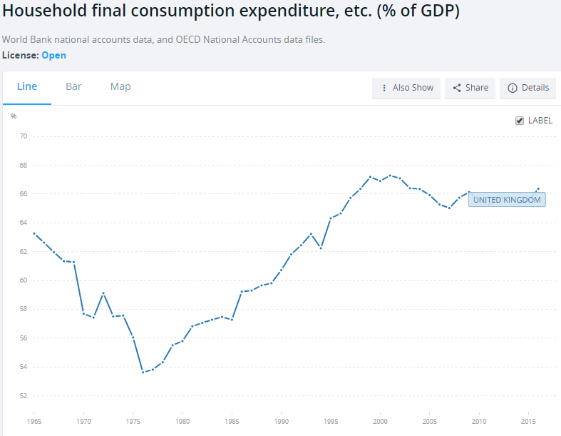
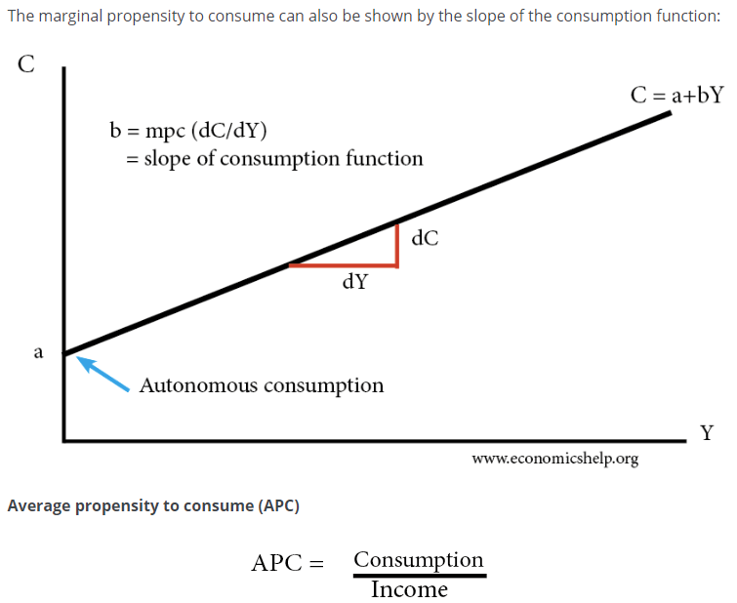
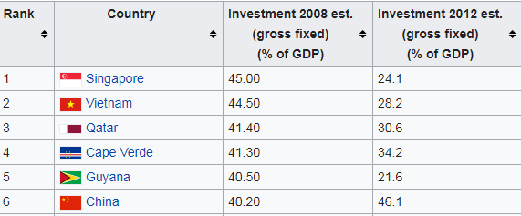
AVERAGE PROPENSITY TO CONSUME
The average propensity to consume = consumption / income.
AGGREGATE DEMAND: INVESTMENT
Investment refers to capital expenditure. That is expenditure in capital goods which can create output. If investment increases AD will increase. In addition, the LRAS of the economy may improve due to the increase in capital goods.
INVESTMENT & THE MULTIPLIER EFFECT | When there is spare capacity in the economy, increased investment will lead to deeper impacts throughout the economy. This will cause higher output and increased income which will lead to greater consumption and another increase in AD. If the MPC & therefore the multiplier is high, the increase in AD will be even greater.
INVESTMENT & THE LRAS | Investment in capital goods improves the productive capacity of the economy leading to a higher level of output & lower price level. A more sustainable level of growth.
EVALUATION | Investment rises & falls with the business cycle. In the UK investment is only around 15% of AD. This partly explains the poor productivity gains seen in the UK in recent times. This could be improved with subsidies & tax breaks. Investment involves opportunity cost. Money spent on investment may means lower dividend payments to shareholders & this may reduce consumption. Yet, in the longer term the economy may benefit. Investment decisions & motives can be questionable. For example, HS2 is a highly expensive, highly questionable government infrastructure project. Private sector investment may be far more efficient.
THE ACCELERATOR EFFECT & INVESTMENT
The accelerator effect states that investment levels are related the rate of change of GDP. Thus, an increase in the rate of economic growth will cause a correspondingly larger increase in the level of investment. But, a fall in the rate of economic growth will cause a fall in investment levels.
WHY DOES THE ACCELERRATOR EFFECT OCCUR? | When firms enjoy increases in demand, they may soon reach full capacity. If they anticipate this demand to continue to increase. They will need to expand their capacity or productivity they will need to invest. Businesses can benefit from greater expansion through financial & technological economies of scale.
OTHER CONSIDERATIONS FOR THE ACCELERATOR EFFECT | Investment in the UK has slumped despite increasing GDP. If GDP falls, or there is a great deal of uncertainty, investment will fall considerably. While GDP may be increasing it could be doing so at a slower rate & this may lead to falling investment. Investment decisions also involve a time lag between decision, financing & implementation Investment levels will depend upon business confidence which will depend upon the political & economic climate. Accelerator Coefficient. Represents the level of induced investment as a proportion of the rise in National income. Accelerator coefficient = Investment/change in income.

Slide 39
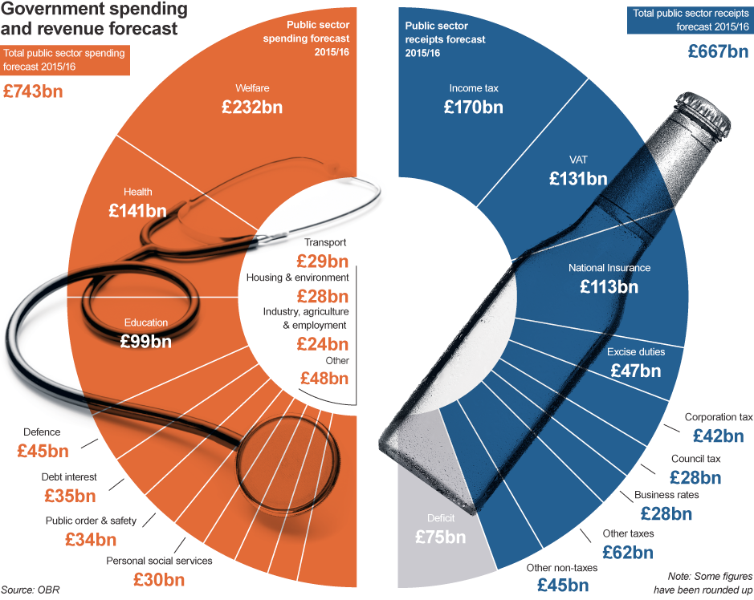
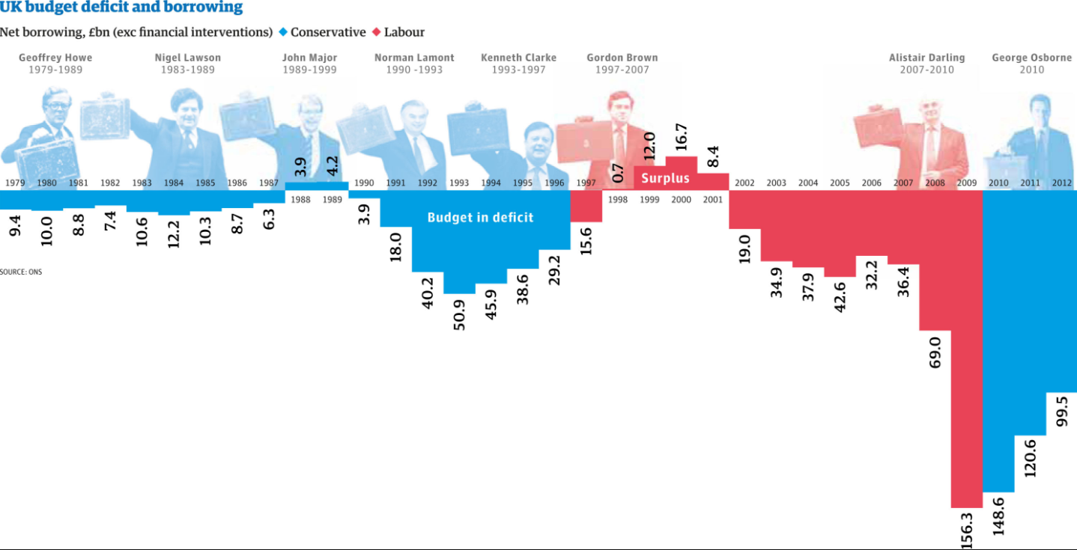
AGGREGATE DEMAND: GOVERNMENT EXPENDITURE
An increase in government expenditure can increase national output.
CATEGORIES OF GOVERNMENT EXPENDITURE | Current expenditure – expenditure on goods & services to directly satisfy individual or collective needs. Capital expenditure – Government spending to generate future benefits through infrastructure investment & research spending Transfer payments – This represents transfers on money through welfare & pension payments.
REASONS FOR GOVERNMENT EXPENDITURE | To correct market failure through missing markets in public & merit goods To implement supply side policies which potentially improve the long term productivity of an economy To inject money into the macro economy to increase AD. To correct market failures through negative externalities. To subsidise the agriculture industry which is subjected to volatile prices To redistribute income more equally.
GOVERNMENT EXPENDITURE & THE MULTIPLIER | The fiscal multiplier occurs when an increase in an injection generates a far greater increase in government economic output. The greater the multiplier, the greater the final increase in output will be & vice versa. This means fiscal expenditure will be most effective when the economy has a high multiplier.
FISCAL REVENUES | The government receives income through taxation. This includes direct taxation placed on income & company profits together with indirect taxation placed on goods and services e.g. Road tax, VAT, fuel duty & sin taxes.
THE FISCAL BUDGET | Tax revenue – Government expenditure
CROWDING IN & OUT | Monetarists believe the fiscal multiplier will be limited by the crowding out effect. E.g. Higher government spending will increase the cost of borrowing through higher bond yields, this will lead to higher borrowing costs for private firms & a decline in private sector investment. Thus AD may fail to increase at all. But Keynesians argue that the private sector typically has a surplus of non-productive savings, thus there will be a positive multiplier effect. Crowding in occurs where a reduction in government spending reduces bond yields & borrowing costs prompting private sector investment.
EVALUATION | How high is the MPC and therefore the multiplier? Thus how effective will expenditure be? Will government spending crowd out the private sector? Will capital expenditure be effective in raising the productive capacity of the economy? What impact will this spending have on the fiscal deficit? & therefore borrowing costs. Will fiscal austerity “crowd in” private sector investment? What are the potential time lags of taxation & expenditure – velocity of circulation?

Slide 40
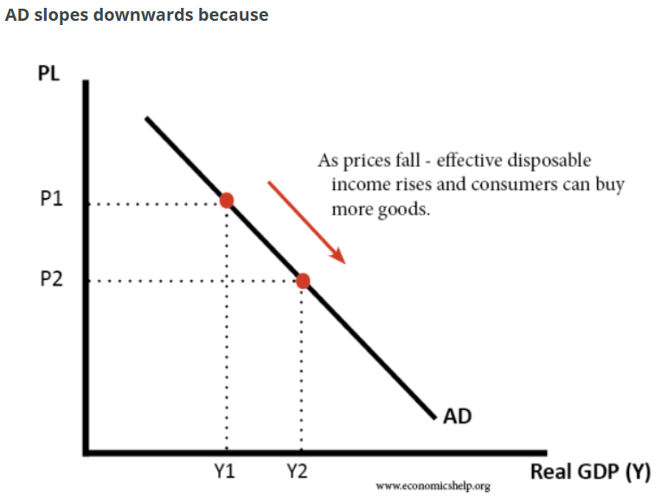
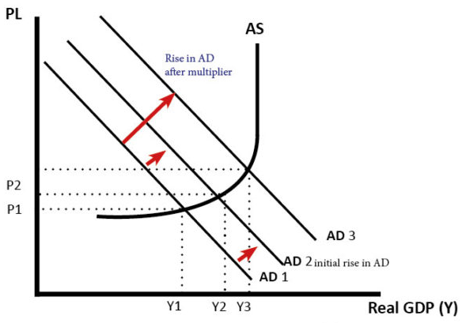
AGGREGATE DEMAND: NET EXPORTS
The net trade balance measures the total value of exported goods & services minus the total value of imported products & services.
TRADE SURPLUS & DEFICIT | A trade surplus means that X>M – therefore aggregate demand (AD) will increase. A trade deficit means that M>X – therefore AD will fall. Thus, there is a net leakage from the circular flow of income. If X=M, then the trade balance is zero, external trade will have a neutral effect on AD.
INCREASE EXPORTS TO IMPROVE TRADE BALANCE | Make the UK economy more competitive. E.g. an increase in labour productivity or better university & private sector links may improve innovation & improve UK export competitiveness. (Supply side policies). Increased economic growth in other countries, may lead to higher demand. Lower value of Sterling, this makes exports cheaper
DECREASE IMPORTS TO IMPROVE TRADE BALANCE | Make the UK more competitive, this makes goods from other countries appear less competitive. Lower value of Sterling, this makes imports more expensive (Expenditure switching policies) By undertaking contractionary monetary & fiscal policy to lower GDP, therefore consumers will have less money to spend. (Expenditure reducing policies).
EVALUATION | How policies may conflict with other MACROECONOMIC OBJECTIVES –which objectives are of greatest importance? J-CURVE, LERNER MARSHALL & TIME LAGS TIME LAGS of SUPPLY SIDE POLICIES–won’t help avoid an impending crisis. Does the TRADE BALANCE really matter? What’s the CAUSE? Are they just investing in capital goods?

Slide 41
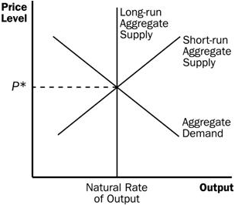
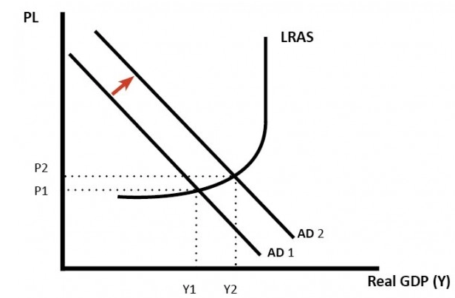
4.2.2.5 DETERMINANTS OF SRAS. 4.2.2.6. DETERMINANTS OF LRAS
This is the total value of goods & services produced in an economy. The aggregate supply curve shows the level of output at different price levels. When the economy reaches its maximum level of capacity (full employment & reflects the economy reaching the PPF boundary) the supply curve become perfectly inelastic. In the short term, firms are unable to produce greater output even at higher prices. The LRAS curve and the PPF are therefore closely linked.
FACTORS DETERMINING LRAS | Broadly speaking this concerns the quantity & quality of the key factors of production: Land Labour Capital The Entrepreneur Together with the ability to generate technological gains through improved capital goods & infrastructure
SRAS CURVE | In the short-run, capital is fixed. Firms can alter variable factors of production, such as labour. The SRAS is viewed as elastic, because in the short-run firms can increase output by getting workers to do overtime.
FACTORS INFLUENCING THE SRAS | Price of raw materials, e.g. oil, food, metals Cost of labour, (wages, taxes, regulation Levels of tax and subsidies
CLASSICAL INTERPRETATION | The classical view sees AS as inelastic in the long term. The classical view sees wages and prices as flexible, therefore, in the long-term the economy will maintain full employment. Classical economist believe economic growth is influenced by long-term factors, such as capital and productivity.
KEYNESIAN INTERPRETATION | Keynesians believe the long run aggregate supply can be upwardly sloping and elastic. They argue that the economy can be below the full employment level, even in the long run. For example, in recession, there is excess saving, leading to a decline in aggregate demand. Keynesians also believe wages and prices can be sticky, and therefore, economies don’t automatically return to full employment equilibrium.

Slide 42
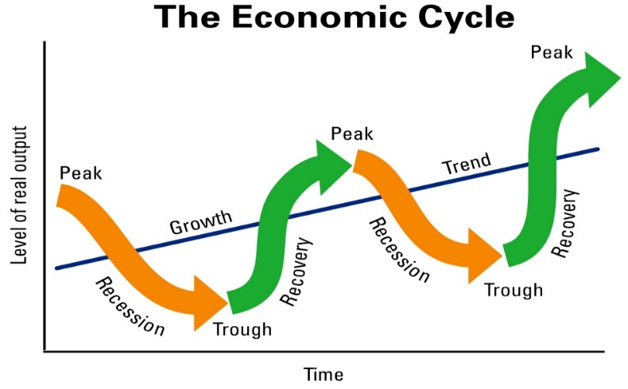
4.2.3. ECONOMIC PERFORMANCE
4.2.3.1 ECONOMIC GROWTH & THE ECONOMIC CYCLE
ECONOMIC GROWTH | In the short run, this is an increase in the country’s output. In the long run, this is an increase in the country’s productive potential. (Shift in LRAS.)
DETERMINANTS OF SHORT RUN GROWTH | Lower interest rates, increased debt, decreased taxation, higher consumer & business confidence, higher government spending, weaker exchange rate.
DETERMINANTS OF LONG RUN GROWTH | Increased factor productivity, increased population, increased competition, improved infrastructure.
ACTUAL GROWTH | An increase in real GDP
POTENTIAL GROWTH | An increase in the productive potential/long term capacity of the economy. .
OUTPUT GAP | The difference between the actual and potential output of an economy.
POSITIVE OUTPUT GAP | Where the actual output of an economy exceeds its potential
NEGATIVE OUTPUT GAP | Where actual output is less than the potential of the economy
TRADE/ECONOMIC CYCLE | Fluctuations in the economic cycle over time
ECONOMIC BOOM | At the top of the economic cycle where output and growth are high
RECESSION | Where economic growth is negative for two consecutive quarters.
PRODUCTION POSSIBILITY FRONTIER | Maximum level of output that an economy can achieve using its existing resources in full
SUSTAINABLE ECONOMIC GROWTH | Maintaining growth over very long time periods, thereby limiting the effects of the economic cycle
CAUSES OF ECONOMIC GROWTH
1. INCREASED AGGREGATE DEMAND | Lower interest rates, Increased labour productivity which will increase wages Increased government spending A depreciation of the currency may boost export earnings Increased consumer confidence may lead to more consumption & borrowing Lower taxation, which will increase disposable income Higher asset prices will give rise to a positive wealth effect & increased consumer & business confidence Financial stability will encourage more lending & borrowing .
2. INCREASED AGGREGATE SUPPLY | Investment in capital goods which increase productivity, Improved education will improve labour productivity in the long run A larger working population through immigration Improved technology which will boost productivity & reduce supply costs Technological improvements.
3. Other factors: | An environment of low inflation which helps to foster business & consumer confidence. Meanwhile exports will be maintained at a competitive level. A stable political & economic climate which promotes low inflation, certainty of business & consumer confidence which may give rise to inward investment.
ANALYSIS OF ECONOMIC GROWTH
BENEFITS | Living standards rise, output increases, lower unemployment which may reduce inequality. Fiscal dividend through the fiscal stabilisers of lower government spending & higher tax revenues, exports can rise, Positive accelerator effect where higher growth leads to higher investment. May attract inward FDI. Development occurs where investment in public & quasi public goods improves. This may give rise to increasing health standards & higher life expectancy.
COSTS | Inflation occurs as demand pull pressures rise & this gives rise to cost push pressures as wage demands increase. Imports may rise as consumption increases due to positive consumer confidence & possible wealth effects Inequality may increase as asset owners benefits from higher asset prices Negative externalities may occur through pollution & depletion of natural resources, boom may be unsustainable.
THE CONCEPT OF SUSTAINABLE ECONOMIC GROWTH & ITS DESIRABILITY
In the 19th Century Malthus believed that rising population & finite resources would lead to huge shortages. However, he failed to predict huge gains in productivity. At the time, Agricultural sectors represented the biggest employers in an economy. Now they represent a few %. Hence, greater economic efficiency can lead to far higher productivity gains. Yet, economic growth does clearly bring negative externalities & complete resource depletion which may have implications future generations.

Slide 43
4.2.3.2. EMPLOYMENT & UNEMPLOYMENT
UNEMPLOYMENT
CLAIMANT COUNT | The claimant count records the number of people receiving unemployment benefits from the government.
ILO/ IFS MEASURE UNEMPLOYMENT | The International Labour Organisation (ILO). The labour force survey is undertaken by the International Labour Organisation (ILO) and is a more direct assessment of unemployment, rather than those who claim benefit.
UNEMPLOYMENT RATE % | This is the % of people in the labour force without a job but registered as being willing and available for work
DEMAND SIDE CAUSES | Global recession Negative multiplier effect Financial crisis High interest rates.
SUPPLY SIDE CAUSES | Structural causes – mismatch of skills for key job roles Geographical immobility Real wage unemployment Technological change Frictional – search based unemployment
COSTS OF UNEMPLOYMENT | Loss of income for unemployed Less tax revenue & higher government borrowing Higher levels of government spending Loss of human capital Inefficient use of resources Opportunity cost Loss of cultural identity/ social & mental health problems.
TYPES OF UNEMPLOYMENT
STRUCTURAL | Occurs due to a changing nature of the structure of the economy. Globalisation has accelerated this process due to the offshoring of manufacturing.
CYCLICAL | When there is a recession or a steep slowdown in growth.
FRICTIONAL | Occurs when people are moving between jobs. Also known as ‘search’ unemployment.
TECHNOLOGICAL | Occurs due to capital goods replacing workers.
REAL WAGE | Where the available supply of workers is greater than the demand. This could be due to a living wage which is set too high.
VOLUNTARY | People choosing to stay on benefits, rather than work.
POLICY RESPONSES TO UNEMPLOYMENT
Expansionary Monetary Policy | Reducing interest rates to stimulate demand through higher consumption & business investment. Promotes borrowing & further spending & investment, while reducing saving. Paradox of thrift – may not stimulate consumption.
Expansionary Fiscal Policy | Reducing taxation to stimulate demand through higher consumption & business investment. Increased government spending. Yet we have a persistent fiscal deficit.
Supply side policies | To improve training & education to upgrade skills of the workforce. Promote business start-ups. But these costly & may not work.
NATURAL RATE OF UNEMPLOYMENT
This occurs when the labour market is in equilibrium yet unemployment persists. This natural rate occurs due to a combination of structural, frictional & even voluntary unemployment. Consequently there will always be a gap between the total labour force available & the market equilibrium.
MONETARIST INTERPRETATION | We can view the natural rate using a monetarists interpretation of the Phillips curve. Here, monetarists believe that the LRAS is inelastic, meaning that further AD increases give rise to only temporary increases in output. Wages rise to help generate higher output & this gives rise to higher inflation. As workers adapt their expectations, they realise that the wage increase is nominal & not real. Consequently, the supply of labour falls & unemployment returns to its natural rate. Monetarists believe that it is only possible to reduce unemployment by increasing the rate of inflation. Thus, the natural rate is known as the NAIRU – Non-Accelerating Inflationary Rate of Unemployment. NAIRU refers to a specific level of unemployment that is evident in an economy that does not cause inflation to rise up Yet monetarists, assume workers fail to predict inflationary changes instead they have adaptive expectations.
YOUTH UNEMPLOYMENT
Cyclical unemployment Financial crisis/ recession Lack of enterprise experience/ entrepreneurial talent Real wage unemployment Lack of graduate jobs or alternatively a lack of qualifications Hysteresis represents the concept that previous unemployment trends may lead to future unemployment. If people are unemployed, their lack of experience, skill & knowledge development makes it more likely that they will fail to find a job later. This downward spiral may mean people become demotivated and fail to undertake further training.
EVALUATION of concept as a whole | Types of unemployment are important but there will be some ‘generic’ problems consequently the size of unemployment might be the important factor. Should policies be aimed at looking to reduce/eradicate unemployment or at looking to deal with the problems caused by the unemployment? How much influence can a government have on unemployment, especially in a global economy, and hence how should this affect its approach? The whole issue of ‘do unemployment figures represent the true case?’ – e.g. unemployment vs underemployment and the issue of full-time vs part-time jobs. Are there possible problems from making unemployment too ‘tolerable’? - ‘make work pay’ etc.

Slide 44

4.2.3.3. INFLATION & DEFLATION
KEY DEFINITIONS
CONSUMER PRICE INDEX (CPI) | Measures changes in the price level of a weighted average of prices of a basket of consumer goods and services purchased by households. It leaves the costs of your home out of the basket.
RETAIL PRICE INDEX (RPI) | A measure of inflation published by the Office for National Statistics monthly. It measures the change in the cost of a representative sample of retail goods and services. It includes housing costs such as mortgage payments, rents & council tax.
INDEX NUMBERS | An economic data figure reflecting price or quantity compared with a base value. The base will equal 100 and the index number is usually expressed as 100 times the ratio to the base value.
THE BASKET OF GOODS | A relatively fixed set of consumer products and services valued on an annual basis and used to track inflation in a specific market or country. The goods in the basket are often adjusted periodically to account for changes in consumer habits
INFLATION | The general rise in prices
CORE INFLATION | Excludes certain items that have volatile prices e.g. oil, gas.
DEFLATION | Reduction in the general level of prices.
HYPER INFLATION | Very high & accelerating rates of inflation where domestic currency becomes worthless.
DEMAND-PULL INFLATION | Occurs when aggregate demand increases at a faster rate than aggregate supply.
COST-PUSH | Inflation caused by rising input costs including staff wages & raw material costs. Causes a leftward shift in SRAS.
STAGFLATION | A stagnant economy with rising prices, may be due to cost push factors in a slump
DEFLATIONARY POLICIES | Policies that may target a reduction in AD.
IMPORTANCE OF INFLATION
GOVERNMENT’S NEED INFLATION | Due to persistent budget deficits and rising national debts. Inflation reduces the real size of national debts.
THE ECONOMY NEEDS INFLATION | High private sector debt means r
BUT INFLATION CAUSES INEQUALITY | Inflation is an effective tax which erodes the real value of currency. This has a disproportionate effect on the poor. Inflation steals the time people have put into earning that currency. This means that unearned income
DEFLATION | Can have some negative consequences but it does mean that people’s purchasing power rises. But in a debt based economic system, deflation increases the real size of debts.
COMMODITY PRICES & INFLATION | Commodities can have a dramatic impact upon inflation. This is particularly true of oil prices which can result in far greater
CHANGES IN OTHER ECONOMIES CAN AFFECT UK INFLATION | Monetary policy decisions by the Federal Reserve or the ECB can have a dramatic impact upon CPI inflation in the UK. E.g. It may cause exchange rates to change and thus import & export prices may fluctuate.

Slide 45


INDEX CALCULATION
ITEM | PRICE CHANGE % | INDEX no. | Weight | Product
Bread | +60% | 160 | 80 | 12800
Butter | +10% | 110 | 20 | 2200
 |  |  | 100 | 15000
Weighted index = 15,000/ 100 = 150. 50% increase in price.
CAUSES OF INFLATION
DEMAND-PULL | Cut in interest rates – raising disposable income & borrowing Increased money supply Higher wages – which will give rise to further cost push pressures Higher government spending
COST-PUSH | Higher wages – meaning that average total costs will rise Depreciation in the exchange rate leading to W£IDEC Increase in VAT Inflation expectations which can become a self-fulfilling prophecy Increased commodity prices – which means prices may be increased.
EFFECTS | Menu costs – costs incurred changing prices Search (shoe leather) costs – switching costs Reduced purchasing power of consumers as disposable incomes fall Uncertainty & lack of investment – due to Psychological effects on consumers – inflation illusion (do people only consider nominal wealth & income rather than real changes?) Redistributional effects – borrowers benefit from inflation as the real value of debt falls & lenders (savers) lose out as the real value of their loans or savings fall. Fiscal drag – as wages rise people are pushed into higher tax brackets on a progressive system. Balance of payments effects – Imports may become more competitive due to domestic inflation & exports will become less competitive in international markets. The trade balance may then deteriorate, & a depreciation of the exchange rate occurs.
EVALUATION | If inflation is anticipated businesses & consumers can plan for this so is this a problem if inflation is stable? Can the inflation actually be controlled? In a globalised economy is this truly possible? High demand pull inflation will bring higher employment levels & perhaps higher firm profits. Are real wages increasing? If so, is there a problem? How severe are the effects of inflation? How long is the anticipated duration? Conflict with other macroeconomic objectives?

Slide 46

4.2.6.3 THE BALANCE OF PAYMENTS ON CURRENT ACCOUNT
BALANCE OF PAYMENTS
The balance of payments is the record of a country’s transactions / trade with the rest of the world.
THE BALANCE OF PAYMENTS CONSISTS OF: | 1. Current Account (trade in goods, services + investment incomes + transfers) 2. Capital Account / Financial Account (capital and financial flows, net investment, portfolio investment) 3. Errors and omissions. It is hard to collect all data so some is missed out.
WHY IT BALANCES | In theory there should be a balancing between capital and current / financial account. If there is a current account deficit, there should be a surplus on the capital / financial account.
DTS Impact of CA deficit
BALANCE OF PAYMENTS – THE CURRENT ACCOUNT (CA)
Measures the inflow and outflow of goods, services and investment incomes.
COMPONENTS OF THE CA | Trade in goods Trade in services Primary income (e.g. UK earnings from direct investment, shares, debt, bonds) Secondary income (e.g. General government transfers) The TRADE BALANCE measures, 1&2, the trade in goods – the trade in services.
CA DEFICIT | Where the value of imports & investment outflows is greater than the value of exports & investment inflows
CA SURPLUS | Where the value of exports & investment inflows is greater than the value of imports investment outflows.
CAUSES OF A CA DEFICIT | Overvalued exchange rates (SUPPLY SIDE). An overvalued exchange rate means exports are more expensive, but imports are cheaper. This encourages domestic consumers to buy imports. It also makes it hard for exporters because they are relatively uncompetitive. High consumer spending (DEMAND SIDE). If there is rapid growth in consumer spending, then there tends to be an increase in imports causing a deterioration in the current account. Unbalanced economy (DEMAND SIDE). An economy focused on consumer spending rather than investment and exports will tend to have a bigger current account deficit. Competitiveness (SUPPLY SIDE). Less competitive export firms will mean less exports abroad. Growing deficit in investment incomes . The UK has a deficit in trade in goods. But, since 2011 the current account deficit has been increased due to a fall in direct investment income.
CONSEQUENCES OF CA DEFICIT | TRADE DEFICIT will mean imports > exports which will reduce AD. Lower AD will mean reduced economic growth. Less demand for exports will cause a DEPRECIATION in the EXCHANGE RATE – W£IDEC – STAGFLATION! Debt burden – if this becomes unsustainable, it may cause a CURRENCY CRISIS & ECONOMIC CRISIS.
EVALUATION | Does a deficit really matter? If it is caused by DEMAND SIDE factors resulting from high GDP growth, it shouldn’t matter. How is it funded? Via short-term speculative investment or Long-term? Where does the CA deficit feature in importance of macroeconomic objectives?
DOES THE CURRENT ACCOUNT DEFICIT MATTER?
YES | It is a sign of uncompetitiveness, which will lead to lower economic growth and poorer prospects in the long run. If capital / financial flows dry up, it could lead to depreciation in the exchange rate and a fall in living standards It is a sign of an unbalanced economy.
NO | The UK has had a persistent deficit since the mid 1980s. Countries with large current account surplus have not necessarily done better, e.g. Japan had a long period of stagnation. In an era of globalisation, financial flows are easier to attract and therefore the deficit is financed by these capital inflows. If the current account was too large, there should be a depreciation in the exchange rate to restore the balance. A current account deficit is a bigger concern in a fixed exchange rate (like Euro) because there is no option of depreciation.

Slide 47
4.2.3.4. POSSIBLE CONFLICT BETWEEN MACROECONOMIC POLICY OBJECTIVES
2- MACROECONOMIC OBJECTIVES - CIGARS
CURRENT ACCOUNT | The focus here should be on ensuring international competitiveness & ensuring that a current account deficit does not become too large.
INFLATION | Inflation should be low & stable. The Bank of England works to a medium term target of 2% inflation on the CPI.
GROWTH | GDP Growth & the benefits that this brings. However, the costs should be carefully managed.
ADVANCES IN PRODUCTIVITY | Employment should be high & ideally their should be productivity & real wage growth.
RATE OF UNEMPLOYMENT | Government policies help to correct inequalities of wealth & income.
STABLE GOVERNMENT FINANCES | The government should seek to pursue sustainable policies
EVALUATION | Do all governments necessarily have the same ultimate objective?/ Does the time scale and the economic situation affect the relative importance? For LEDCs, a small increase in income can generate huge gains in utility. Is economic growth a ‘sufficient’ objective or merely a necessary step towards some other objective, e.g. improved standard of living, improved physical quality of life indicators, happiness? It also depends upon the nature of economic growth. E.g. must not create too many negative externalities & the distribution of economic growth – who benefits from the economic growth. If growth benefits primarily the richest in society, growth may do little to overcome poverty. Why is economic growth the principal objective for a government, instead of the others?
ANALYSIS OF MACROECONOMIC OBJECTIVES
BENEFITS OF ECONOMIC GROWTH | Higher average income Lower unemployment Lower government borrowing Improved public services Money can be spent on protecting the environment Increased investment Increased research & development
SIMULTANEOUS ACHIEVEMENT OF OBJECTIVES | Economic growth will also help to keep employment high. Investment may help to boost productivity & therefore international competitiveness. This will boost the supply side of the economy.
CONFLICTING ECONOMIC OBJECTIVES | Economic growth often conflicts with inflation, damage to the environment & rising inequality. Meanwhile, short run pursuit of economic growth may lead to debt build up which leads to boom/ bust economic cycles. However, recessions are a real opportunity for implementing change. “Never let a good crisis go to waste.”
OUTPUT GAPS | Negative output gaps will increase unemployment & lead to disinflationary or even deflationary pressures.

Slide 48
4.2.4. FINANCIAL MARKETS & MONETARY POLICY
4.2.4.1. THE STRUCTURE OF FINANCIAL MARKETS & FINANCIAL ASSETS
CHARACTERISTICS & FUNCTIONS OF MONEY | Money should be a store of value. Money is a unit of account. Money is a medium of exchange.
THE MONEY SUPPLY | The total amount of money circulating in an economy. This includes NARROW & BROAD money. NARROW money refers to the notes & coins in circulation & other money equivalents e.g. bank deposits. BROAD money is the total amount of money held by households & companies in an economy.
MONEY MARKET | Refers to trading in very short-term debt investments. At the wholesale level, it involves large-volume trades between institutions and traders. At the retail level, it includes money market mutual funds bought by individual investors and money market accounts opened by bank customers.
CAPITAL MARKET | Where savings and investments are moved between suppliers of capital and those who are in need of capital. Capital markets consist of the primary market, where new securities are issued and sold, and the secondary market, where already-issued securities are traded between investors.
FOREIGN EXCHANGE MARKET | Where currencies are traded.
ROLE OF FINANCIAL MARKETS | 1.To facilitate saving by businesses and households: Offering a secure place to store money and earn interest 2. To lend to businesses and individuals: Financial markets provide an intermediary between savers and borrowers 3. To allocate funds to productive uses: Financial markets allocate capital to where the risk-adjusted rate of return is highest 4. To facilitate the final exchange of goods and services such as contactless payments systems, foreign exchange etc. 5. To provide forward markets in currencies and commodities: Forward markets allow agents to insure against price volatility 6. To provide a market for equities: Allowing businesses to raise fresh equity to fund their capital investment and expansion
DEBT VS EQUITY | Debt is money owed to another person or institution. Equity represents ownership in an asset. This may be a percentage share in the asset.
MARKET INTEREST RATES & BOND PRICES | If a £100 bond, yielding 2%, sells off badly as investors perceive a lack of creditworthiness in the UK, it would result in a rising yield. Or a bond rally would cause yields to fall while the bond price would rise.
BOND VALUE | YIELD | RETURN P/A
£100 | 2% | £2
£50 | 4% | £2
£200 | 1% | £2
4.2.4.2. COMMERCIAL BANKS & INVESTMENT BANKS
COMMERCIAL BANKS | Is where most people do their banking. Commercial banks make money by providing and earning interest from loans such as mortgages, auto loans, business loans, and personal loans. Customer deposits provide banks with the capital to make these loans.
INVESTMENT BANKS | Is a financial services company or corporate division that engages in advisory-based financial transactions on behalf of individuals, corporations, and governments.
OBJECTIVES OF COMMERCIAL BANKS | Profit maximisation – achieved by borrowing short term & relending. However, banks must reach a trade off between liquidity & profitability. Liquidity helps to prevent the chance of a bank run. But means capital is not used to generate a return. Liquidity helps to build security & ensures good risk management & avoiding insolvency.
IMPACT OF BANK FAILURE | Systemic risk to other banks, recession, loss of jobs, lost output. Bank bailouts (privatised profits but nationalised losses.)
BANK CREDIT CREATION | Banks create 97 percent of new currency via the creation of new lending (credit).

Slide 49
4.2.4.3. CENTRAL BANKS & MONETARY POLICY
CENTRAL BANKS | A central bank is an independent national authority that conducts monetary policy, regulates banks, and provides financial services including economic research. Its goals are to stabilize the nation's currency, keep unemployment low, and prevent inflation.
MAIN FUNCTIONS OF A CENTRAL BANK | Currency regulator or bank of issue. Bank to the government. Custodian of Cash reserves. Custodian of International currency. Lender of last resort. Clearing house for transfer and settlement. Regulator of credit creation. Protecting depositors interests.
BANK BASE RATE | Represents the cost of borrowing & the reward for saving.
MONETARY POLICY (MP) | CREDIT AVAILABILITY – As the Bank regulator, they can determine the amount of credit availability for mortgages, consumer credit and business loans. QUANATITATIVE EASING– this involves printing currency which is then distributed to banks & pension funds in return for UK government bonds. It has the same impact as reducing interest rates as money supply increases & bond yields decrease. FORWARD GUIDANCE– reflects verbal assurances from the governor of the Bank of England about the intended direction of monetary policy. This is said to help to boost investor & consumer confidence RESERVE REQUIREMENT– reflects the Central Bank’s regulation that determines the minimum amount of reserves that commercial banks must hold.
OBJECTIVES OF MP | Low inflation – CPI target is 2% +/- by 1%. With lower inflation business investment is more likely to increase. Stable economic growth.
THE MONETARY POLICY COMMITTEE (MPC) | The Monetary Policy Committee is a committee of the Bank of England, which meets for three and a half days, eight times a year, to decide the official interest rate in the United Kingdom.
FACTORS FOR CONSIDERATION OF BANK BASE RATE | Economic slack Real wage growth Indebtedness Value of sterling Events overseas.
COMMERCIAL BANK BALANCE SHEET
ASSETS | LIABILITIES (CAPITAL)
CASH £1,000 | CUSTOMER DEPOSIT £1,000
LOAN TO CUSTOMER £10,000 | MONEY LENT TO CUSTOMER £10,000
4.2.4.3. MONETARY POLICY (MP)
EXPANSIONARY (LOOSE) MONETARY POLICY | Here interest rates are reduced to stimulate Aggregate Demand, increasing consumption, borrowing & investment. This will also cause a depreciation in the currency: W£IDEC.
CONTRACTIONARY (TIGHT) MONETARY POLICY | Interest rates will be increased, reduce Aggregate Demand, decreasing consumption, borrowing & investment. This will cause an appreciation in the exchange rate: SPICED. This could be accompanied by an increase in reserve requirement ratios to further reduce lending & improve banking sector liquidity.
HOW MP WORKS | MP is set by the Central Bank They have independence from the government but try to met the CPI inflation target of 2% +/- 1%. They set the base rate Base rate changes which affects the savings & borrowing rates for consumers & businesses. This then influences consumption, investment & savings activity.

Slide 50



How Monetary Policy works.
Impact of Contractionary Monetary policy.

Slide 51
BANK OF ENGLAND MONETARY POLICY COMMITTEE (MP) & INFLATION TARGETING
The Committee of members from the Bank of England who determine monetary policy for the UK economy through interest & exchange rates & the money supply.
2% CPI TARGET | The MPC targets a CPI Inflation rate of 2% +/- 1%.
ARGUMENTS IN FAVOUR OF INFLATION TARGET | Importance of controlling inflationary expectations and the impact of these expectations on wage and price-setting To try to control demand pressures within an economy The various causes of inflation and whether it is feasible to target inflation caused by, for example, cost-push pressures. Can a monetary authority not compensate for the factors outside their control? Just because certain contributing factors can’t be controlled, does this mean that all intervention is meaningless?
ARGUMENTS AGAINST AN INFLATION TARGET | Does the setting of a target in itself serve any purpose? The difference between having a target that is unattainable and not having a target at all. There are a wide range of factors outside of the control of the monetary authorities due to fluctuating commodity prices, globalisation & exchange rate changes. Would core inflation be a better target? This measures the long run trend in the price level and excludes the more volatile goods such as food and energy prices which the MPC cannot control anyway.
EVALUATION OF INFLATION TARGETTING | Potential conflicts in terms of inflationary targets and other macroeconomic objectives. Just because a target cannot be achieved, does this make its existence a waste of time? What purpose does an inflation target serve? Does it matter if it is not met? Differing relative importance of outside factors over time. The extent to which the Monetary Policy Committee can realistically be expected to see far enough into the future to realistically be able to set the correct level of interest rates. How successful has inflation targeting been & who determines what success really means? How credible is the MPC?
MONETARY POLICY CRITICISMS
Some limitations of monetary policy include: Liquidity Trap – This occurs when a cut in interest rates fail to stimulate economic activity. e.g. because of low confidence or banks don’t want to pass base rate cut onto consumers. Difficult to control many objectives with one tool – interest rates. For example, a rise in oil prices causes cost-push inflation and lower growth. The Bank could increase interest rates to reduce inflation, but, it would cause economic growth to fall as well. In 2009, inflation rose to rising oil prices, but the economy was also in recession; the Bank decided to ‘allow’ the temporary inflation and concentrate on economic recovery. Changing interest rates affects the exchange rate. Tight monetary policy causes an appreciation in the exchange rate which will make exports less competitive. Interest rates may affect some parts of the economy more than others. e.g. higher interest rates increase the disposable income of people with savings. But, could cause homeowners to be unable to afford their mortgages. Time lags – If the Bank of England change base rates, it can take up to 18 months for the effects to filter through the economy. For example, if people have a two-year fixed mortgage, they will not notice until they re-mortgage. This means the Bank needs to predict future inflation so that they can change interest rates in anticipation.

Slide 52

QUANTITY THEORY OF MONEY
Shows the relationship between the money supply, the general level of prices & the level of output in an economy. It is based on the equation of exchange, that increases in the money supply, M, will lead to increases in the price level, P.
EQUATION OF EXCHANGE (The Fisher Equation) | Distinguishes between the real & the money side of the economy. MV ≡ PT M is the total amount of money in the economy (the money supply). V is the velocity of circulation of money. P is the average price of each transaction made in the economy. T is the total number of transactions made over a period. T is difficult to measure so it is often substituted for Y = National Income MV = PY where Y = national output The above equation must hold the value of expenditure on goods and services must equal the value of output.
EXAMPLE | If M = £100 where it has changed hands 4 times (V) over a period of time. Thus M X V = £400. If P (avg. price) is £2 there will have been 200 separate transactions (T) over the period.
WHY MONEY SUPPLY LEADS TO INFALTION | According to monetarists, in the short term, V is fixed. Due to V being determined by institutional factors such as regularity of pay days. They also believe that Y is fixed in the short run (remember the vertical, inelastic LRAS curve). Consequently, increasing the money supply will lead to inflation.
OTHER POINTS | Milton Friedman predicted an increase in the money supply would take about 9-12 months to lead to higher output. Friedman placed great emphasis on the role of price expectations. If there are expectations of higher inflation, it becomes self-fulfilling – workers demand higher wages to meet rising living costs. Firms put up prices to meet rising costs. Strict monetarist policies would help reduce expectations. After another year output will return to its initial equilibrium causing prices to rise to accommodate the rise in money supply
FRIEDMAN’S K-PERCENT RULE | Milton Friedman argued that the money supply should rise by a fixed k-percent each year. This rate of increase should depend on institutional factors and be determined independently of policymakers. Friedman believed this rule would avoid the extremes of deflation (Falling money supply, e.g. Great Depression) and inflation due to rising money supply. It would give business strong expectations of what would happen to money supply and inflation.
DIAGRAM ANALYSIS | Following a rise in the Money Supply, consumers have more money and therefore spend more money on goods; this shifts AD to the right. AD1 to AD 2. Firms respond by increasing output along SRAS. Real output increases from Y1 to Y2. National output now exceeds the equilibrium level of output. Therefore there is an inflationary gap. Firms need to hire more workers, so wages rise leading to an increase in costs and hence prices. Initially, workers agree to work more hours because they see an increase in nominal wages. As prices rise money can buy less, therefore, there is a movement to the left along the new AD. Also, workers realise the increase in nominal wage is not a real wage increase. Therefore, workers also demand higher nominal wages to produce more output and to compensate them for rising prices, therefore SRAS shifts to the left. The economy has returned to the equilibrium level of output (Y1), but at a higher price level (P3). Therefore the rise in the Money Supply cause a rise in AD, But because the LRAS is inelastic there is no increase in real output, but inflation rises. It is a form of demand-pull inflation.
MILTON FRIEDMAN | “Inflation is always & everywhere a monetary phenomenon”.

Slide 53
4.2.4.4. THE REGULATION OF THE FINANCIAL SYSTEM
ROLE OF THE BANK OF ENGLAND | Currency regulator or bank of issue. Bank to the government. Custodian of Cash reserves. Custodian of International currency. Lender of last resort. Regulator of credit creation. Protecting depositors interests.
PRUDENTIAL REGULATION AUTHORITY (PRA) | Create policies for firms to follow as well as watch over aspects of the business – we call this supervision. We want to ensure that the financial services and products that we all rely on can be provided in a safe and sound way. PRA were established as part of a new wave of regulation in financial services after the financial crisis of 2007. We now supervise around 1,500 financial institutions including banks and insurance companies.
FINANCIAL POLICY COMMITTEE (FPC) | Collecting information about financial markets. It’s vital we talk to people working in financial markets so we understand what’s happening, what the risks are and consider how to address them together. Managing market operations – the buying and selling of things owned by the government, to change the amount of money available in banking system. A few examples of this are quantitative easing, printing money and managing the UK’s gold and money reserves (our country’s investments) on behalf of the government. We also hold a small number of foreign currency reserves, and carry out payments to other countries for government departments and a small number of their customers. Setting standards for financial markets. By doing this, we aim to make sure financial markets are fair and there when you need them.
FINANCIAL CONDUCT AUTHORITY (FCA) | Prevent misconduct- They will investigate and enforce against classic types of misconduct such as insider trading and shadow-banking. Providing advice Launching legal investigations - As an arm of the UK government, the FCA reserves the right to investigate any person or entity that they have a reasonable suspicion of being guilty of financial crime.
LIQUIDITY RATIOS
CAPITAL RATIOS
MORAL HAZARD | Occurs when an entity has an incentive to increase its exposure to risk because it does not bear the full costs of that risk. For example, when a corporation is insured, it may take on higher risk knowing that its insurance will pay the associated costs.
SYSTEMIC RISK | Refers to the risk of a breakdown of an entire system rather than simply the failure of individual parts. In a financial context, if denotes the risk of a cascading failure in the financial sector, caused by linkages within the financial system, resulting in a severe economic downturn.

Slide 54
4.2.5. FISCAL POLICY & SUPPLY-SIDE POLICIES
4.2.5.1 FISCAL POLICY
DEFINITION | The manipulation of government spending, taxation & borrowing to influence aggregate demand & provide public goods. It can also influence Aggregate Supply by changing the incentives to work, thus leading to microeconomic effects. Stimulate economic growth in a period of a recession. Keep inflation low (UK government has a target of 2%) Fiscal policy aims to stabilise economic growth, avoiding a boom and bust economic cycle.
FISCAL BUDGET | A statement of the spending & income plans of an individual, firm or government.
BUDEGT SURPLUS | Arises due to spending being less than tax receipts.
BUDGET DEFICIT | Arises due to spending being greater than tax receipts.
NATIONAL DEBT | Accumulated budget deficits amounting to a nation’s debt.
PUBLIC SECTOR BORROWING REQUIREMENT | Where the government runs a budget deficit it will be financed by the PSBR. It will sell national savings certificates and securities such as gilts or treasury bills and bonds.
DEMAND MANAGEMENT | Government use of fiscal & other policies to manipulate the level of aggregate demand.
EXPANSIONARY FISCAL POLICY | Increased government spending & decreased taxation to increase aggregate demand via G, I & C. While T is reduced. This helps combat a NEGATIVE OUTPUT GAP.
CONTRACTIONARY FISCAL POLICY | Decreased government spending & increased taxation to decrease aggregate demand due to potential overheating or a positive output gap.
FISCAL AUSTERITY | Reduced government spending & increased taxation to correct a persistent budget deficit. (Often used together with expansionary monetary policy).
TYPES OF GOVERNMENT EXPENDITURE | Current expenditure – expenditure on goods & services to directly satisfy individual or collective needs. Capital expenditure – Government spending to generate future benefits through infrastructure investment & research spending Transfer payments – This represents transfers on money through welfare & pension payments.
LAFFER CURVE | Increasing taxes from a low level will mean tax revenues will increase. However, beyond a given point, tax increases will lead to falling tax receipts, as people have less incentive to work.
DIRECT TAXATION | Taxation placed directly upon incomes & company profits e.g. National Insurance, income tax & corporation tax.
INDIRECT TAXATION | Taxation placed upon goods & services e.g. VAT, Sin taxes.
REGRESSIVE TAXATION | Where the tax rate decreases as the amount subject to taxation rises. Indirect taxes represent regressive taxation due to the fact that poorer people will lose more of their disposable income to such charges.
PROGRESSIVE TAXATION | Based on the taxpayer's ability to pay. It imposes a lower tax rate on low-income earners than on those with a higher income. This is usually achieved by creating tax brackets that group taxpayers by income ranges.
CROWDING OUT | Government spending may fail to increase overall aggregate demand because higher government spending causes an equivalent fall in private sector spending and investment. This can be due to the opportunity cost of finance being used by the government rather than the private sector.
CROWDING IN | Where private sector investment increases in response to changes in government spending. E.g. with austerity, it is often cited that this may improve private sector incentives or frees capital for private sector investment.
AUTOMATIC FISCAL STABILISERS | When the economy grows tax revenues will increase from direct taxation and indirect taxation as people & firms earn more & consume more. This helps to dampen demand. While welfare benefits will be lower. The Opposite happens in a recession.
MARGINAL RATE OF TAXATION | The amount of tax paid on an additional £ of income
AVERAGE RATE OF TAXATION | Percentage of total income deducted for taxation.
FISCAL POLICY & the MULTIPLIER | Increasing Government spending can be particularly beneficial when the multiplier is high. When low government spending will have less impact on AD.

Slide 55


FISCAL POLICY – STRANDS OF EVALUATION
FISCAL POLICY & INCENTIVES | How different taxes affect different people in varying ways – e.g. with varying tax rates it possibly acts as an incentive for some and a disincentive for others. • Does the benefit depend upon the state of the economy? If there are no jobs available, benefits can hardly act as a disincentive to work. • Is it not the way in which tax revenue is raised that is all important? For example, a tax on expenditure would hardly act as a disincentive to work.
FISCAL POLICY & ITS ABILITY TO IMPROVE INEQUALITY | The extent to which reduction of the inequality of income is still a macroeconomic objective. • Whether fiscal policy is the only way that inequality can be reduced. Are there supply-side alternatives? Might industrial policy help? • The degree to which fiscal policy will be successful in tackling inequality depends upon correctly identifying the causes of inequality. • Making the tax and benefit system more progressive may not have as large an effect on inequality as expected – they may distort incentives & generate more inflation. • Contextualising this within the context of the UK’s recent economic history – the extent to which this might have been tackled in the 16 years of unbroken growth and the extent to which this is unlikely to happen in the near future with the public finances in their current state.
GENERAL POINTS | It depends on the size of the multiplier. If the multiplier effect is large, then changes in government spending will have a bigger effect on overall demand. It depends on the state of the economy. Fiscal policy is most effective in a deep recession where monetary policy is insufficient to boost demand. In a deep recession (liquidity trap). Higher government spending will not cause crowding out because the private sector saving has increased substantially. See: Liquidity trap and fiscal policy – why fiscal policy is more important during a liquidity trap. It depends on other factors in the economy. For example, if the government pursue expansionary fiscal policy, but interest rates rise, and the global economy is in a recession, it may be insufficient to boost demand. Bond yields. If there is concern over the state of government finances, the government may not be able to borrow to finance fiscal policy. Countries in the Eurozone experienced this problem in the 2008-13 recession.
FISCAL POLICY CRITICISMS
The government may have poor information about the state of the economy and struggle to have the best information about what the economy needs. Time lags. To increase government spending will take time. It could take several months for a government decision to filter through into the economy and actually affect AD. By then it may be too late. Crowding out. Some economists argue that expansionary fiscal policy (higher government spending) will not increase AD because the higher government spending will crowd out the private sector. This is because the government have to borrow from the private sector who will then have lower funds for private investment. Government spending is inefficient. Free market economists argue that higher government spending will tend to be wasted on inefficient spending projects. Also, it can then be difficult to reduce spending in the future because interest groups put political pressure on maintaining stimulus spending as permanent. Higher borrowing costs. Under certain conditions, expansionary fiscal policy can lead to higher bond yields, increasing the cost of debt repayments.

Slide 56

4.2.5.2. SUPPLY SIDE POLICIES
How changes in the aggregate supply will affect variables such as national income; in particular, how government micro-economic policy might change aggregate supply through individual markets.
CAPITAL MARKET SUPPLY SIDE POLICIES | Corporation tax cut Improving access to finance
LABOUR MARKET SUPPLY SIDE POLICIES | Lower benefits Lower minimum wages Reduce Trade Union power Income tax cut – reduced marginal tax rates Improving occupational & geographical mobility of labour Promoting education, training & apprenticeships
GOODS MARKET SUPPLY SIDE POLICIES | Privatisation Deregulation Trade liberalisation Promoting entrepreneurship
INTERVENTIONIST SUPPLY SIDE POLICIES | Government expenditure on education & training Government expenditure on infrastructure Subsidies to firms for R&D.
DESIRED IMPACT OF SUPPLY SIDE POLICIES | The economy’s trend rate of growth may well increase. Reduced price level (lower inflation) Increased economic growth Increased innovation, productivity & Total Factor Productivity growth Improved international competitiveness
EVALUATION | Issues of opportunity cost, government failure and distributional issues as they relate to specific policies. Consideration of the fiscal deficit/ current pursuit of fiscal austerity. The time frame involved – policies to tackle unemployment may take a considerable period of time to have an effect. Whether or not the market will eventually improve the situation Whether the government might not want to reduce unemployment below a particular level because of other macroeconomic objectives. Supply side policies are often very expensive.
INTENDED IMPACT OF SUPPLY SIDE POLICIES

Slide 57
4.2.6.1. GLOBALISATION
Process in which national economies have become increasingly integrated & interdependent.
FACTORS ACCELERATING GLOBALISATION | TRADE LIBERALISATION, emergence of Trading Blocs, Growth of MULTINATIONAL CORPORATIONS, technological advances, MOBILITY of CAPITAL & LABOUR, containerisation, transition of former COMMAND ECONOMIES to MARKET ECONOMIES.
GENERAL BENEFITS | Clearly, consumers benefit by paying lower prices & having increased choice. Consumer surplus increases substantially. GLOBAL EFFICIENCY is increased. Drives domestic & global efficiency. Domestic economies can redistribute resources to the next best alternative – this should have higher value-added to take advantage of quality of education etc. Economic welfare is maximised. Many imports are inputs for goods that may be manufactured in the developed economy. This helps to reduce the price of the final product.
GENERAL COSTS | Producer surplus is reduced this will mean lower profit margins – will this impact upon DYNAMIC EFFICIENCYof remaining firms? Will it deincentivise? Unemployed workers – some will be long term structurally unemployed – this presents huge damage to the local economy. Some will be frictionally or “search” unemployed. How will redistribution take place? Does it require moving & huge upheaval for families? Overall impact upon labour force participation rate? Loss of cultural identity amongst those unemployed. This may impact upon participation in the labour market. Income taxes levied on workers are effectively another cost for the business – do the international firms have such cost structures or possibly even benefit from e.g. energy subsidies, cheap loans as Chinese SOEs.
MANAGING GLOBALISATION | PROTECTIONISM BORDER ADJUSTMENT TAX– via indirect tax such as VAT. Would levy domestic goods & imported goods at same level. This could be used to offset income tax levels. Up-skilling workforce. Education, re-training. Encouraging business start-ups. Supply side initiatives.
THE THREAT OF DEGLOBALISATION | The process of diminishing interdependence and integration between certain units around the world. Examples: World trade growth, which, over the 90s and 00s, easily outpaced global GDP growth, has been expanding at a slower rate than global output. Trump & Protectionism Is BREXIT an example of deglobalisation?
LEDCs & GLOBALISATION
BENEFITS | Exploit COMPARATIVE ADVANTAGE Exploit low costs factors of production, Develop & diversify economy Attract inward FDI – Human & technology transfers Higher exports, AGGREGATE DEMAND & GDP growth HDI improvements.
COSTS | PRIMARY PRODUCT DEPENDENCY as a constraint upon growth – PREBISCH SINGER HYPOTHESIS & long run decline in TOT Danger of DUTCH DISEASE Resource depletion, environmental degradation & NEGATIVE EXTERNALITIES Tariff escalation reinforcing PRIMARY PRODUCT DEPENDENCY Attracting ‘hot money’ capital flows, promoting an over-reliance on foreign short run capital
MANAGING GLOBALISATION | Should they adopt a more gradual approach to globalisation as China has been doing? Does rapid opening expose them to large imbalances & a speculation?
MEDCs & GLOBALISATION
BENEFITS | Lower consumer prices – consumer surplus, improved domestic & global efficiency – reallocate resources further up value chain, economic welfare maximised, many imports are inputs for higher value-added manufacturing in MEDCs, reducing price of final good.
COSTS | Producer surplus is reduced this will mean lower profit margins for the most efficient domestic firms- will this impact upon dynamic efficiency of remaining firms? Unemployed workers – some will be long term structurally unemployed – this presents huge damage to the local economy. Some will be frictionally or “search” unemployed. How will redistribution take place? Does it require moving & huge upheaval for families? Impact upon labour force participation rate? Loss of cultural identity amongst those unemployed. This may impact upon participation in the labour market and last more than one generation.
EVALUATION | Is it a level playing field? Income taxes levied on workers are effectively another cost for the business – do the international firms have such cost structures? or possibly even benefit from energy subsidies, cheap loans as Chinese SOEs or other forms of export subsidies? Ensuring a level playing field- Instead of PROTECTIONISM, Border adjustment tax – via indirect tax such as VAT. Would levy domestic goods & imported goods at same level. This could be used to offset domestic income tax levels. Does a level playing field matter? SUPPLY SIDE POLICIES: Up-skilling workforce. Education, re-training. Encouraging business start-ups. Are there alternative ways for MEDCs to develop manufacturing sectors? Germany has done this despite rise of China & low cost E. European countries entering EU through promoting small & medium sized businesses & investing in technical colleges.

Slide 58



4.2.6.2 TRADE
ABSOLUTE & COMPARATIVE ADVANTAGE
ABSOLUTE ADVANTAGE | Occurs when a country can produce a product using fewer factors of production than another nation.
THEORY OF COMPARATIVE ADVANTAGE
States that a country should specialise in the goods or services it can produce at the lowest opportunity cost.
ASSUMPTIONS OF COMPARATIVE ADVANTAGE | 2 Nations 2 Goods No transportation costs Free trade exists Constant returns to scale Perfect FACTOR MOBILITY.
CRITICISMS | More than 2 countries trade Perfect knowledge rarely exisits Transportation costs – distorts CA Existence of economies of scale & INCREASING RETURNS –distort CA Rates of inflation are ignored – distorts CA Assumes free trade. No PROTECTIONISM – distorts CA NON PRICE COMPETITION ignored EXCHANGE RATE movements ignored – distorts CA R&D investment ignored
 | COTTON (TONNES) | COMPUTERS
INDIA | 20 | 10
GHANA | 16 | 2
 | COTTON (TONNES) | 1 COMP
INDIA | ½ Comp | 2t Cot
GHANA | 1/8 Comp | 8t Cot
Therefore INDIA can trade 1 Comp for perhaps 5 Tonnes of Cotton. Both countries benefit in mutually beneficial trade.
 | FORKS | KNIVES
JACK | 10 | 30
JILL | 30 | 10
Where would mutually beneficial trade occur here?
TERMS OF TRADE
DEFINITION | Measures the rate of exchange of one good or service for another when two countries trade with each other. For international trade to be mutually beneficial for each country, the terms of trade must lie within the opportunity cost ratios for both country.
CALCULATION | We calculate the terms of trade as an index number using the following formula: Terms of Trade Index = 100 x Average export price index / Average import price index
ANALYSIS | If export prices are rising faster than import prices, the terms of trade index will rise. This means that fewer exports have to be given up in exchange for a given volume of imports. If import prices rise faster than export prices, the terms of trade have deteriorated. A greater volume of exports has to be sold to finance a given amount of imported goods and services. The terms of trade fluctuate in line with changes in export and import prices. Clearly the exchange rate and the rate of inflation can both influence the direction of any change in the terms of trade

Slide 59

THEORY OF FREE TRADE
International trade left to its natural course without tariffs, quotas, or other restrictions.
ADVANTAGES | Exploit comparative advantage eg. natural resources, Increasing exports, raises AD, raises economic growth & living standards Consumers benefit from lower prices, increased choice & better political relations Economies of scale and global efficiency benefits Raises profits & tax revenues. Technological transfer & growth of secondary industries
DISADVANTAGES | Access to international markets can be limited for LEDCs Protectionism, non convertible currencies, tariff escalation (primary products often have much lower tariffs than secondary products) Can lead to over-specialisation e.g. primary product dependence in LEDCs. Difficult to grow infant industries in LEDCs Structural unemployment in MEDCs causing a loss of cultural identity. The lower price may mean that even the most efficient domestic firms may have their DYNAMIC EFFICIENCY undermined.
EVALUATION | To what extent does Free Trade actually take place? Is it a level playing field both for MEDCs & LEDCs?
FREE TRADE QUOTES
DAVID RICARDO | “Under a system of perfectly free commerce, each country naturally devotes its capital and labour to such employments as are most beneficial to each. This pursuit of individual advantage is admirably connected with the universal good of the whole.”
ADAM SMITH | “If a foreign country can supply us with a commodity cheaper than we ourselves can make it, better buy it of them with some part of the produce of our own industry, employed in a way in which we have some advantage.”
JOHN MAYNARD KEYNES | “In a regime of Free Trade and free economic intercourse it would be of little consequence that iron lay on one side of a political frontier, and labour, coal, and blast furnaces on the other. But as it is, men have devised ways to impoverish themselves and one another; and prefer collective animosities to individual happiness.”
INTERNATIONAL COMPETITIVENESS
The UK’s international competitiveness measures the relative cost of British exports. If UK goods and services become more expensive than our competitors, then we see a decline in competitiveness.
BENEFITS OF IMPROVING INTERNATIONAL COMPETITIVENESS | Exports relatively cheaper leading to higher demand for exports. Higher exports will help increase aggregate demand and economic growth Improved competitiveness will help improve the UK’s current account deficit. Lower Economic growth and living standards, (negative multiplier effect) Create jobs in the export sector Help to reduce inflation in the economy.
MEASURING INTERNATIONAL COMPETITIVENESS | 1. Relative Export Prices If UK exports become more expensive than other countries, this is a decline in competitiveness. Terms of Trade Index = 100 X Average export price index / Average import price index 2. Productivity and Unit Costs of Production
FACTORS DETERMINING COMPETITIVENESS | Relative inflation rates Labour productivity growth Levels of infrastructure / e.g transports Cost of business – levels of regulation Exchange Rate
PRODUCTIVITY | Labour productivity measures the amount of goods and services produced by one hour of labour; Total Factor Productivity (TFP) is the portion of output not explained by the amount of inputs used in production. As such, its level is determined by how efficiently and intensely the inputs are utilized in production.
IMPOVING PRODUCTIVITY | Promoting R&D, Investment in infrastructure, Education & training programmes to improve long-term productive capacity of the economy, raising Interest rates to combat ‘Zombie’ firms & improve this misallocation of capital, catapult centres.

Slide 60


PROTECTIONISM
Occurs when countries place restrictions on imports into the economy. This can involve higher tariffs (a tax on imports) or quotas and embargoes. Other forms of protectionism can be less obvious, such as domestic subsidies to give industries unfair advantages.
EXAMPLES OF PROTECTIONISM | Tariffs – A tax on imports. Quotas – A physical limits on the quantity of imports Embargoes – This is a total ban on a good, this may be done to stop dangerous substances Subsidies – If a gov’t subsidises domestic production this gives them an unfair advantage over competitors. This is quite common. Administrative barriers Making it more difficult to trade, e.g. imposing minimum environmental standards. These are sometimes known as non-tariff barriers.
ARGUMENTS FOR PROTECTIONISM | Infant Industry argument -protect new industries against free trade Diversify the economy – tariffs and protectionism can help develop new industries to give more diversity to economy Raise revenue for government. Low cost competition. Improve CURRENT ACCOUNT position. Protect certain key industries from international competition to try and safeguard jobs.
ARGUMENTS AGAINST PROTECTIONISM | Protectionism leads to retaliation and therefore higher import prices and higher consumer prices. May also flout WTO rules. Higher prices lead to lower overall demand causing job losses in other industries Protectionism can encourage inefficient firms to stay in business. LONG RUN DOMESTIC EFFICIENCY LOSS. Protectionism can keep smaller national firms which can’t benefit from the same economies of scale. Benefits of Free Trade
EVALUATION | Can domestic firms easily enter markets & increase production depends upon degree of product homogeneity. Are there alternative ways for MEDCs to develop manufacturing sectors? Germany has done this despite rise of China & low cost E. European countries entering EU through promoting small & medium sized businesses & investing in technical colleges. Alternatively, a Border adjustment tax – via indirect tax such as VAT. Would levy domestic goods & imported goods at same level. This could be used to offset income tax levels & ensure a more level playing field. Up-skilling workforce. Education, re-training. Encouraging business start-ups. Supply side initiatives.
LUDWIG VON MISES | “The philosophy of protectionism, is a philosophy of war”.

Slide 61


THE EUROPEAN UNION: A SINGLE MARKET (SM)
This occurs when the member countries act as a single economic area with the free movement of labour and capital, goods & services.
KEY ELEMENTS | No Tariffs on trade between member states Elimination of border controls Free movement of People Mutual recognition of qualifications Harmonization of taxes and other industrial and economic laws
BENEFITS | TRADE CREATION. Exploitation of comparative advantage allows lower prices and costs. Leading to higher output and more employment Reduction in the direct costs of barriers Economies of scale from specialization Greater competition Free movement of labour increases labour market flexibility and opportunities
COSTS | STRUCTURAL CHANGE due to increased specialization Adverse Regional multiplier effects. The creation of a single market tends to attract capital and jobs away from the periphery areas to the centre. Development of Monopoly/ Oligopoly power TRADE DIVERSION. If external barriers remain high countries could lose out
CRITICISMS | Agricultural subsidies inefficient Bureaucracy Lack of democracy Euro has led to widespread unemployment across Europe TARIFF ESCALATION on LEDCs
MONETARY UNION: SM+ | A common currency N0 internal exchange Rates Common monetary policy
TRADE CREATION
Refers to the increase in economic welfare from joining a free trade area, such as a customs union.
BENEFITS | Trade creation will occur when there is a reduction in tariff barriers, leading to lower prices. This switch to lower cost producers will lead to an increase in consumer surplus and economic welfare.
COSTS | Often domestic job losses are more visible than the gains from cheaper prices. If domestic producers lose out significantly, this may have a higher political impact than slightly lower prices for the majority of the population. It could lead to structural unemployment.
EVALUATION | The impact of trade creation will depend upon the Elasticity of demand and supply. If demand and supply are inelastic, the net gain will be much lower.
TRADE DIVERSION
Occurs when tariff agreements cause imports to shift from low cost countries to higher cost countries. Trade diversion may occur when a country joins a free trade area with a common external tariff.
COSTS | Considered undesirable because it concentrates production in countries with a higher OPPORTUNITY COST and lower COMPARATIVE ADVANTAGE. Consumers tend to lose out because they pay higher prices from the less efficient producer.
A COMMON MARKET
In a common market, the members: eliminate internal trade barriers, adopt common external trade barriers and allow free movement of resources, for example labour, among member countries.
EVALUATION
‘Theory of second best’ next to global free trade? Countries will only benefit from customs unions if trade creation is greater than trade diversion.

Slide 62
WORLD TRADE ORGANISATION
The WTO is the only global international organization dealing with the rules of trade between nations. “Its main function is to ensure that trade flows smoothly, predictably and freely as possible”. WTO.org
WHAT THE WTO STANDS FOR IN GLOBAL TRADE | Non-discrimination between trading partners A focus on lowering trade barriers That trade is stable & predictable & that trade barriers are not suddenly raised Encourages competitive trade rather than export subsidies & dumping More beneficial to less developed countries Protects the environment & does not use environmental practise as a form of protectionism
FUNCTIONS OF THE WTO | Progressive opening & regulation of markets The WTO acts as conductor, tribunal, monitor & trainer: As a conductor, they ensure that rules are respected by member countries As a tribunal they settle disputes between member countries They monitor trade policies of member countries They run training programmes for countries developing exposure to international trade.
CRITICISMS | That free trade benefits developed countries more than developing countries due to the infant industry argument The WTO only serves the interests of MNCs through the most favoured nation principle Policies have been bad for the environment To diversify export sectors the LEDCs must use tariffs to protect infant industries Undermines local development, penalizes & exploits poor countries.

Slide 63
4.2.6.3. THE BALANCE OF PAYMENTS
The balance of payments is the record of a country’s transactions / trade with the rest of the world.
THE BALANCE OF PAYMENTS CONSISTS OF: | 1. Current Account (trade in goods, services + investment incomes + transfers) 2. Capital Account / Financial Account (capital and financial flows, net investment, portfolio investment) 3. Errors and omissions. It is hard to collect all data so some is missed out.
WHY IT BALANCES | In theory there should be a balancing between capital and current / financial account. If there is a current account deficit, there should be a surplus on the capital / financial account.
POLICIES TO RECTIFY A PERSISTENT CURRENT ACCOUNT DEFICIT
1. EXPENDITURE REDUCING POLICIES | CONTRACTIONARY MONETARY & FISCAL POLICY Reduced government spending &/ or increased taxation Increased INTEREST RATES - Reduced MONEY SUPPLY But, ECONOMIC GROWTH & UNEMPLOYMENT? CONFLICTING MACROECONOMIC OBJECTIVES. OUTPUT GAP? MARGINAL PROPENSITY TO IMPORT? Consumer & business confidence?
2a EXPENDITURE SWITCHING POLICIES: PROTECTIONISM | PROTECTIONISM: Tariffs, quotas, Export Subsidies, Non Tariff Barriers – Import COST PUSH INFLATION, retaliation, WTO rules, Higher prices for consumers, Inflationary? Impact on Long Run domestic efficiency.
2b EXPENDITURE SWITCHING POLICIES: DEPRECIATION | b. CURRENCY DEPRECIATION - W£IDEC. Depends upon PED for exports & imports. MARSHALL LERNER CONDITION? Cost push inflation, retaliation & currency wars.
3. SUPPLY SIDE POLICIES | Investment in R&D, promoting CAPITAL INVESTMENT, re-training programmes, education to improve INTERNATIONAL COMPETITIVENESS of Exports. But, these are COSTLY, long run policies that may not work!
EVALUATION | How policies may conflict with other MACROECONOMIC OBJECTIVES –which objectives are of greatest importance? WTO RULES, AIMS & PROTECTIONISM. J-CURVE, LERNER MARSHALL & TIME LAGS TIME LAGS of SUPPLY SIDE POLICIES–won’t help avoid an impending crisis. Does the CURRENT ACCOUNT DEFICIT really matter? What’s the CAUSE?
BALANCE OF PAYMENTS – THE CURRENT ACCOUNT (CA)
Measures the inflow and outflow of goods, services and investment incomes.
COMPONENTS OF THE CA | Trade in goods Trade in services Primary income (e.g. UK earnings from direct investment, shares, debt, bonds) Secondary income (e.g. General government transfers) The TRADE BALANCE measures, 1&2, the trade in goods – the trade in services.
CA DEFICIT | Where the value of imports is greater than the value of exports.
CA SURPLUS | Where the value of exports is greater than the value of imports.
CAUSES OF A CA DEFICIT | Overvalued exchange rates (SUPPLY SIDE). An overvalued exchange rate means exports are more expensive, but imports are cheaper. This encourages domestic consumers to buy imports. It also makes it hard for exporters because they are relatively uncompetitive. High consumer spending (DEMAND SIDE). If there is rapid growth in consumer spending, then there tends to be an increase in imports causing a deterioration in the current account. Unbalanced economy (DEMAND SIDE). An economy focused on consumer spending rather than investment and exports will tend to have a bigger current account deficit. Competitiveness (SUPPLY SIDE). Less competitive export firms will mean less exports abroad. Growing deficit in investment incomes . The UK has a deficit in trade in goods. But, since 2011 the current account deficit has been increased due to a fall in direct investment income.
CONSEQUENCES OF CA DEFICIT | TRADE DEFICIT will mean imports > exports which will reduce AD. Lower AD will mean reduced economic growth. Less demand for exports will cause a DEPRECIATION in the EXCHANGE RATE – W£IDEC – STAGFLATION! Debt burden – if this becomes unsustainable, it may cause a CURRENCY CRISIS & ECONOMIC CRISIS.
EVALUATION | Does a deficit really matter? If it is caused by DEMAND SIDE factors resulting from high GDP growth, it shouldn’t matter. How is it funded? Via short-term speculative investment or Long-term?
DOES THE CURRENT ACCOUNT DEFICIT MATTER?
YES | It is a sign of a lack of export competitiveness &/ or an overvalued exchange rate. It requires financing & this requires positive investor sentiment. It can be a sign of an unbalanced economy – a lack of savings & a consumption binge.
NO | It can represent a fast growing economy which is carrying out much investment Under a floating exchange rate, the currency can depreciate in response to a large current account deficit, as such In an era of globalisation, financial flows are easier to attract and therefore the deficit is financed by these capital inflows.

Slide 64


THE J CURVE
Asserts that a trade deficit can actually worsen after a depreciation, but improve in the long run.
WHY ELASTICITIES VARY: SHORT RUN | In the short run, demand is often inelastic. Therefore, cheaper exports fail to increase export revenue. This is due to the fulfilment of supply contracts from purchases of imports, which are now more expensive. Moreover, foreign producers may react slowly to the cheaper UK EXPORTS due to being unable to cancel existing contracts.
LONG RUN | In the long run demand becomes more elastic so the trade deficit improves over time. This is because contracts expire & domestic firms may seek supplies from domestic suppliers, who are now more price competitive. This may depend upon the degree of PRODUCT HOMOGENEITY. While foreign firms may wish to purchase the more price competitive UK exports.
ELASTICITIES & THEIR IMPACT ON TOTAL REVENUE | ELASTIC: Price UP = Total Revenue Down ELASTIC: Price Down = Total Revenue UP INELASTIC: Price UP = Total Revenue UP INELASTIC: Price DOWN = Total Revenue DOWN
MARSHALL LERNER CONDITION | States that a currency depreciation (W£IDEC) will only correct a current account deficit if: PEDeXports + PEDiMports > 1 Example: PEDX inelastic = P DOWN = TR DOWN PEDM inelastic = P UP = TR UP. Therefore, the MARSHALL LERNER CONDITION is not upheld, PEDX+PEDM <1, & the CURRENT ACCOUNT would Worsen.
4.2.6.4. EXCHANGE RATES (ER) KEY TERMS
The exchange rate is the rate at which one currency trades against another on the foreign exchange market (FOREX).
REAL EXCHANGE RATE | This is the exchange rate after being adjusted for the effects of inflation, it therefore more accurately reflects purchasing power
APPRECIATION | When the value of a currency increases e.g. £1=$1.27 up to £1=$1.50. SPICED
DEPRECIATION | When the value of a currency decreases e.g. £1=$1.27 down to £1=$1.10. W£IDEC.
FLOATING EXCHANGE RATES – Commonly adopted by MEDCs
When the value of the currency is determined by the market– supply & demand for currency.
ADVANTAGES | Less need for currency reserves to defend a currency Freedom of domestic monetary policy Good for macroeconomic adjustment on the current account Reduced risk of currency speculation
DISADVANTAGES | Volatility can be unpredictable & this can create cost push inflation Self-correction of trade deficits is unlikely.
FIXED EXCHANGE RATES – Commonly adopted by LEDCs
Where the government seeks to keep the value of a currency at a certain level compared to other currencies
ADVANTAGES | Less exchange rate uncertainty Some flexibility Reductions in the cost of trade Discipline on domestic products.
DISADVANTAGES | Interest rate effects domestic demand Large foreign currency reserves are needed Speculative attacks can occur when too low or too high.
FACTORS INFLUENCING EXCHANGE RATES | Interest rates – higher interest rates encourage hot money flows and demand for currency. This causes an appreciation. Inflation – higher inflation makes exports less competitive and reduces demand for currency. This causes a depreciation. Confidence in the economy / currency.
GOVERNMENT INTERVENTION IN THE FOREX MARKETS
GOVERNMENTS MAY WISH TO: | Depreciate the ER to increase employment, APPRECIATE the ER to combat INFLATION Maintain a FIXED ER, Stabilise a FLOATING currency, Improve a CA position
HOW | Buy or sell domestic currency using FOREIGN CURRENCY RESERVES, Changing INTEREST RATES or via QUANTITATIVE EASING

Slide 65



EXCHANGE RATES – COUNTRY CONSIDERATIONS
LEDC PRIORITIES | Provides stability for businesses that trade with foreign countries and this improves business & consumer confidence Can help to reduce cost push inflation from volatile floating currencies. The currency is likely to be pegged to that of a dominant trading partner or to the US$ if their exports are primarily denominated in that currency. This can help to ensure stability of demand for international trade. An LEDCs monetary authorities often lack the same level of confidence as that of MEDCs and a fixed exchange rate regime helps to ‘tie the hands’ of monetary authorities. This is because any changes in interest rates, or alternatively by printing currency, would lead to a change in the value of the currency against the pegged currency. However, having a liberalised capital account (free capital flows) & a fixed exchange rate regime has been a key source of vulnerability for many LEDCs in recent times. Particularly when there has been growing evidence of signs that their currency may be over-valued by for instance a growing current account deficit & rising unemployment in export industries. Or alternatively where a government’s fiscal deficit continues to grow.
MEDC PRIORITIES | Allowing ERs to act as a self-correction mechanism for current account deficits. MEDC countries clearly rate the importance of freedom of domestic monetary policy highly. This provides the economy with a means of stabilising the business cycle and tackling any potential output gaps through changes in the money supply. Floating exchange rates also enable free capital flows & in the UK it is said that long term investments total 500% of GDP – a key source of finance for our current account position. Yet such capital flows can promote volatility and some MEDCs do practise ‘dirty floating.’ No need to retain foreign currency reserves to help prop up the currency’s value. This is because, the currency should simply be allowed to float freely, thereby reducing the likelihood of speculation.
EVALUATION | A perfect exchange rate does not exist, they all involve making a clear choice between free capital flows, a fixed rate of exchange and independent monetary policy. See impossible trinity below. MEDCs typically benefit from more long term capital flows via FDI – less speculative activity!? In LEDCs, pegged exchange rates require, careful monitoring and regulation of capital flows if financial crises are to be avoided such as East Asian crisis of 1997. Meanwhile, China’s capital controls help to prevent free market speculation of the Chinese currency. Are floating EXCHANGE RATEs only suitable for MEDCs? Thus LEDCs would only experience their disadvantages. Ergo, fixed rates suit LEDCs. ‘Dirty floating’ - when is this used & why is it used?
QUOTES ON EXCHANGE RATE
MILTON FRIEDMAN | The problem is that, in a world of floating exchange rates, as Italy was before the euro, if one country is subjected to a shock which requires it to cut wages, it cannot do so with a modern kind of control & regulation system. It is much easier it is much easier to do it by letting the exchange rate change. Only one price has to change, instead of many.
APPRECIATION OF THE £ STERLING

Slide 66
4.2.6.5. ECONOMIC GROWTH & DEVELOPMENT
AMARTYA SEN | “The process of improving people’s well being & quality of life involving improvement in standards of living, reduction in poverty, improved health & education along with increased freedom & economic choice”
MICHAEL TODARO | Availability & distribution of life sustaining goods – food, shelter, health An increase in standards of living Expansion & economic & social choices.
SUSTAINABLE ECONOMIC DEVELOPMENT | Economic development that attempts to satisfy the needs of humans but in a manner that sustains natural resources and the environment for future generations.
MEASUREMENTS OF DEVELOPMENT: SINGLE INDICATORS
GDP, GDP PER CAPITA, GNI. USE OF PPP. | GDP at Purchasing Power parity (PPP) takes into account variations in living costs. PPP is an attempt to work out how much currency will be needed to buy the same quantity of goods and services in different countries.
HEALTH MEASURES | Life expectancy, infant mortality.
EDUCATION MEASURES | Adult literacy, enrolment in primary education.
MEASUREMENTS OF DEVELOMENT: HUMAN DEVELOPMENT INDEX
A measure of economic development and economic welfare. The Human Development Index examines three important criteria of economic development (life expectancy, education and income levels) and uses this to create an overall score between 0 and 1. 1 indicates a high level of economic development, 0 a very low level.
COMPONENTS OF HDI | Life Expectancy Index. Average life expectancy compared to a global expected life expectancy.. Education Index mean years of schooling expected years of schooling Income Index (GDP PER CAPITA at PPP)
ADVANTAGES | Broad measurement – still includes GDP per capita Focus on development outcomes Allows for progress to be measured over time Attention focus on those with low development – Identify where aid should be distributed
DISADVANTAGES | Distribution of income is not considered. Arbitrary weighting – allocation of resources Freedom & choice is not considered. Other factors might be more significant– crime, corruption, poverty, NEGATIVE EXTERNALITIES. Wide divergences within countries – e.g. China. Reflects long-term changes (eg life expectancy) & may not show recent short-term changes.
EVALUATION | How accurate are the statistics compiled by LEDCs? Calculation of statistics does not help feed people, so allocate resources to this? Consideration of other factors that are more important e.g. freedom from war, secure property rights, political & economic freedom? Will LEDCs focus on HDI, while MEDCs focus on GDP growth?
HARVEY FIRESTONE: | “The growth & development of people is the highest calling of leadership”
ECONOMIC GROWTH
ECONOMIC GROWTH Characteristics & BENEFITS | Higher incomes – Jobs, quality of life, material standards of living, income inequality, reduction in poor. Higher profits – Technology, jobs. Fiscal Dividend – state provision of Health, education, infrastructure.
PROBLEMS OF GROWTH | DISTRIBUTION OF INCOME– INCOME INEQUALITY & Gini coefficient NEGATIVE EXTERNALITIES & sustainability – Pollution, environmental degradation. Growth in one dominant sector – Risk of PRIMARY PRODUCT DEPENDENCY
JUDGEMENT | Growth a necessary but not sufficient condition of development
AMARTYA SEN | “Economic growth without investment in human development, is unsustainable & unethical.”
LEDCs
The LEDC(Less Economically Developed Country) sector includes countries with a lower GDP and a lower standard of living than MEDC (More Economically Developed Country) countries.
COMMON CHARACTERISTICS OF LEDCS | Low standards of living Low levels of productivity Low levels of saving High population growth Primary sector dominance Incomplete markets High unemployment/ underemployment Low economic power on the international stage However, they do also have differing characteristics – they are not all the same.

Slide 67



POVERTY DEFINITIONS
ABSOLUTE POVERTY | Characterised by severe deprivation of basic human needs, including food, safe drinking water, sanitation facilities, health, shelter, education and information
RELATIVE POVERTY | Occurs where people lack the minimum amount of income needed in order to maintain the average standard of living in the society in which they live
POVERTY CYCLE | A set of factors or events by which poverty, once started, is likely to continue unless there is outside intervention. The poverty cycle can be called the “POVERTY TRAP” when it is applied to countries.
LEDCs & TRADE & DEVELOPMENT
BENEFITS | Exploit COMPARATIVE ADVANTAGE of FACTOR ENDOWMENTS. Increased exports – increased AGGREGATE DEMAND – INCREASED ECONOMIC GROWTH & DEVELOPMENT. Consumers benefit from lower prices, increased choice & better political relations ECONOMIES OF SCALE & improved PRODUCTIVE EFFICIENCY – increased profits & corporation tax TECHNOLOGICAL & HUMAN CAPITAL TRANSFERS – Learning from Western business practices. Growth of SECONDARY INDUSTRIES & movement away from a DUALISTIC STRUCTURE
BARRIERS | ‘Resource curse’ – DUTCH DISEASE & PRIMARY PRODUCT DEPENDENCY – depletion of resources, slowing demand. Price volatility of PRIMARY PRODUCTS Limited access to International Markets due to PROTECTIONISM, TARIFF ESCALATION, inconvertible currencies, land locked. Long term decline in the TERMS OF TRADE – PREBISCH SINGER HYPOTHESIS
POLICIES TO PROMOTE TRADE | a). IMPORT SUBSTITUTION INDUSTRIALISATION via PROTECTIONISM b). EXPORT PROMOTION – Remove protectionism & encourage trade c). TRADE LIBERALISATION – Washington Consensus d). BILATERAL TRADE AGREEMENTS – establishment of COMMON MARKETS with neighbouring trade partners e.g. East African Community (EAC).
LONG TERM SOURCES OF GROWTH & DEVELOPMENT – FACTOR ENDOWMENTS
Factor endowment is commonly understood as the amount of land, labour, capital, and entrepreneurship that a country possesses and can exploit for manufacturing.
NATURAL (LAND) FACTORS | Improved use of LAND, via fertilisation, better agricultural methods, building upwards.
HUMAN CAPITAL FACTORS | Increased population, improved health & education, vocational training & re-training.
CAPITAL & TECHNOLOGICAL FACTORS | Investment in CAPITAL to improve PRODUCTIVITY
INSTITUTIONAL FACTORS | Good banking sector who reward saving & are ALLOCATIVELY EFFICIENT in the redistribution of loans, good legal system to limit crime & corruption, good education/ health & infrastructure.

Slide 68

TRADE & DEVELOPMENT KEY CONCEPTS
DUALISTIC ECONOMIC STRUCTURE | A dual economy refers to the existence of two distinct types of economic segments within an economy. This involves: A capitalist based manufacturing sector (geared towards global markets) Labour intensive agricultural sector (low productivity, subsistence farming or local markets)
PRIMARY PRODUCT DEPENDENCY | Often developing countries have a COMPARATIVE ADVANTAGE in producing primary products. This is because many developing countries (e.g. in Africa are rich in resources, but poor in capital & education). Therefore, they can mine and export primary products to gain revenue. However, in the long term, these present constraints to growth: They have a low YED –meaning that as the world gets richer, demand increases more slowly There are finite resources Prices are often volatile Lack of investment in education
DUTCH DISEASE | Refers to the problems associated with a rapid increase in the production of raw materials causing a decline in other sectors of the economy. When the raw materials run out, the economy can be in a worse position than before.
IMPACT OF DUTCH DISEASE – SHORT & MEDIUM TERM | Appreciation in currency. Higher demand for exports lead to increased demand for Sterling. Decline in competitiveness. The problem of this appreciation in the exchange rate is that other trade-able sectors of the economy will become uncompetitive. Manufacturing industries will see a substantial fall in demand, due to the higher exchange rate. Growth in luxury imports. While domestic firms will notice little benefit. Growth in real wages. Increased wealth and spending on services, will increase REAL WAGES. This will further decrease competitiveness of manufacturing exports. Indirect-deindustrialisation. With manufacturing becoming uncompetitive due to higher exchange rate and higher wages, output will fall, and there will be a decline in investment, leading to lower growth. These sectors will begin to lag behind other countries. It can be very difficult to catch up later. Income inequality. Often the discovery of raw materials, such as oil benefits a relatively small percentage of the population. Those who own the oil fields can see huge wealth, but the benefits of oil and gas are often not equally distributed within society. Tax revenue. High output of oil and gas can lead to substantial tax revenues for the government. The government will often cut other taxes and rely on oil tax revenues.
LONG TERM IMPACT | 1. Manufacturing export industries have shrunk and fallen behind. Because of declining output and investment, it can take many years for the exporting industries to catch up. A struggle with lower economic growth. 2. Current account deficit. With oil exports, countries can run a current account surplus, but when oil exports drop their old exporting industries have faded away so they are left with large current account deficits, 3. Falling tax revenue. When oil revenues dry up, they need to raise taxes on income and spending which can lead to lower growth and lower living standards. Ambitious government spending patterns have to be curtailed. 4. Unemployment. With falling GDP, the demand for high end services will decline, causing unemployment.
OVERCOMING DUTCH DISEASE | Limit hot Capital inflows & thereby appreciation of the exchange rate, use EXPORT windfall to DIVERSIFY exports sectors through SUPPLY SIDE POLICIES.
TERMS OF TRADE & THE PREBISCH SINGER HYPOTHESIS
TERMS OF TRADE | Measures the relative price of exports compared to the price of imports. Terms of Trade = 100 * Index of export prices / Index of Import prices Basically, the TOT refer to how many exports will need to be sold in order to be able to purchase imports. If there is a fall in the exchange rate, there will be a deterioration in the TERMS OF TRADE because the price of exports falls.
SHORT RUN CHANGES IN TOT | Demand & supply of exports or imports will adjust TOT Relative Inflation rates which may increase export prices. Exchange rate movements which will influence the relative prices of imports & exports.
LONG RUN CHANGES IN TOT | Incomes Productivity Technology improvements may reduce the price of exports & worsen TOT
PREBISCH SINGER HYPOTHESIS | States that there will be a long run decline in the TERMS OF TRADE for countries that rely depend upon natural resources. This is because PRIMARY PRODUCTS have a LOW YED, meanwhile MANUFACTURED IMPORTS will have much HIGHER YED. Thus, LEDC’s demand growth for imports will outstrip growth in demand for exports. Yet, EXPORTS must increase to fund same quantity of IMPORTS.
OVERCOMING PREBISCH SINGER HYPOTHESIS | Use EXPORT revenues to diversify EXPORT sectors through SUPPLY SIDE POLICIES.

