Slide 1
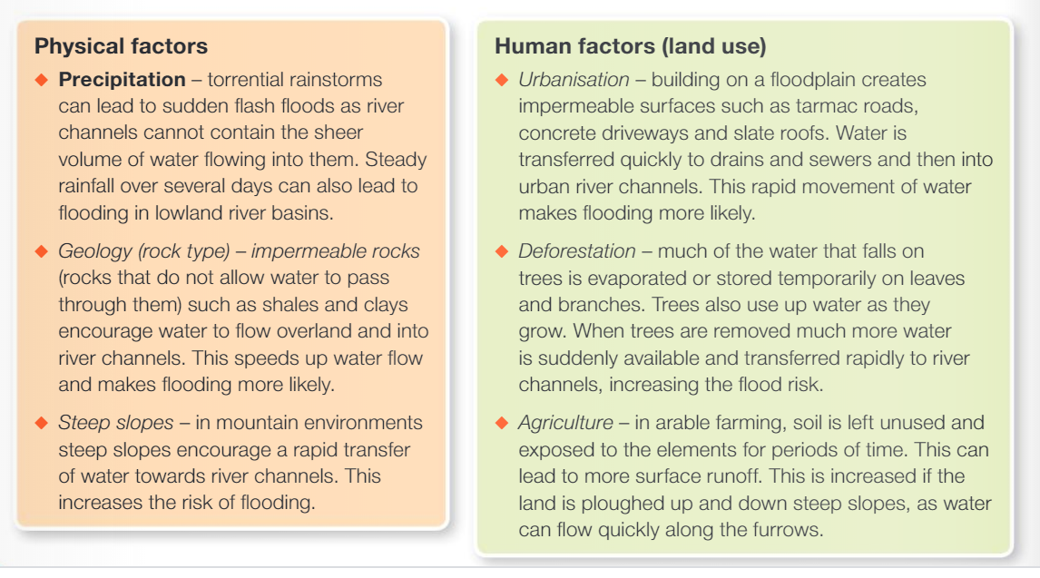
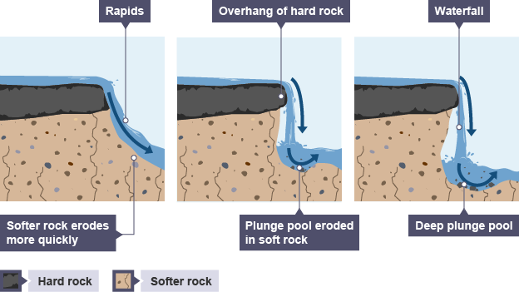
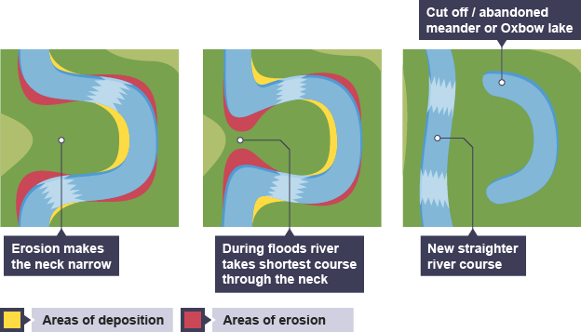
Future Floods KO Big Q: How will floods affect us in the future?
Box 3: How we can reduce the risk of flooding?
2+ examples of hard river engineering 2+ examples of soft river engineering
(built defences) (natural defences)
Overall, what were the main causes and why?
Box 1: Why is flooding an issue?
Explain 2+ physical and human causes of flooding in the UK
Challenge: Outline where in the UK is more at risk from flooding and why?
Hard engineering strategies | Soft engineering strategies
Usually more expensive and require artificial structures or changes to the river channel. They have an immediate impact on the river and the surrounding landscape. For example: -building dams to control the flow of the river -making the river channel wider and deeper so that it can hold more water -straightening the river so that water leaves the area more quickly | Usually less expensive and work more with the natural surroundings. They often take longer to work and will attempt to manage floods rather than prevent them. For example: -planting trees to intercept rainfall and reduce the water reaching the river -providing flood warnings by monitoring rainfall and river discharge and alerting people. -land use zoning, which involves using land beside the river for activities like grazing and recreation, which can be relocated during times of flood
Box 4: What are floods like in different places?
Research 2 places to compare floods e.g. Flash flood in Boscastle 2004 or Mississippi 2019, or Bangladesh floods 2019 or your own examples & year.
Example 1: ___________________ Example 2: ________________
Key facts
Causes (P&H)
Impacts (SEE)
Overall, how do these examples compare?
UK Case study: the Cumbrian floods 2015 | Coping with flooding in Bangladesh
Physical causes The warm air from the mid-Atlantic caused relief rainfall over the Cumbrian Mountains. The warmer the air, the more moisture it holds. Warm air from the mid-Atlantic moved towards land due to the prevailing wind. Impacts: Social Over 43,000 homes across Cumbria and Lancashire suffered from power cuts. Approximately 5,200 homes were affected by flooding. Economic Rail and road services were disrupted. Many businesses suffered through damage to property and stock. The estimated cost was £500 million across Cumbria. The government provided £50 million for victims and businesses. | Causes of flooding in Bangladesh Cyclones cause coastal flooding. Lots of low-lying land. Melt water from the Himalayas. Heavy deforestation. Impacts: Social 9m people made homeless Approximately 1 000 people died from drowning and from waterborne diseases Economic Millions s of small subsistence farmers (who live on trading what they grow on a small scale) lost their land or crops to flooding. An estimated 20 000 people left rural areas in search of work in towns and cities further north
Box 2: What landforms are there at each stage of a river?
Explain how waterfalls are created in the upper course of a river.
2+ points about the formation a waterfall using processes of erosion such as hydraulic action, abrasion or attrition.
Explain how meanders and ox bow lakes are created in the middle and low course of a river.
2+ points about the formation a meander using processes of erosion such as hydraulic action, abrasion or attrition.
The river erodes the rocks in three main ways:
Hydraulic action –sheer force of the water into small cracks and breaks down the rock.
Corrasion –bed and banks are eroded by the load hitting against them.
Corrosion –water dissolves minerals from the rocks and washes them away.
Future floods Key terms:
Flood – When there is too much water in the channel, a river bursts its banks
Drainage basin – The area of land drained by a river
Confluence – The point where 2 or more rivers meet
Watershed – The imaginary line around a drainage basin,
Precipitation – Any form of water falling from clouds such as rain, hail, sleet, snow etc
River channel – What the river flows in, gets wider down stream
Hydraulic action – A process of erosion caused by the force of the water hitting the rock
Impermeable surface – surfaces that do not let water soak into the ground such as tarmac Saturated – When the ground cannot hold anymore water
Relief – The height of the land, goes from steep valleys with narrow flood plains down to flat wide land with wide flood plain along a river’s course.
The river is meandering across the valley and erodes laterally.
Most water is directed towards the outside bend, there is also reduced friction and increased velocity.
The fast flowing water erodes the outside bends using hydraulic action, when the sheer force of the water breaks down the rock.
STAR: Research answers for 2 of your own simple or complex enquiry questions, record on the back.

