Slide 1
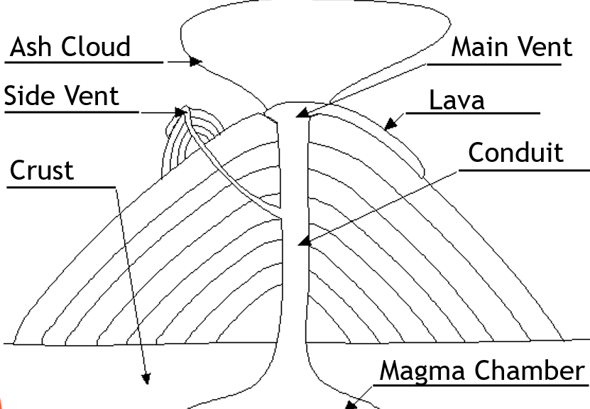
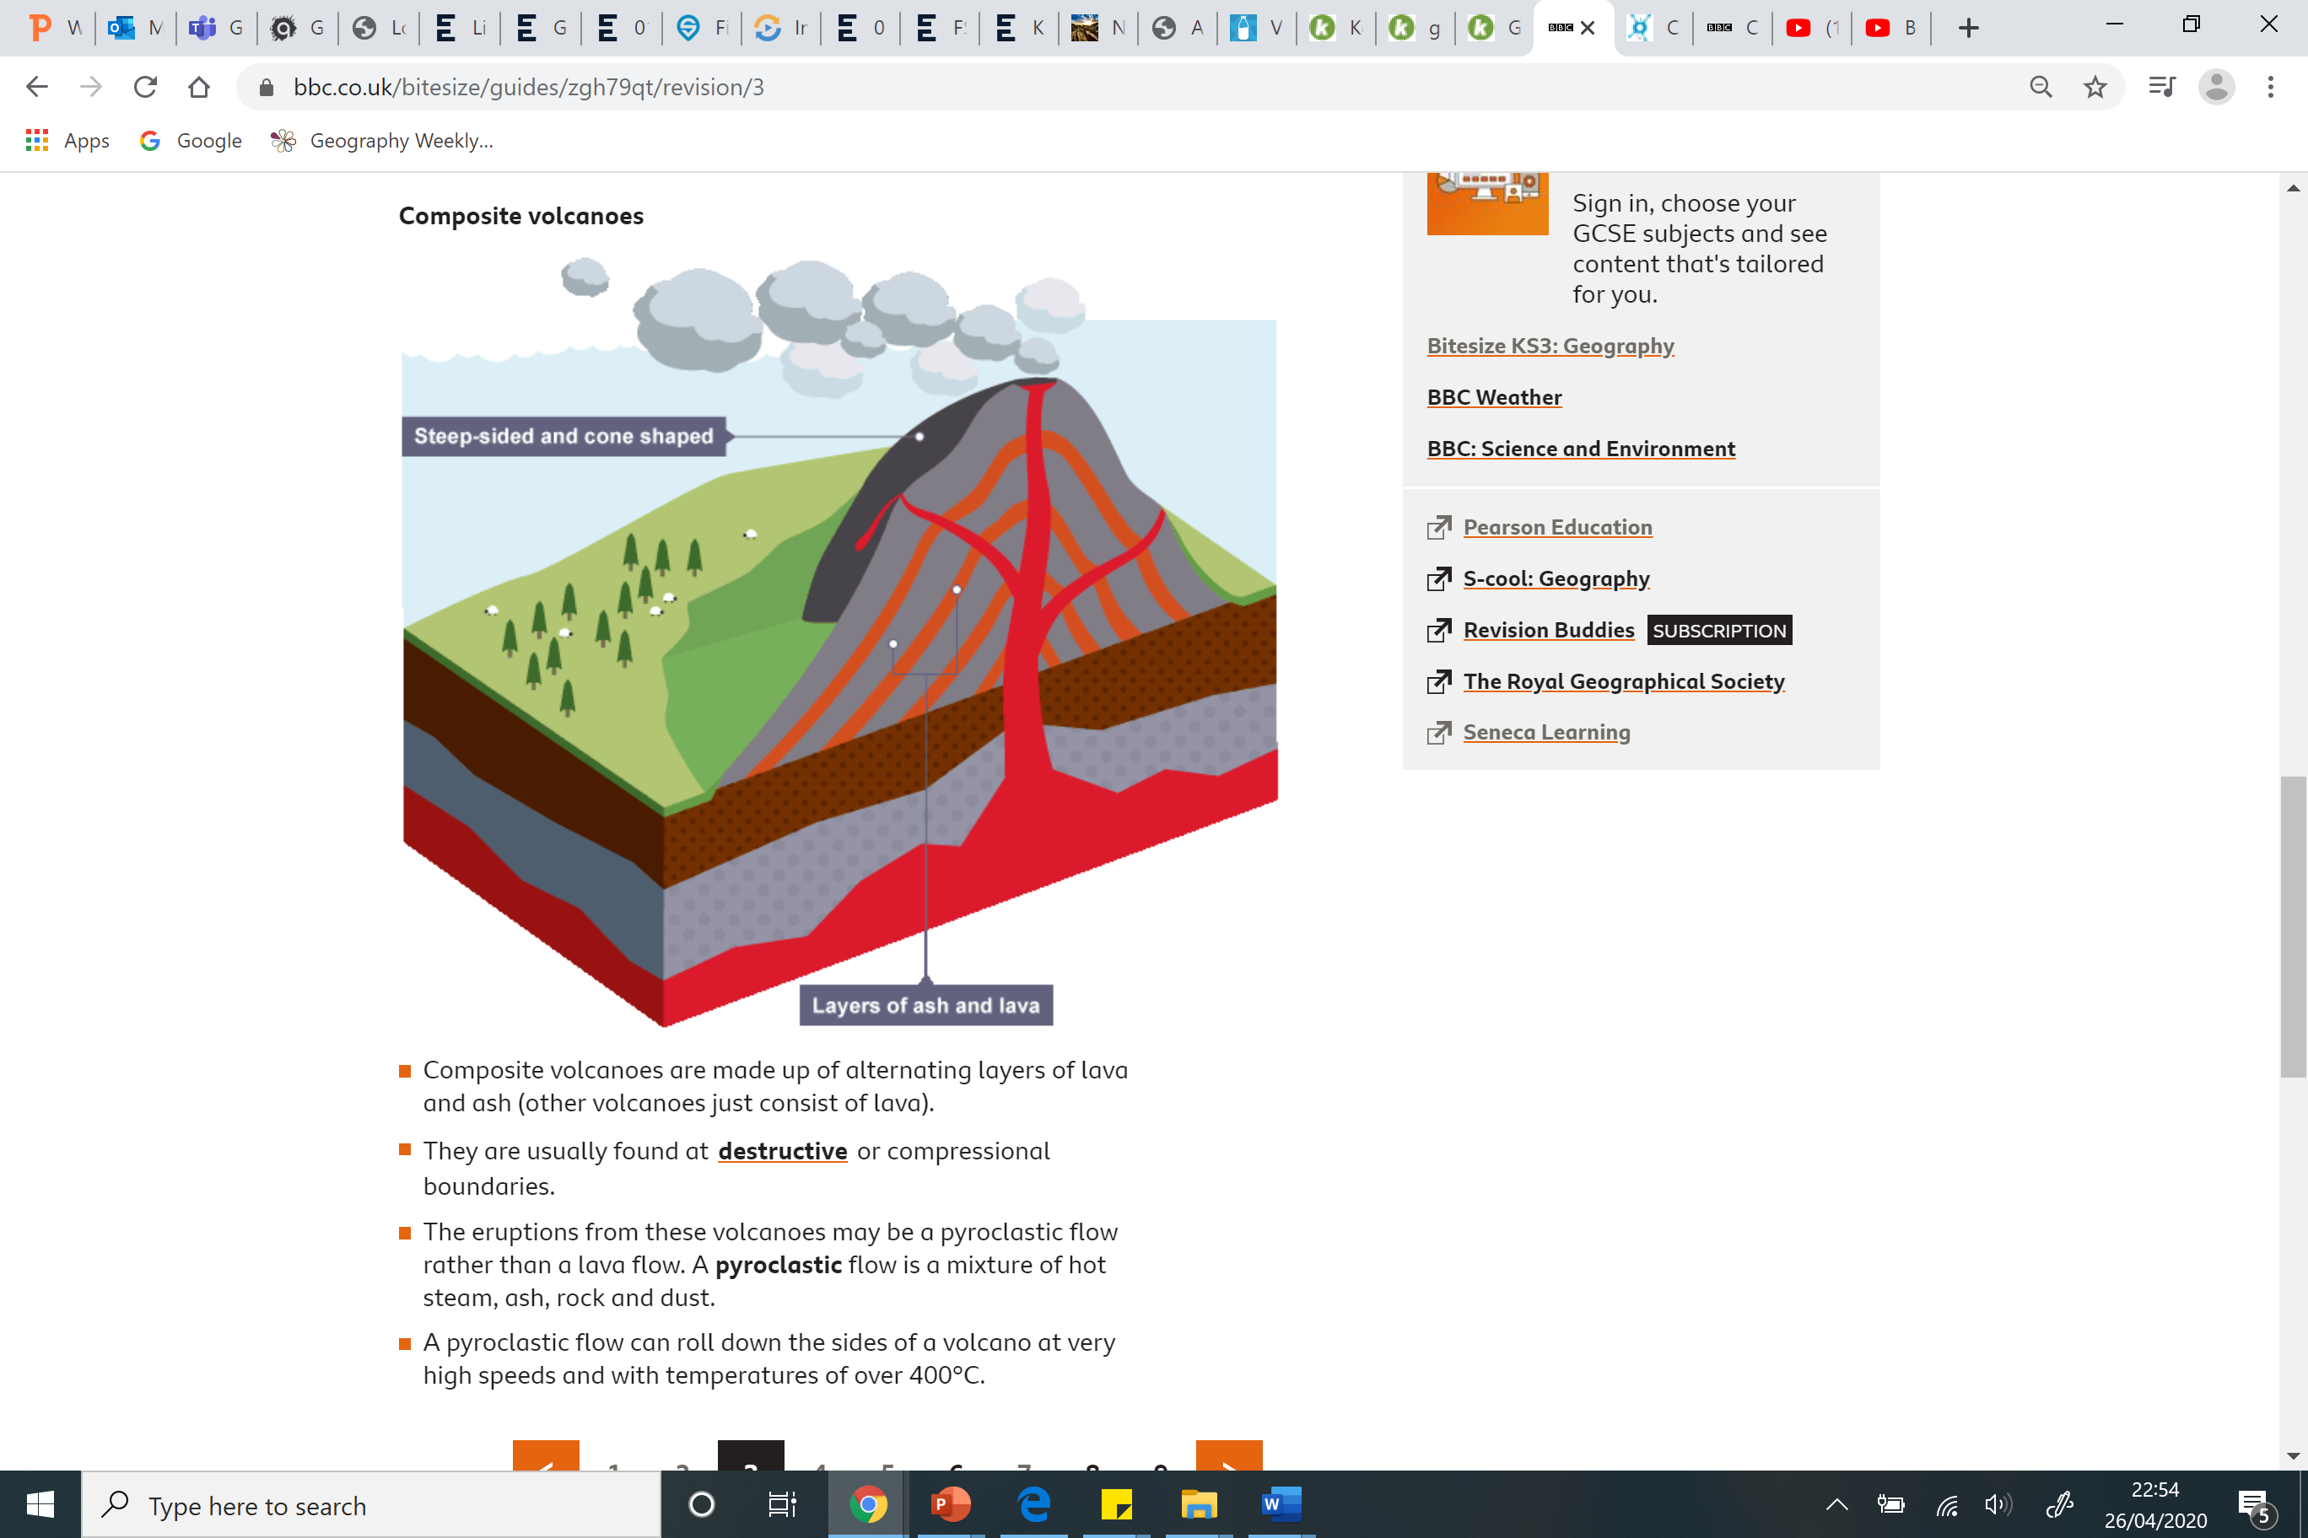
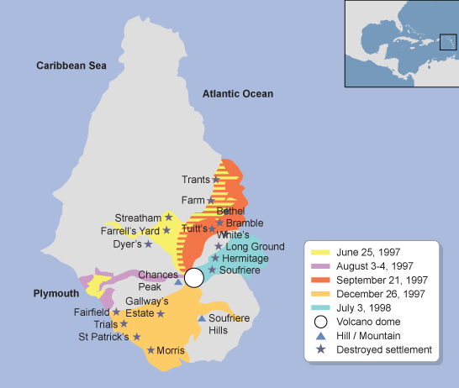
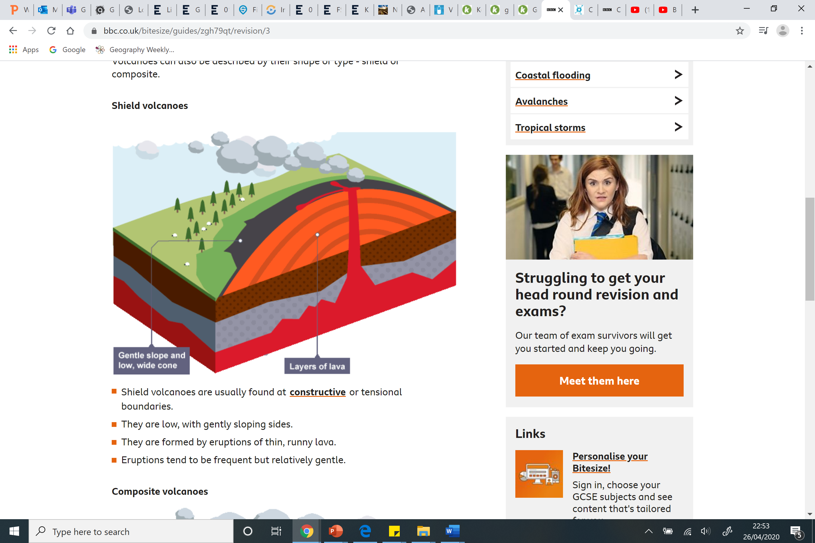
Violent Volcanoes A3 KO Big Q: Why are volcanoes violent?
Box 3: Explain 3+ reasons why people live near to volcanoes. (500 million people live near to volcanoes across the world)
Geothermal heat is used to generate electricity in some countries, it a very cheap and environmentally friendly way to create energy. This is quite common in countries such as Iceland and Canada where the temperature can change quite drastically between Summer and Winter.
Granite is formed through volcanic eruptions, it a very durable building material and is also very valuable. Because granite is so hard, people sometimes use it for building stone or statues if you want them to last a long time, or luxury kitchens!
Geothermal spas are located near to volcanoes. The water is cooled down and pumped into lagoons where people bathe in the warm nutrient rich waters. Tourists from all over the world come to visit these sorts of resorts.
Growing crops Volcanic soil is extremely nutrient rich and is perfect soil for growing crops such as in Hawaii and southern Italy.
Overall, what do you think are the strongest reasons to explain why so many people live near volcanoes and why?
Example judgement: Overall, people need food to eat or sell so I believe that being able to grow crops easily is the strongest reason why people live near volcanoes.
Box 1: Why are volcanoes violent?
Make a diagram and label the different features of a volcano
Explain 2+ reasons why volcanoes are violent – magma is easily released at divergent plate boundaries as they spread apart meaning frequent ‘flowing’ eruptions.
Trapped gases build up and are released at convergent plate boundaries can cause rarer and much more explosive eruptions.
Box 2: Explain the formation of shield and composite volcanoes.
Shield volcano
Wide, flat shaped volcanoes with runny flowing magma means that when it erupts, the lava flows out quite far before cooling, slowly building up the gentle slopes.
Composite (strato) volcano
Tall, thin and cone shaped volcano, this has viscous (thicker) magma which doesn’t flow as free and when it erupts the lava and ash create layers that build up it’s steep slopes.
Stretch: Supervolcanoes
Volcanoes on a massive scale and erupt very rarely (hundreds and thousands of years) and leave large craters called calderas.
Box 4: Explain 3+ effects of the Montserrat eruption
Montserrat is a small island in the Caribbean.
In 1995 the volcano began to give off warning signs of an
eruption (small earthquakes and dust and ash erupted).
Once Chances Peak (the volcano) had woken up it then
remained active for five years.
The most intense eruptions occurred in 1997.
Physical impacts :
•Montserrat was devastated by pyroclastic flow (hot gases and rocks travelling at up to 430mph).
•Volcanic eruptions and lahars (hot mud flows) have destroyed large areas.
•Tiny pieces of ash were blasted into the air forming a plume of ash. As it cooled down it fell back to the earth, covering areas in a layer of ash.
Human impacts
•The population of the island (11,000 people) evacuated in 1995 to the north of Montserrat as well as to neighbouring islands and the UK.
• 19 people were killed by the eruptions as a small group of people chose to stay behind to watch over their crops.
•The capital, Plymouth, was covered in layers of ash and mud. Many homes and buildings were destroyed, including key infrastructure such as the only hospital, the airport and many roads.
Overall, what were the main or most severe effects and why?
Example judgement: Overall, the loss of life is a huge social impact so many would argue that it is the most severe effect, as human life cannot be replaced and there will be family + friends grieving too. Some may argue that the whole islands evacuation is the most severe because it affected more people on a larger scale, disrupting peoples lives and costing a lot of money.
Volcanoes Key words:
1.Volcano – a mountain or hill, having a crater or vent through which lava, rock fragments, hot vapour, and gas are or have been erupted from the earth's crust.
2.Shield volcano – a broad, wide and flat domed volcano with gently sloping sides.
3.Composite volcano –a tall steep conical volcano built up by many layers of lava and tephra.
4.Pyroclastic flow – a destructive mass of very hot ash, lava fragments, and gases ejected from a volcano
5.Lava – molten rock above ground that has usually erupted from a volcano.
6.Magma – molten rock beneath ground, stretching deep into the earth’s crust.

