Slide 1


Servant Leadership and SVP feast day
Presented by the Head Boy Team

Slide 2
What is Servant Leadership
A shift from ‘me’ to ‘us’
The term was coined by Robert Greenleaf, a twentieth century researcher who was sceptical about traditional leadership styles which focussed on more authoritarian relationships between leaders and team members.
In essence, it means the leader puts emphasis on their team members so that they can become autonomous and freethinking. It encourages team members to take initiative and to participate in decision making.

Slide 3
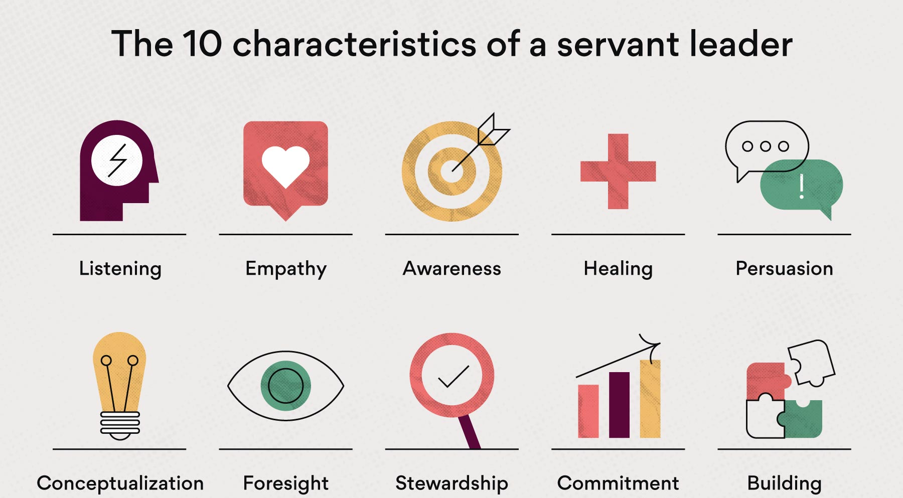

Slide 4
Key Takeaways -
Listening – listening to contributions from all members of a team demonstrates respect for each person, but also allows the team to work towards a shared goal
Empathy – to value and understand the perspectives of others, and be willing to change an approach to suit the team. Ensuring that team members are happy will deliver better results as the team feel more motivated.
Foresight – the ability to identify the best approaches that build on past mistakes and the impact of a decision on the future.

Slide 5
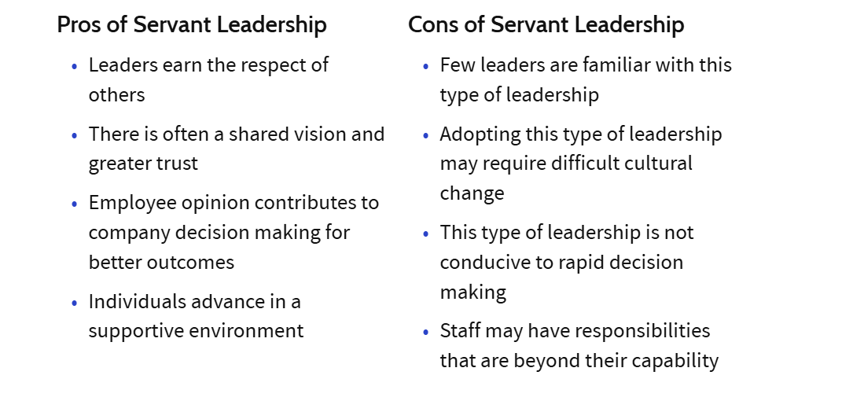
Evaluating Servant Leadership

Slide 6
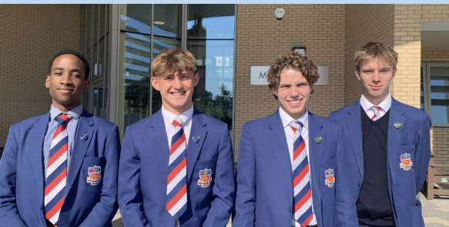
How does this Apply to Us
Notes:
Teamwork – rely on each other and draw on each others strengths
We are meant to serve the school, help with any issues
Always there to help
Representatives of the school
Shared vision of the school
Our role – bridge between students and teachers,

Slide 7
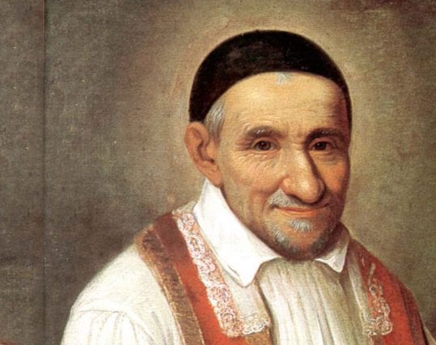
Saint Vincent de Paul Feast Day
Celebrated by the Catholic Church on 27th September
He is the Patron Saint of Charities, Hospitals, Volunteers and Prisoners

Slide 8
Who was Saint Vincent de Paul?
Known as the Patron of Catholic Charities for his work among the poor and marginalised communities.
Vincent established the Congregation of Priests of the Mission in 1625
While he initially begun his priesthood in order to secure himself a life of leisure, his perspective change after hearing the confession of a dying peasant. This motivated him to found institutions which helped the poor and marginalised both spiritually and materially.
Additionally, he established the Daughters of Charity, the first congregation of religious women who worked to help the poor, sick and imprisoned. Donations collected by the group went towards homes for abandoned children, a hospice for the elderly, and places where 40,000 poor people were given lodging and work.

Slide 9
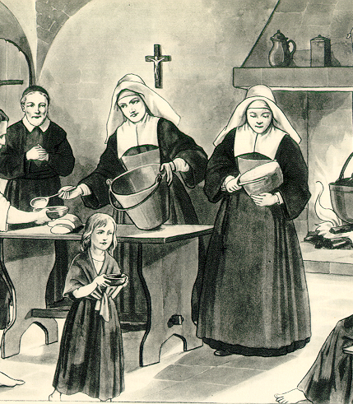
Key Events
Born on 24th April 1581, in south-western France, de Paul was ordained a priest at 19
In 1605 while travelling to Marseille, de Paul was captured by pirates and sold into slavery in Tunis. He escaped two years later (1607) with the help of his master's Christian wife
He later settled in Paris, where he founded:
  Confraternities of Charity – associations of laywomen dedicated to helping the sick and poor
  Congregation of the mission - to educate and train clergy
  Daughters of Charity – founded with St. Louise de Marillac

Slide 10
How does Saint Vincent de Paul show Servant Leadership
Saint Vincent was an example of servant leadership as he led by example.
Saint Vincent did not just give orders or delegate tasks, he actively participated in the work. This included visiting the sick, distributing food to the poor and marginalised and caring for abandoned children.
Saint Vincent showed his beliefs and his goals through is actions, qualities of a servant leader
He empowered the poor by helping them to become self–sufficient
Vincent listened to the poor and marginalised to understand their needs, through this he gained their trust as he worked with them towards a shared goal

Slide 11
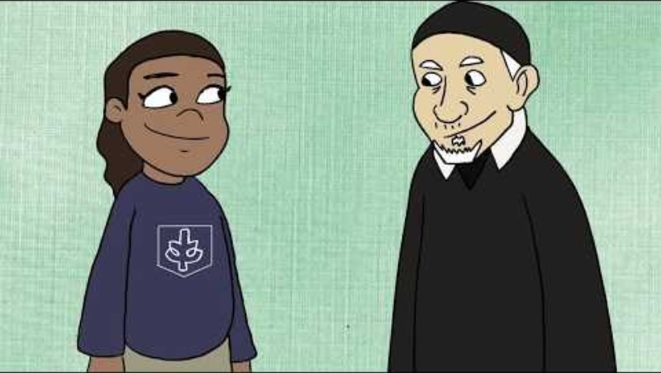
Notes:
https://www.youtube.com/watch?v=hHaZkHxn3fU

Slide 12
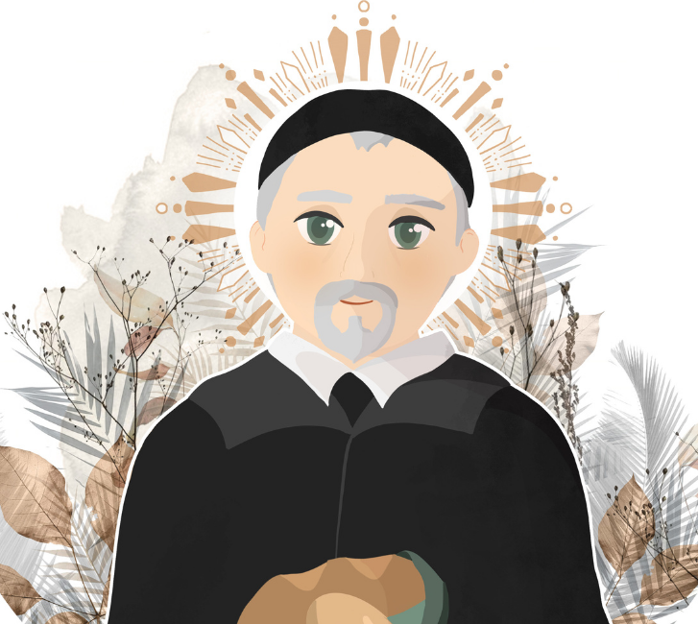
Prayer to Saint Vincent de Paul
Noble Saint Vincent de Paul,
beloved servant of the poor,
may we follow your example and do good works,
among those whom society has abandoned,
enslaved, or forgotten.
Pray for us to our beloved God
that we may commit ourselves selflessly to doing
the same charitable acts that you did all your life.
Amen.

