Slide 1


Exam Stress Workshop
Rebecca and Cam
Mental Health Practitioners
Trafford MHST
Trafford Thrive in Education
“Supporting you to thrive … your way”
Notes:
Both introduce self
Rebecca introduce service

Slide 2
Session aims:
To understand what stress is and what it looks like
To identify one strategy to manage exam stress
“Supporting you to thrive … your way”
Notes:
Rebecca

Slide 3


What is exam stress?
“Supporting you to thrive … your way”
Notes:
Cam
Explaining the stress response and what happens to us physically when stressed. It will talk about the fight/flight response which you may have heard of and some techniques afterwards which we’ll also talk about a bit more throughout the session.
The flight fight response is like a smoke alarm or car alarm, it is helpful when it works right, but it can keep going off when there isn’t any serious danger which can cause unpleasant physical symptoms, be exhausting and impact our well being and performance.

Slide 4
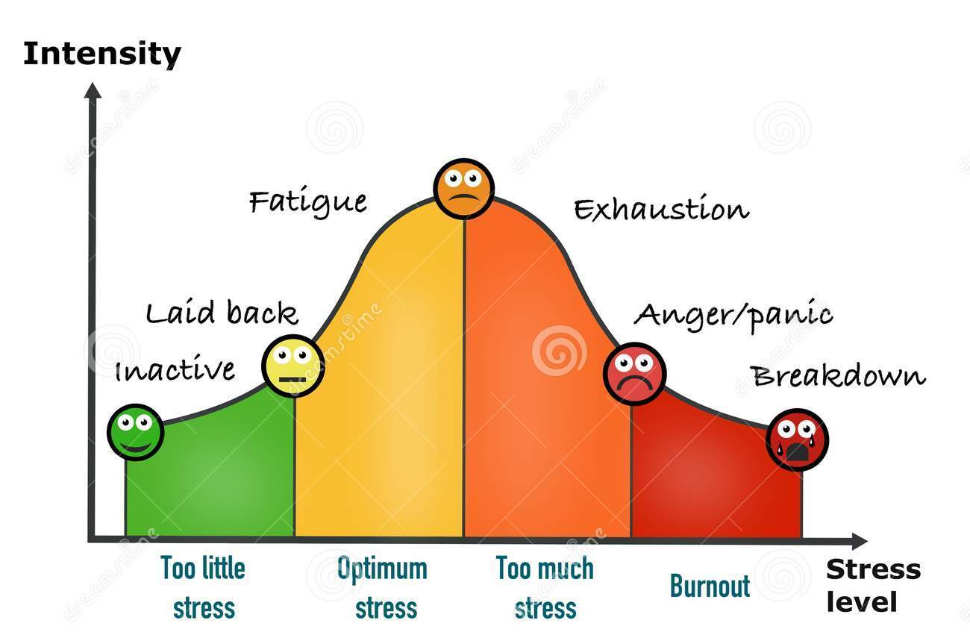
Stress performance curve
“Supporting you to thrive … your way”
Notes:
Cam
This graph is commonly used to illustrate the idea that we perform best with some stress to motivate us but too much stress can cause physical and emotional symptoms that affect our ability to focus.
*Talk through graph*
This is because of the effects of the fight/flight response if we become constantly stressed and worried.

Slide 5
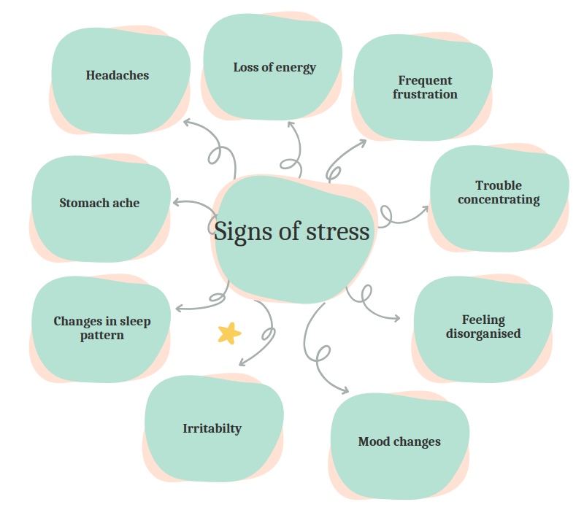
What exam stress might look like
“Supporting you to thrive … your way”
Notes:
Rebecca

Slide 6
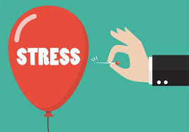
Ways to reduce stress
Listen to your favourite music
Take regular breaks during studying / revision
Try meditation or breathing techniques
Get sunlight and fresh air everyday to increase serotonin levels
Practice good sleep hygiene – try to stick to the same “going to bed” and “wake up” times to regulate your body’s natural circadian rhythm (even at the weekends), avoid caffeine and sugary snacks in the evenings, make sure your bed and bedroom are comfortable e.g. temperature and lighting, avoid using technology when in bed.
“Supporting you to thrive … your way”
Notes:
Rebecca

Slide 7
Organisational and Practical Tips
Try to keep your study area clean and tidy
Try to avoid multi-tasking
Create a study routine and/or revision timetable
If not need for studying, put your phone in another room or on silent
Use other resources that school have suggested such as websites or videos
Break larger tasks into smaller more manageable tasks
“Supporting you to thrive … your way”
Notes:
Cam

Slide 8
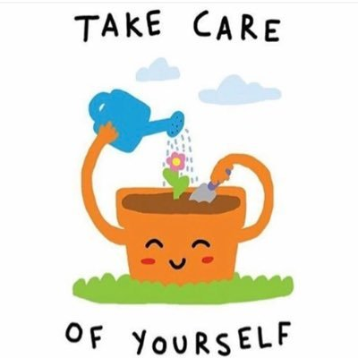
Self-care
Make time for doing things you enjoy
Make sure your goals are your own goals and not those of others around you
If you become overwhelmed or don’t know where to start, it might help to speak to a teacher, the school nurse and parent/carer or any other person you feel able to confide in
Try to move your body each day such as going for a 15 minute walk, engaging in a sport, going to a yoga class or doing it at home
Try to get at least 8 hours of sleep each night
Try to make sure you are eating enough and a varied diet
“Supporting you to thrive … your way”
Notes:
Cam

Slide 9
“Supporting you to thrive … your way”
Notes:
Rebecca
Although we are saying the stress response can help us perform, if the physical and emotional symptoms are distressing and become overwhelming, these techniques can reduce the amount of adrenaline flooding our systems.

Slide 10
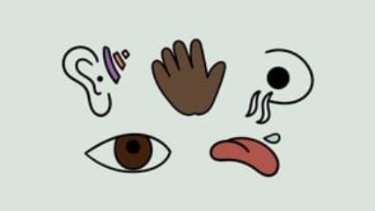
Example Grounding Technique Video
“Supporting you to thrive … your way”
Notes:
Rebecca – now we’re going to have a look at one of the calming techniques in practice

Slide 11
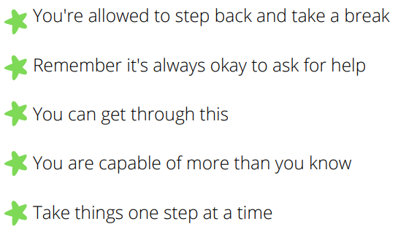
Remember
“Supporting you to thrive … your way”
Notes:
Cam

Slide 12
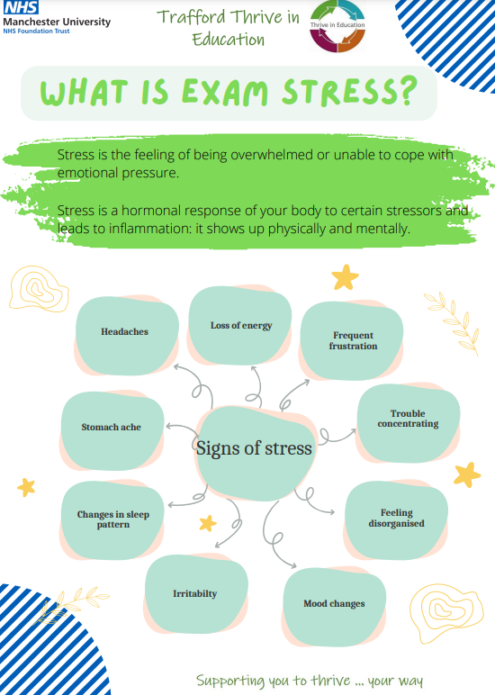
Exam stress advice booklet
We will email school a copy of our Exam Stress advice booklet to share with you
This contains revision tips, advice about self-care, organisational tips and much more!
“Supporting you to thrive … your way”
Notes:
Cam

Slide 13





Useful information & Contact
Services for young people
“Supporting you to thrive … your way”
Notes:
Rebecca

Slide 14

Trafford Thrive in Education
“Supporting you to thrive … your way”
Notes:
Rebecca

