Slide 1
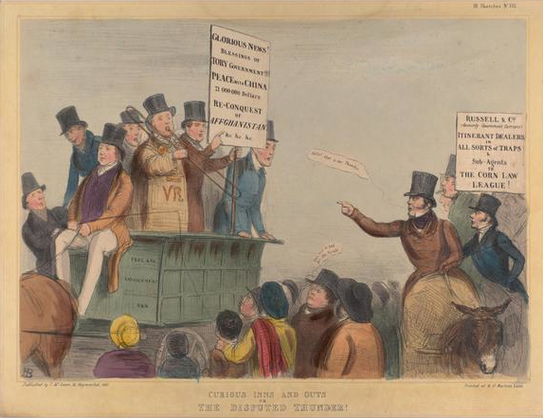
Challenge and Transformation: Britain c.1851 – 1964
Component 1G
Transition Resources
Complete these resources over the summer, ready to begin A Level British History
These will be checked by your teacher in your first British History lesson

Slide 2
Challenge and Transformation Overview
Challenge and Transformation (Your British A Level) is split into 4 time periods:
c. 1851 - 1885
1885 - 1914
1914 - 1939
1939 - 1964
Year 12
Year 13
For each timer period, you will have four units:
c. 1851 - 1885
Political Developments
Social Developments
Economic Developments
Anglo-Irish Developments
Your exam will have two question types:
How far was……
Essay
How far to you agree?
To what extent……..
Extract
Using your understanding of the historical context, assess how convincing the arguments in these three extracts are in relation to ……..

Slide 3
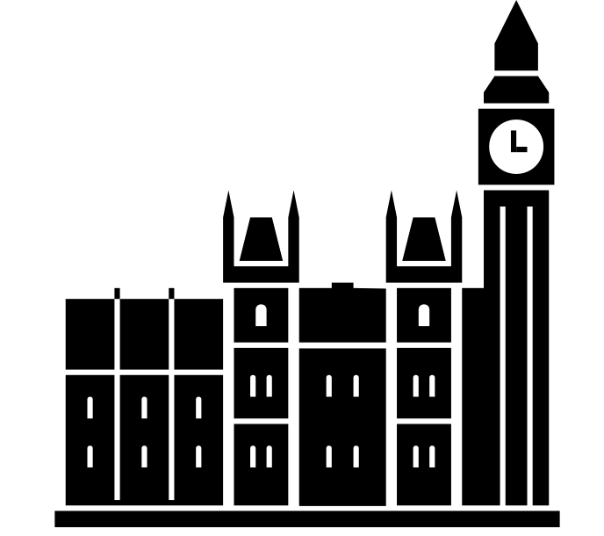
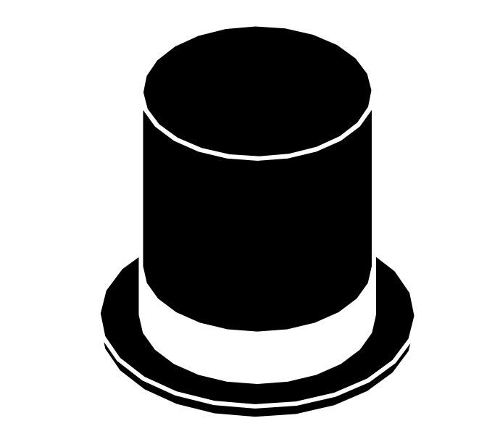
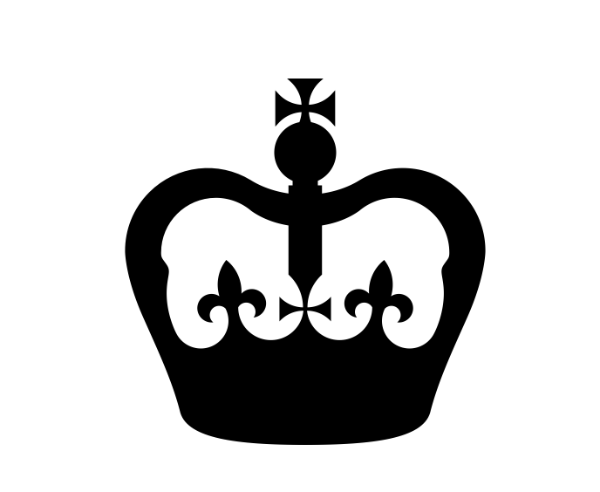
TASK 1: The Process of Law Making
The 3 Components of the British Political System
House of Commons
House of Lords
Monarch
How are people voted into the House of Commons?
How often are elections held in 1832?
How many people could vote in 1832?
How do people enter the House of Lords?
What is the main difference between the House of Lords and the House of Commons?
What
Who was the monarch in 1832?
Who was the monarch in 1837?
Who was the monarch in 1901?
Who was the monarch in 1910?
Who was the monarch from January to December 1936?
Who was the monarch from 1936?
Who was the monarch from 1952?
How an idea becomes a law:
Bill
Act

Slide 4
Explain the role of the House of Commons in law-making in 1832 (not the present day!)
Key Words: Bill Readings Draft Amendment Debate
Explain the role of the House of Lords in law-making in 1832 (not the present day!)
Key Words: Veto
Explain the role of the Monarch in law-making

Slide 5
TASK 2: British Electoral System in 1832
British Political Parties
 | Whigs | Tories
Support-Base
View on Reform
Religious Affiliation
Economic Policy in 1832
Belief on the role of the Monarchy
Key members in 1832

Slide 6
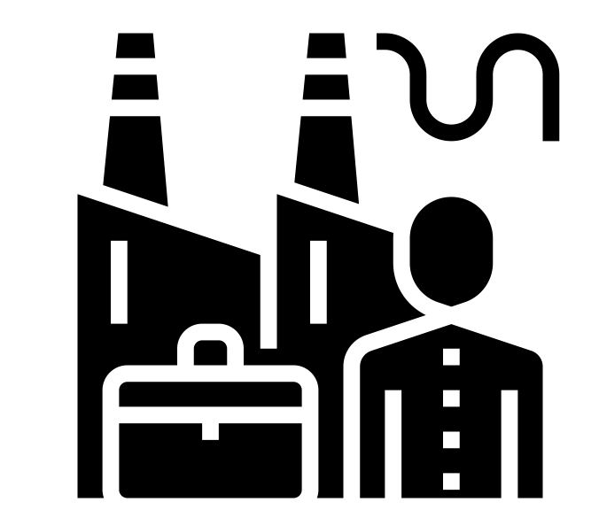
Components of the Electorate
Landowning Classes
Who were they? How did they enter the electorate?
Industrial Middle-Class
Who were they? Why had they grown in political power? How did they enter the electorate?
Influences in Politics
The Church of England
How did the Church of England influence the House of Lords? Which party were they more likely to support? What was the ‘Oxford Movement’?
Non-Conformists
Which groups were involved? How did they differ from the Church of England? Which party were they more likely to support?

Slide 7



Extension Tasks:
Research:
The Political Career of Lord Palmerston
The Political Career of Sir Robert Peel
The Political Career of Lord Aberdeen
The Political Career of Lord Derby
The 1832 Reform Act and its implications
Different Political Ideologies – Communism, Socialism, Conservatism
Different Economic Ideologies – Laissez-Faire, Protectionism
Read:
Iain Dale, The Prime Ministers: Three Hundred Years of Political Leadership (London: Hodder & Stoughton), 2020 – Gives a comprehensive overview of the careers of all the Prime Ministers in our period
Eric J Evans, Parliamentary Reform in Britain, 1770 – 1918 (London: Routledge, 2000) - Explains the causes and consequences of reform acts in a clear, concise way.
Robert Whitfield, The Extension of the Franchise (Oxford: Heineman, 2001) - Focuses on how and why voting rights expanded, ideal for understanding 1867 and 1884 reforms.
[Available online at: https://archive.org/details/extensionoffranc0000whit ]
Hugh Cunningham, The Challenge of Democracy: Britain 1832 – 1918 (New York: Longman, 2001) - Explores the evolution of democracy in Britain, with accessible analysis.
Clyve Jones, A Short History of Parliament (New York: Boydell Press, 2012) - A concise overview of how Parliament evolved—great for historical context.
Ben Dupre, 50 Political Ideas You Really Need to Know (London: Quercus, 2011) - A beginner-friendly guide to key political concepts. [Available online at: https://archive.org/details/50politicalideas0000dupr_n1j2]
Isabel Hardman, Why We Get the Wrong Policitians (New York: Atlantic Books, 2019) - A clear, witty look at how Parliament works and why it often fails to deliver.
Watch:
https://www.andrewchater.com/timelines-tv/ - Selection of relevant political, social and economic documentaries on Timelines TV
Listen:
The History of England by David Crowther – a selection of relevant political, social and economic documentaries
The Key to Being Successful at British History A Level is….
Reading Widely
(Use Mr Bancroft’s wider reading sheets)
Thinking Critically
(One of the key components of being successful is creating arguments)
Picturing the End Goal
(Don’t wait until Year 13 to start preparing properly)

