Slide 1
Sixth Form Open Evening
12th November 2025

Slide 2
Mr Dermot Rainey
Principal

Slide 3
Mission & Charism
Edmund Rice/Christian Brothers
‘Equipped to make a positive impact in the modern world’

Slide 4

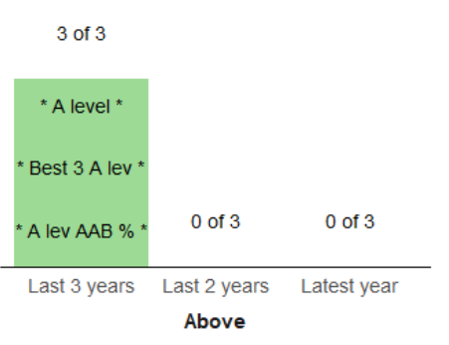



A Level Results
ALPS grade 2 = top 10% nationally for progress
Average Points Score = 44.52 (B+)
APS ‘significantly above national for the past 4 years
Consistency across subjects – all but 1 subject had positive value added and even then, 1 grade higher would’ve pushed it in to a positive
52.3% of grades at A*/A
80.6% of grades at A*-B

Slide 5
Mr Stephen Brady
Assistant Principal/
Director of Sixth Form

Slide 6
The Sixth Form Team
Mr Brady - Assistant Principal / Director of Sixth Form
Dr Sate – Head of Year 12
Miss Widolf – Head Of Year 13
Mrs Grainger - Sixth Form & Careers Admin
Team of experienced tutors
Mr Gunning – Whole School Careers Lead
Mrs Hart – Whole School Academic Mentor
Miss Dean – Whole School Behaviour/Pastoral Mentor
Mr Brady - Assistant Principal / Director of Sixth Form
Dr Sate – Head of Year 12
Miss Widolf – Head Of Year 13
Mrs Grainger - Sixth Form & Careers Admin
Team of experienced tutors
Mr Gunning – Whole School Careers Lead
Mrs Hart – Whole School Academic Mentor
Miss Dean – Whole School Behaviour/Pastoral Mentor

Slide 7
Curriculum
Step up from GCSE
All academic options (no T-Levels)
Most students take 3 A-levels, EPQ or Core Maths
  Core Maths cannot be taken by A-level Maths students
  More information on EPQ later
  More information on Core Maths in Maths talk by Mrs Monk
A small number take 4 A-levels
  Further Maths
  Only for most able and motivated
  For those who benefit from a 4th
General R.E.
PSHE
Supervised study

Slide 8
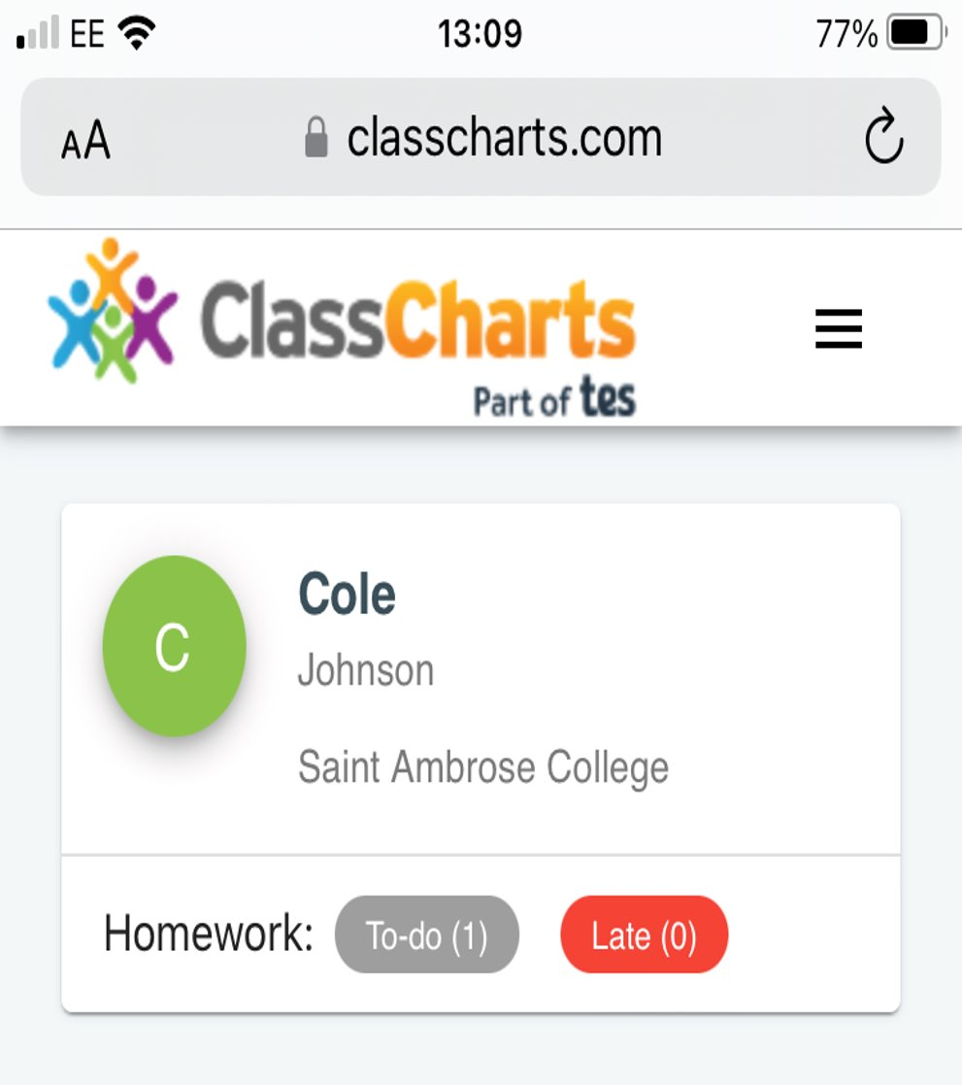

Homework and independent study
Classcharts
Microsoft Teams
More than just lessons and homework
Commitment to course
Interest outside of the curriculum
Commitment to complete extensive independent study

Slide 9
Choosing your options
Play to your own strengths and interests
  Use your attainment data
  Not your friend’s
Think about your future aspirations
  Unifrog
  https://www.informedchoices.ac.uk/
  https://www.thecompleteuniversityguide.co.uk/student-advice/what-to-study/choosing-a-levels
  “facilitating subjects”
Speak to your teachers and others who can advise
Go to subject areas today that you are less sure about or you know less about

Slide 10
Oxbridge, Medics & US applications
Oxbridge
  Meet once a week
  Mock interview practice
  External support and social mobility programmes
Medics
  Weekly sessions with Doctors and Medical lecturers from UoM, Imperial, Cambridge and Alder Hey
  Extensive programme
  Student led society as well as staffed sessions
  Medical ethics competition (Oxford)
US – Common App
  3 applying to US this year
Destinations

Slide 11
Student Leadership Team
Team of 28 this year led by Head Boy and 5 Deputies
Appointed via application and interview process in April/May
Lead on key initiatives
  Societies, house assemblies
  Charity fundraising
  Spirituality
  Environment
  Diversity and equality
  Careers
  Mentoring

Slide 12
Co-curriculum
  Sports
  Oxbridge
  Medics
  MOOCS
  Mock Trial
  Model United Nations
  Wider reading
  Debating
  Young Enterprise
  Mentoring & subject ambassadors

Slide 13
External Applicant
School environment
Teaching excellence
Spiritual life
  Sierra Leonne
  Edmund Rice and advocacy
  Thursday Thought & Liturgy
Personal development
  societies

Slide 14
EPQ
  Independent, academic, research-based project
  Requires approximately 120 hours of work
  3 timetabled lessons for support and taught skills with a supervisor
  Completed over the course of Year 12 and submitted before the summer
  Benefits
    Develop undergraduate skills in research, analysis, evaluation, referencing
    Reduced offer from university
    Evidences wider reading and provides substance for personal statement
  Requires an excellent work ethic and commitment to independent study

Slide 15
Applying for Saint Ambrose Sixth
Applications open tomorrow and close 13th February
Application information and form on the school website: Saint Ambrose College - Sixth form Admissions
Internal applicants
  Year 11 options assembly and taster day (15th Jan)
  interviews (29th and 30th Jan)
External applicants
  Interview evenings with a member of the School Leadership Team will be undertaken once the Admissions Office has received applications.
Entry requirements are 60 A8 points subject to our admissions policy, with further details on subject specific requirements on the website and in your booklet

Slide 16
This evening
End of the speeches
5 sessions of subject talks
15 min sessions
Tannoy will sound at the end of each one.
Student leadership team here to direct you if you are unsure where to go
To avoid congestion in between sessions:
  Please travel clockwise
  Please follow the signs on the stairs (up/down) where applicable
Thank you very much for coming

