Slide 1
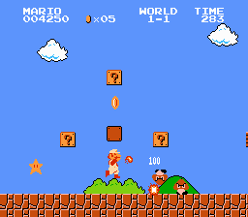
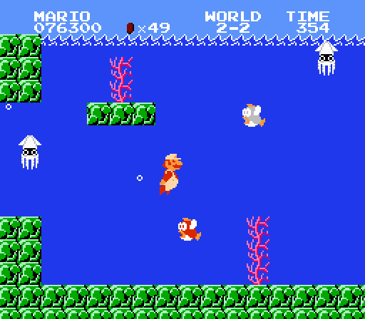
If Mario were a class, what properties would he have?

Slide 2
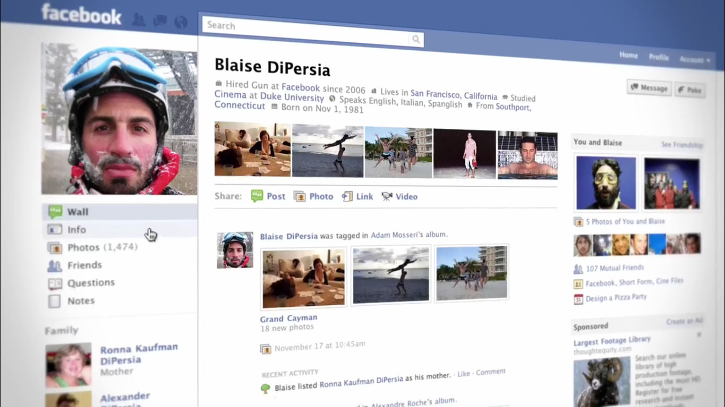
Could you write a class for a Facebook profile?

